Slide 1
Anemia
an enigma in chronic kidney disease
Mohammad Asgar Khan, MD

Slide 2
Anemia
Learning Objectives:
Learn the pathophysiology of anemia in CKD.
Learn the diagnostic challenges of anemia in CKD.
Learn the therapeutic strategies and related controversies in the treatment of anemia in CKD.

Slide 3
Anemia
Classification:
Etiologic---
Marrow Failure
Excessive destruction of Red cell
Blood loss
Morphologic---
Normocytic
Microcytic
Macrocytic

Slide 4
Anemia in CKD
Mechanisms:
Erythropoietin deficiency---ESA enhances maturation of erythroblastic cells and prevents apoptosis of marrow cells.
Iron and other nutritional deficiency
Blood loss---phlebotomy and cannulation during hemodialysis.

Slide 5
Anemia in CKD
Challenging condition since the understanding of CKD and subsequent managements.
Anemia in CKD was the most morbid complication during the pre-Erythropoietin era.
It was almost a routine, to get monthly red cell transfusion while on hemodialysis then.
Discovery of Erythropoietin is one of the most important in the management of CKD and thereby treatment of anemia.

Slide 6
Erythropoietin
1953—Allan Erslev---postulated the presence of a factor later on named Erythropoietin.
1974-----Allan Erslev-----demonstrated the presence of Erythropoietin in the kidney.
1977---Eugene Goldwasser---first isolated erythropoietin from urine.
1983---Fu Kuen Lin----cloned the gene of human Erythropoietin.
1984-----AMGEN--- commercially produced Erythropoietin as Epogen. They retained the right of production of all Erythropoietin and marketing in ESRD patients in USA; and gave J&J to market Erythripoietin in non-ESRD patients as Procrit in USA and world-wide marketing of Erythropoietin.
1989---Epogen was approved for anemia in CKD & cancer patients.
2001---Derbopoietin alfa was launched
2012---Peginesatide launched and was withdrawn in the following year.

Slide 7
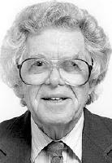

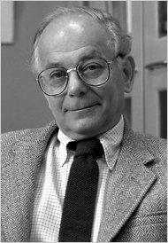
Pioneers
Allan Erslev
Eugene Goldwasser
Fu Kuen Lin

Slide 8
Erythropoietin
It is a Gylcoprotein hormone, synthesized by the intrestitial fibroblasts of peritubular region of kidneys in adults and by liver in fetal and perinatal period.
Molecular weight is 34kD.
Gene is located on the long arm of chromosome 7 (7q11-q22).

Slide 9
Prevalence of Anemia in CKD patients
McClellan et al 2004

Slide 10
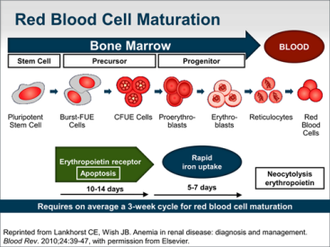
Erythropoiesis

Slide 11
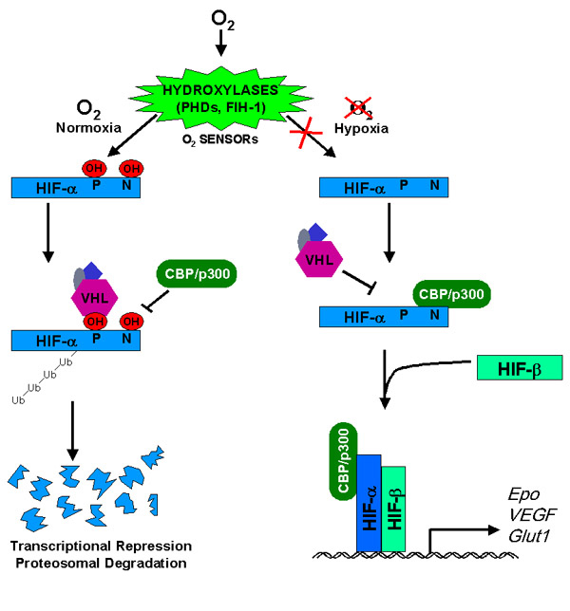
Normal Oxygen Sensing

Slide 12
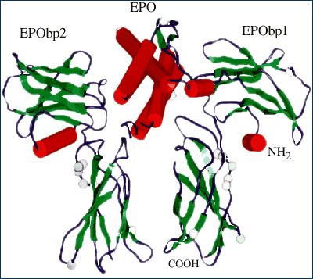
Erythropoietin Receptors
Two different types:
Monodimeric---- receptor in marrow cells.
Heterodimeric---
Brain
Kidney
Myocardial cells
Endothelial cells
CKD Anemia

Slide 13
Question?
A 74 AAM DM, HTN & CKD5 has Hb of 8.5 gm/dl.
What is the goal of correction using Epo &/or iron.
1. No correction
2. 13-15 g/dl
3. 10-11 g/dl
4. 9-10 g/dl

Slide 14
Pivotal Clinical Trials in CKD Anemia
NHCT(1998): National Hematocrit Cardiac Trial---
N-1200, high hemoglobin was conferred with high death and the trial was thereby prematurely stopped.
Canadian Cardiac Trial(2005)---similar trial with very similar observation.
CREATE(2006): Cardiovascular Risk Reduction by Early Anemia Treatment with Epoetin beta
CHOIR(2006): Correction of Hemoglobin and Outcomes in Renal Insufficiency
TREAT(2009): Trial to Reduce Cardiovascular Events with Aranesp Therapy.

Slide 15
Normal Hematocrit Cardiac Trial
Tested the hypothesis that patients with normal Hgb 13-15 g/dl will do better than patients with Hgb of 9-11 g/dl.
N: 1233 HD patients with CAD & CHF,
Primary end point: Death or MI
Early terminated trial due to excessive thrombosis in patients with normal Hgb( 243 vs 179).

Slide 16
CREATE
Non-dialysis CKD patients
Placebo control trial
N: 603
100 centers in 22 countries
Epotein beta
Hgb 13.49 g/dl vs 11.6 g/dl
Looked into CV events & mortality
Early treatment vs late treatment.

Slide 17
CHOIR Correction of Hemoglobin and Outcomes in Renal Insufficiency
Participants: N=1432, eGFR 15-30 ml/dl/1.73m2: Hgb<11 g/dl.
Design: SQ Epoeitin alfa
High Arm: target 13.5 g/dl
Low Arm: target 11.3 g/dl
Results: Study terminated early due to safety and futility
More patients in High arm had CV events
No improvement in QOL
Trend towards faster rate of progression of CKD requiring RRT.

Slide 18
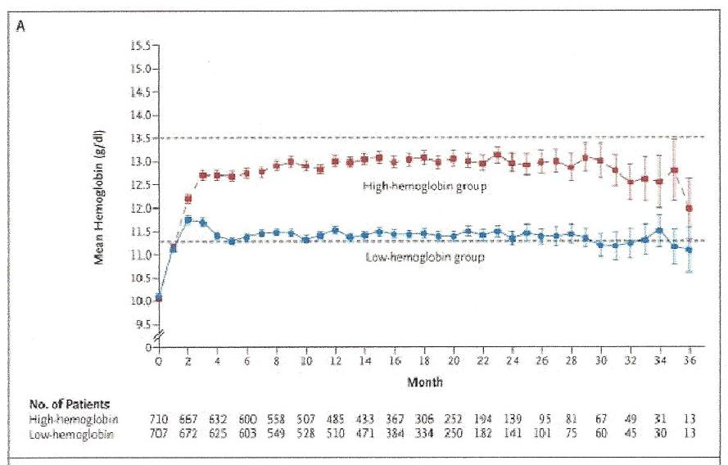
CHOIR Hemoglobin & Epoetin alfa Over Time

Slide 19
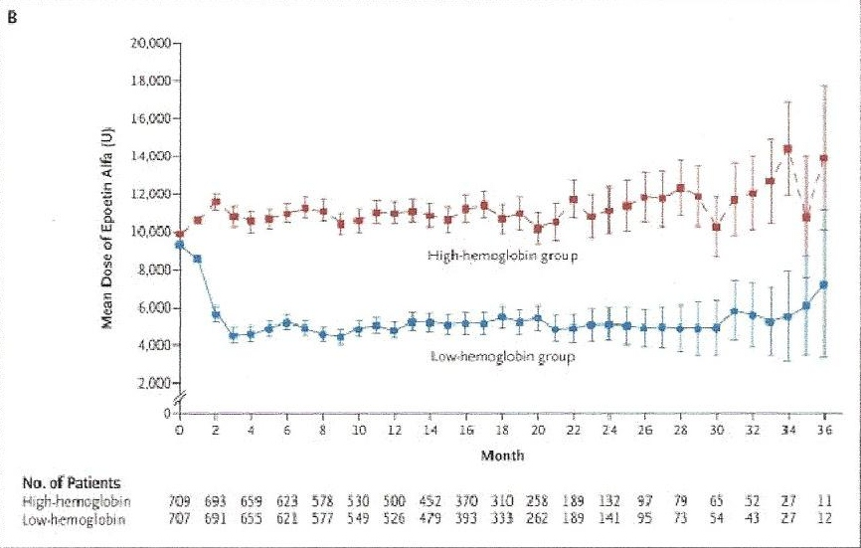
CHOIR Hemoglobin & Epoetin alfa Over Time

Slide 20
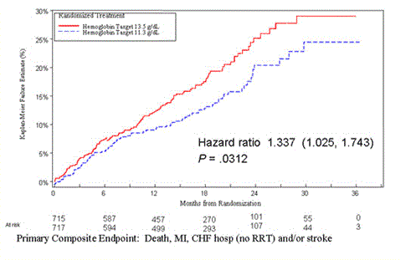
CHOIR Kaplan-Meier Plot of the Time to the Primary Composite Event between Randomization and Termination:

Slide 21
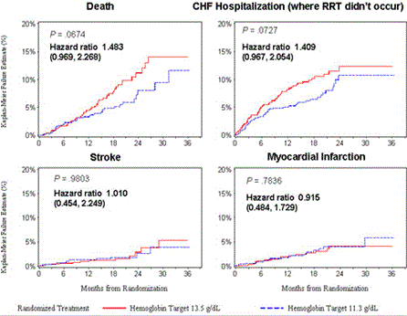
CHOIR Components of Primary End points

Slide 22
CHOIR Conclusions:
Exert caution when raising Hb in patients with anemia of CKD.
Goal Hb in patients with CKD: 11-12 g/dl.
Need more data in pre-dialysis and dialysis patients, but range of 10-12 g/dl is recommended for all patients with CKD.

Slide 23
TREAT
Study Population
Hb <11 g/dl
GFR 20-60
T2DM
Primary Endpoint
Composite event rate
comprising all-cause mortality
and CV events
– Myocardial ischemia
– Myocardial infarction
– Congestive heart failure
– Cerebrovascular accident
N 2000, Aranesp Group( target Hb 13.0 g/dl)
N 2000 Control Group
Secondary Endpoints:
• Time to ESRD or all-cause mortality(key secondary endpoint)
• Time to – All cause mortality/ CV mortality/ Myocardial Ischemia/ MI/ CVA/ CHF/ ESRD
• Rate of decline in eGFR relative to baseline
• Change in patient reported fatigue.

Slide 24
TREAT Trial Of Darbepoetin in DM and CKD
4038 Pts with DM, CKD not on dialysis, anemia randomized -
• Death or CVasc Dis in 632 Darbe vs. 602 PBO NS
• Death or ESRD in 652 Darbepoetin vs. 618 PBO NS
• Strokes 101 Darbepoetin vs 53 PBO P<.001
• Transfusions 297 Darbepoietin vs. 496 PBO p<.001
• Less fatigue with Darbepoetin
Pfeffer, et al. N Engl JMed 2009;361:2019.
“For many persons involved in clinical decision making,
the risk will outweigh the potential benefits.”

Slide 25
Risk factors for increase morbidity / mortality
High Hgb—hyperviscosity----activation of endothelial cells / platelets
Activation of heterodimeric erythropoietin receptors
Exposure to high doses of ESA----Proven in several studies.
Hypertension in ESA treated patients.

Slide 26
Types of ESAs
Protein based ESA therapy
Epotein ( alfa, beta, delta, omega)
Biosimilies (epoetin zeta)
Derbopoietin alfa—Glysocylated erythropoietin
CERA(methoxy polythylene glycol epoetin beta)
Synthetic Erythropoietin (SEP)
EPO fusion protein----- EPO-EPO
- GM-CSF-EPO
- Fc-EPO
- CTNO 528
Small molecule ESAs
Peptide based ( e.g. Hematide)
Non-peptide based.

Slide 27
Iron
• Iron, fourth most abundant element in earths crust
• Iron is an essential element for survival, required by
all cells
– Involved in electron transport reactions, oxygen carrying and
metabolism
• Concentration is tightly regulated as it can by toxic
Fe2+H202 OH +Fe3+ OH-
• Regulation by controlling iron release into the
plasma

Slide 28
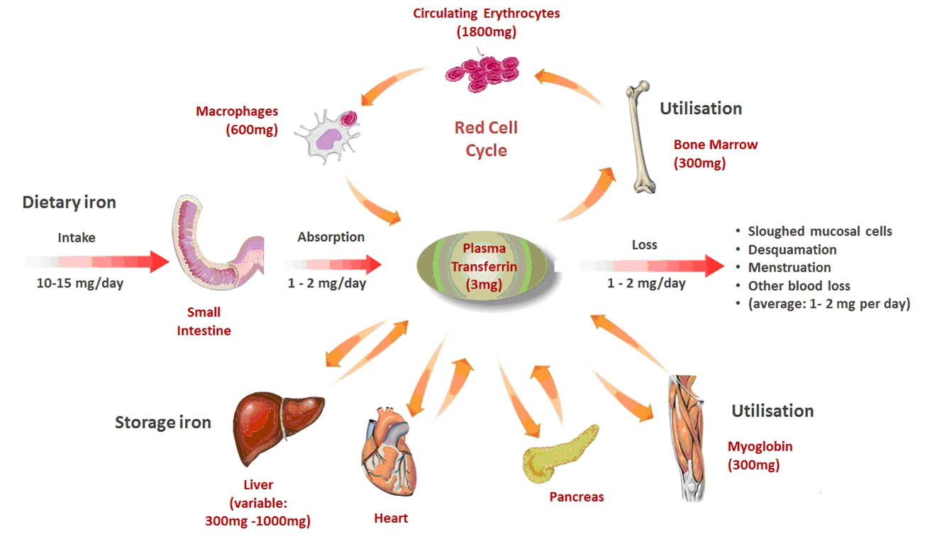
Distribution of Iron in Adults

Slide 29
Iron Metabolism
“Mammalian iron physiology is complex, but
understanding two key proteins- hepcidin and
ferroportin- provides insight into the large majority of iron disorders”
Nancy C Andrews. NEJM 2012

Slide 30
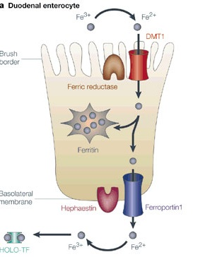
Iron transport across enterocytes
Combined action of membrane iron
transporter and an iron oxidase
Nature Reviews: Genetics

Slide 31
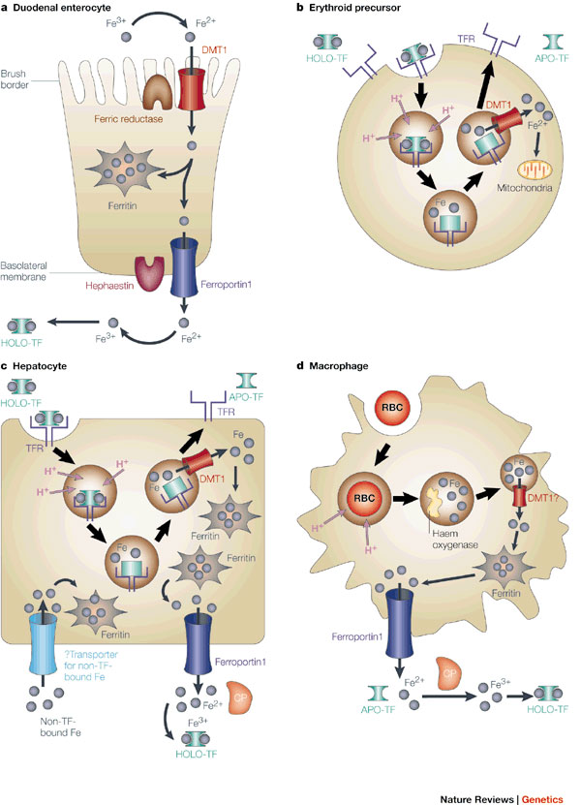
Ferroportin mediated Transport

Slide 32
Hepcidin
Mechanism of action:
– Binds to ferroportin (receptor) – inducing internalization and
degradation
• Controls plasma iron levels by:
– Regulating GI absorption, release from RES and hepatocyte, and
placental transfer
• Expression is directly, but inversely, related to iron requirements
– High requirements- low hepcidin
– Low requirements- high hepcidin
• Regulation occurs at the transcription level by:
– Iron
– Inflammation
– Erythropoiesis
– Hypoxia

Slide 33
Hypo-Responsiveness to ESAs
• Iron deficiency
• Inflammation
– Chronic infections
– Failed renal allograft
• Hematological disorders or malignancy
• Hyperparathyroidism
• Nutritional—Folate, vitamin B12, carnitine
• Drugs: ACE/ARB, AL++ overload
• Inadequate dialysis/oxidative stress

Slide 34
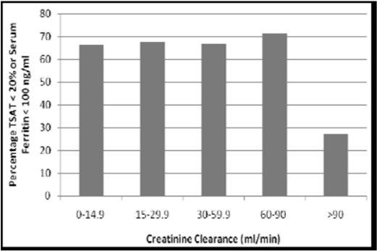
Iron Deficiency in Anemia of CKD #1 Cause of Hypo-responsiveness
Fishbane S, et al. Clin J Am Soc Nephrol 2009;4:57.

Slide 35
Question
A 38‐year‐old male with CKD stage 4 due to diabetes mellitus type 1 nephropathy presents for follow‐up of his anemia management. His Hgb remains at 9.4 gm% despite Darbo 120 μg SQ each week for the last 6 weeks. He denies any history of bleeding, but he has been hospitalized twice in the past 2 months for severe diabetic foot ulcer which is associated with osteomyelitis requiring ongoing wound care and IV clindamycin.
Pertinent labs: CBC: WBC 8400, Hgb 9.4, platelets 212 K,
reticulocytes 0.9%. TSAT 30%, ferritin 513.
LDH, folate, B12, peripheral blood smear are all normal. Stool hemocult negative.

Slide 36
Question
Which statement is TRUE regarding this patient’s anemia which is
hyporesponsive to ESA therapy?
A. The primary cause of the hyporesponsiveness to ESA therapy is
overt iron deficiency.
B. The chronic inflammation associated with his osteomyelitis has
produced a deficiency in H1Fα resulting in anemia resistant to ESA
therapy.
C. The resistant anemia is likely due to clindamycin‐induced
hemolysis.
D. The chronic inflammation with his osteomyelitis upregulates
hepcidin which alters effective iron utilization which prevents
successful incorporation of iron into Hgb.
E. The anemia is likely due to pure red cell aplasia induced by the
vehicle in the ESA product.

Slide 37
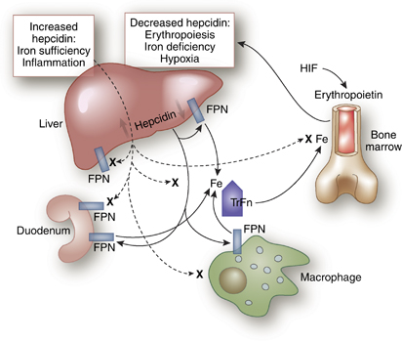
Role of Inflammation & Hepcidin in anemia in CKD

Slide 38
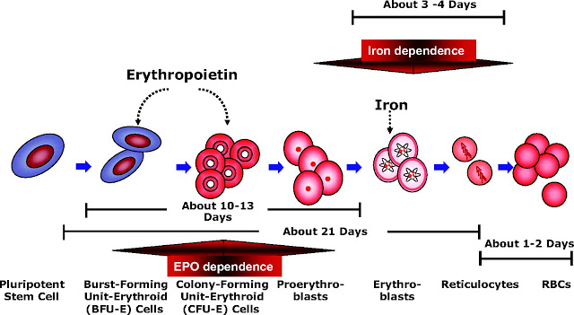
Erythropoisis in CKD

Slide 39
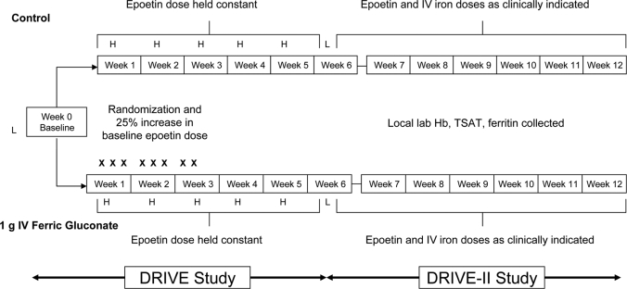
Drive Study I & II

Slide 40
Dialysis Patient’s Response to IV Iron with elevated Ferritin ( DRIVE )
Prospective, randomized, controlled, parallel-group, multicenter clinical trial.
Major Inclusion Criterias:
S. ferritin 500-1200 ng/ml
Hb ≤ 11.0 g/dl
TSAT ≤25%
Receiving Epoetin dose ≥ 225IU/Kg/wk or ≥22,500 IU/wk
IV Iron ≤ 125 mg per week in any of the 4 weeks prior to screening.
Patients are randomized in a 1:1 ratio to receive:
IV iron group: 1 gram of Ferric Gluconate (125 mg X8 HD sessions)
Control group: No IV iron
Both group receive a 25% increase in Epoetin alfa dose

Slide 41
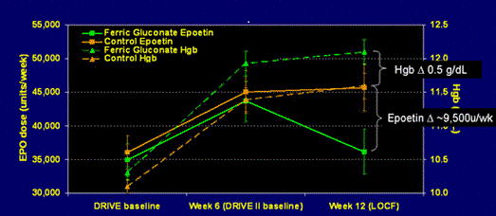
Drive II: Changes in Epoetin dose & Hemoglobin
Drive II: Changes in Epoetin dose & Hemoglobin
During DRIVE II, both groups maintained their DRIVE I Hgb increase, but
-Control group epoetin dose remained significantly elevated (p=0.0004)
-Ferric Gluconate group epoetin dose returned to baseline level (P=0.6039)

Slide 42
Conclusions: Drive I & Drive II
In anemic patients with elevated ferritin and TSAT ≤ 25%, the most effective strategy known is to increase Epoetin dose by 25% and to administer 1 gram of IV Iron.
IV Iron and Epoetin increase results in higher hemoglobin and lower Epoetin requirements over a 12-week period.
Ferritin above or below 8 ng/dl and TSAT < 20% vs 20% vs 25% can not discriminate between responders to IV Iron and non-responders.

Slide 43
The Proper Use of Ferritin to Guide Decisions on IV Iron Use
CKD 3 and 4
1. A low ferritin (<100 ng/mL) usually indicates low iron stores.
2. A higher ferritin lacks predictive value. Use clinical judgment
on whether to give IV or oral iron.
3. IV iron can raise Hgb, delay or prevent the need for ESA
therapy, or lower ESA doses.
Patients on Dialysis
1. A low ferritin (< 200 ng/mL) usually indicates low iron stores.
2. A higher ferritin lacks predictive value. Use clinical judgment
on whether to give IV iron.
3. IV iron can raise Hgb and lower ESA doses and cost.

Slide 44
Management of Anemia in CKD
• Rule out other causes of anemia – bleeding, nutritional deficiencies, bone marrow disorder, hemoglobinopathies etc.
• Once CKD cause of anemia is established –
–Evaluate for iron deficiency – check TSAT and Ferritin
–Supplement Fe as needed
–Evaluate Hgb response
• If anemia persists consider ESA
• Do Not Over-treat!!! Hgb 10-11 is current goal.

Slide 45
Iron Treatment
• Iron — often ineffective by p.o. route
• IV iron — best therapy route in ESRD
–Less rigorously tested in ND-CKD
• Even if KDOQI iron parameters are “on target,”
anemia may respond to iron therapy
–“functional iron deficiency”
–iron-restricted erythropoiesis

Slide 46
Benefits and Risks of ESAs
• Benefits
– Reduction in blood transfusions
– Improvement in patient’s quality of life
• Risks
– Cardiovascular events
– Hypertension
– Thromboembolism
– Cancer progression
– No benefit in CKD progression

