Slide 1
Transitional Care Management Billing Codes:
What are they? And what do they mean for Pharmacists?
Kathleen Pincus, PharmD, BCPS
University of Maryland School of Pharmacy
Washington Metropolitan Society of Health-System Pharmacists & District of Columbia College of Clinical Pharmacy Joint Spring Meeting
May 10, 2014

Slide 2
Learning Objectives
After this presentation, attendees will be able to:
Identify patients eligible for transitional care management services in accordance with the Medicare physician fee schedule
List the five elements of transitional care management services necessary to satisfy the Medicare requirements
Explain to a colleague three ways a pharmacist can participate in transitional care management services
Utilize published evidence to describe the impact on medication related problems on hospital readmission rates

Slide 3
Transitional Care Management

Slide 4
Medicare Beneficiary Rehospitalizations
Medicare beneficiaries discharged from hospital
  1 out of 5 rehospitalized within 30 days
    90% unplanned
    $17 billion
  3 out of 4 readmissions may be avoidable
N Eng J Med 2009; 360: 1418-28.
MedPAC Report June 2007

Slide 5
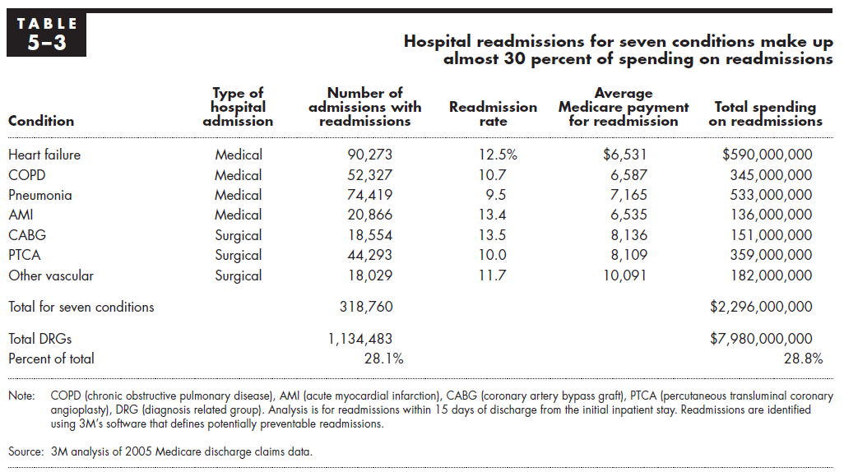
Readmissions by Condition
MedPAC Report June 2007

Slide 6
Health Care Reform
Patient Protection & Affordable Care Act (2010)
  Hospital Readmissions Reduction Program (Sec 3025)
  Hospitals with higher than expected readmission rates
    Decrease in reimbursement for all Medicare discharges
  Started with: Pneumonia, Acute myocardial infarction, Heart failure
MedPAC Report June 2007

Slide 7
Post Discharge
Only 44% of patients are seen by any physician 14 days after discharge
  49% saw PCP within 30 days of discharge
  Discharge summaries available at 1st follow-up visit: 12-34%
  Patients who saw PCP had a 3% readmission rate, those that didn’t had a 21% readmission rate
Fam Pract Manag 2013; 20(3): 6
JAMA 2007; 297: 831-41.

Slide 8
Post Discharge
19% of patients discharged from the hospital have an adverse event resulting from their hospitalization
  30% preventable, 32% ameliorable
  59% of preventable or ameliorable adverse events are due to poor communication between providers in the hospital and either patient or primary care providers
  66% related to medications
    Medication allergies developed after discharge
    Delay in required monitoring related to medications
    Side effects of newly prescribed medications
Ann Intern Med 2003; 138: 161-7.

Slide 9


HOW DO
YOU GET FROM…
HOSPITAL
PRIMARY CARE
Images:
http://medschool.umaryland.edu/familymedicine/about.asp
http://umm.edu/programs/pulmonary/professionals/pulmonary-fellowship/facilities

Slide 10
Transitional Care Management Billing Codes

Slide 11
Transitional Care Management Billing Codes
CMS added new transitional care management (TCM) codes to the physician fee schedule in 2013
  99495 & 99496
  To incentivize non face-to-face aspects of care management
CMS 2012

Slide 12
Who Qualifies?
Patients Discharged From:
Hospital Stay | Inpatient Outpatient observation service Outpatient partial hospitalization
Skilled Nursing Facility | Skilled nursing facility Rehabilitation hospital Long-term acute care hospital
Community Partial Hospitalization | Mental health Substance abuse
CMS 2012

Slide 13
What must be done?
Assume responsibility for beneficiary’s care
Establish a care plan
Communicate with patient and/or caregiver within 2 days
Face-to-face visit within 7 or 14 days
Appropriate complexity of medical decision making
CMS 2012

Slide 14
Assuming Responsibility for Care
Obtain and review discharge summary
Review diagnostic tests and treatments
Update patient’s medical record to incorporate changes in health
Within 14 business days of discharge
CMS 2012
Fam Pract Manag 2013; 20(3): 6

Slide 15
Establishing Care Plan
Establish or adjust care plan, including assessment of:
  Health status
  Medical needs
  Functional status
  Pain control
  Psychosocial needs
CMS 2012
Fam Pract Manag 2013; 20(3): 6

Slide 16
2 Day Communication
Methods
Communication with patient and/or caregiver
Within 2 business days of discharge
Forms of communication
  Direct contact
  Telephone call
  Electronic communication
OR documentation of 2 unsuccessful attempts
Content
Assess medication regimen understanding
Initiate medication reconciliation
Educate on care plan and potential complications
Assess need for home and community-based resources
Coordinate follow-up visits
CMS 2012
Fam Pract Manag 2013; 20(3): 6

Slide 17
Face-to-Face Visit
Within
  7 days for 99496 (high complexity)
  14 days for 99495 (moderate complexity)
Calendar days (not business days)
CMS 2012
Fam Pract Manag 2013; 20(3): 6

Slide 18
Which of these patients are eligible for (billable) TCM services?
A 45 yo patient discharged from a substance abuse partial hospitalization?
A 65 yo patient discharged to a rehabilitation hospital after a hip replacement surgery
A 72 yo patient seen in the emergency department for community acquired pneumonia discharged to home with oral antibiotics
A 68 yo patient discharged to home from an skilled nursing facility after a 21 day stay following cardiac surgery

Slide 19
Who can bill the TCM codes?
Not limited to primary care providers
Telephone call:
  Physicians
  “clinical staff under the direction of the physician”
    Incident-to level providers
Face-to-face visit:
  Physician or
  “qualified non-physician provider”
    Clinical nurse specialist, clinical psychologist, clinical social workers, nurse mid-wives, nurse practitioners, and physician assistants
    Practicing within the scope of their authority according to laws in their state and the Medicare statutory benefit
CMS 2012
Fam Pract Manag 2013; 20(3): 6

Slide 20
When do you bill the codes?
30 days after discharge
What do the codes pay?
Estimated $60 extra for a similar complexity visit for established patients
  $600 million cost to Medicare in the first year
  Increasing payment to primary care physicians by 3-4%
CMS 2012
Fam Pract Manag 2013; 20(3): 6

Slide 21
An office manager for a primary care physician’s office wants to implement TCM services. Which of the following scenarios is compliant with Medicare specifications?
A front desk staff member calls patients the day after hospital discharge to schedule 7 or 14 day appointments with their PCP
A licensed social worker calls patients within 4 days of hospital discharge to discuss community and home based resources
A nurse practitioner calls patients within 2 days of hospital discharge using a structured questionnaire and to schedule 7 or 14 day appointments with herself
A medical assistant calls patients the week of hospital discharge to perform medication reconciliation and update the patient’s electronic medical record

Slide 22
The Role of the Pharmacist

Slide 23
Medication Related Errors
66% of adverse events experienced after hospital discharge are related to medications
  Medication allergies
  Delay in required monitoring
  Side effects to new medicines
RED study: Of participants contacted after discharge
  65% had at least one medication problem
  53% required corrective actions
Ann Intern Med 2003; 138: 161-7
Ann Intern Med 2009; 150: 177-87

Slide 24
Commonly Implicated Medications
Classes
Gastrointestinal Cardiovascular Opioids Neuropsychiatric Hypoglycemic Antibiotics Corticosteroids Anticoagulants
Omission of orders for PRN medications
  Inadequate pain control
Duplicate medications
Inability to fill prescriptions
Ann Intern Med 2003; 138: 161-7
J Gen Intern Med 2009; 24: 630-5

Slide 25
Transitional Care Management Billing Codes:
What are they? And what do they mean for Pharmacists?
Kathleen Pincus, PharmD, BCPS
University of Maryland School of Pharmacy
Washington Metropolitan Society of Health-System Pharmacists & District of Columbia College of Clinical Pharmacy Joint Spring Meeting
May 10, 2014

Slide 26
References
Jenks SF, Williams MV, Coleman EA. Rehospitalizations among patients in the Medicare fee-for-service program. N Eng J Med 2009; 360: 1418-28.
Medicare Payment Advisory Commission (MedPac). Report to the congress: promoting greater efficiency in Medicare. Washington, DC: June 2007.
Bloink J, Adler KG. Transitional care management services; new codes, new requirements. Fam Pract Manag 2013; 20(3): 12-17.
Kripalani S, LeFevre E, Phillips CO, Williams MV, Basaviah P, Baker DW. Deficits in communication and information transfer between hospital-based and primary care physicians: implications for patient safety and continuity of care. JAMA 2007; 297: 831-41.
Forester AJ, Murff HJ, Peterson JF, Gandhi TK, Bates DW. The incidence and severity of adverse events affecting patients after discharge from the hospital. Ann Intern Med 2003; 138: 161-7.
Centers for Medicare & Medicaid Services. Medicare Program: Revisions to payment policies under the physician fee schedule, DME face to face encounters, elimination of the requirement for termination of non-random prepayment complex medical review and other revisions to Part B for CY 2013 (Final Rule) 2012; 77 Fed. Reg.: 68,978-94.
Tija J, Boner A, Briesacher BA, McGee S, Terrill E, Miller K. Medication discrepancies upon hospital to skilled nursing facility transitions. J Gen Intern Med 2009; 24: 630-5.

