Slide 1
Toxicities of Radiation Therapy in Cancer
Bradley Burton, PharmD, BCOP, CACP
September 13, 2014

Slide 2
Disclosure
No personal or financial disclosures to report
This continuing education activity contains discussion of published and/or investigational uses that are not indicated by the FDA. Please refer to the official prescribing information for each product for discussion of approved indication, contraindications, and warnings.

Slide 3
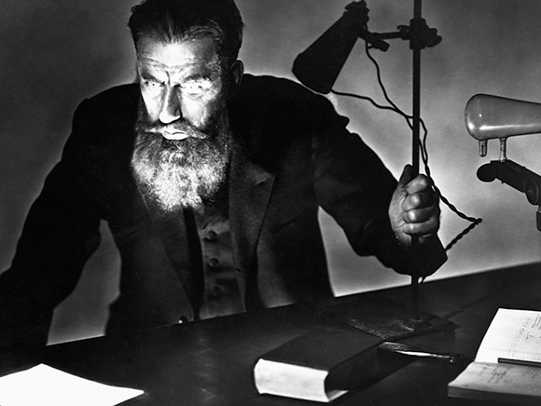
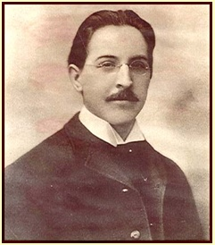
Back in time…
Dr. Wilhelm Röentgen
Dr. Emil Grubbe

Slide 4
Objectives
Summarize the proposed mechanisms behind the anti-cancer effects of radiation therapy and its toxicities
Identify the most common toxicities of radiation therapy experienced by cancer patients
Discuss pharmacologic and nonpharmacologic methods for the prevention and/or treatment of toxicities of radiation therapy

Slide 5
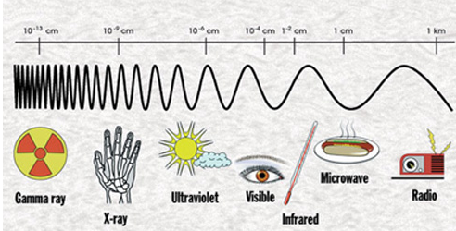
The Electromagnetic Spectrum
http://passion4science.wordpress.com/2011/08/06/electromagnetic-spectrum/

Slide 6
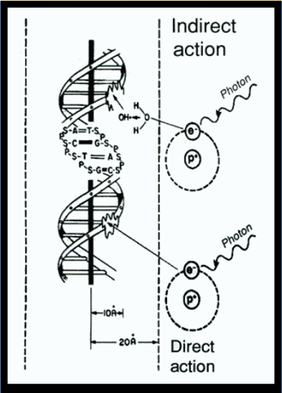
Radiation Oncology: The Basics
Radiation-Induced DNA Damage
Direct
Indirect
- Interaction of charged particles with DNA
Ionization of water
Free radical species
CELL DEATH
Harrison LB, et al. Oncologist 2002;7(6):492-508.

Slide 7
Radiation Oncology: The Basics
Radiation-Induced DNA Damage
Direct
Indirect
- Interaction of charged particles with DNA
Ionization of water
Free radical species
CELL DEATH
Harrison LB, et al. Oncologist 2002;7(6):492-508.

Slide 8
Considerations and predictions
Acute toxicity
  Appears days after treatment initiated
  Resolves within 4 weeks
  Rapidly proliferating cells
Chronic toxicity
  Months to years
  Examples
    Tissue fibrosis (scarring)
    Secondary malignancies
Time course
Target and surrounding organ(s)
Target and surrounding organ(s)
Type and intensity of radiation
Type and intensity of radiation
Concurrent therapy
Concurrent therapy
Patient specific factors
Morgan, et al. Radiation Oncology. In: DeVita VT, et al. Cancer: Principles and Practice of Oncology. 8th ed, Philadelphia: Lippincott, Wilkins, and Williams; 2008. p. 289-311.
Radvansky LJ, et al. Am J Health-Syst Pharm 2013;70:1025-1032.

Slide 9
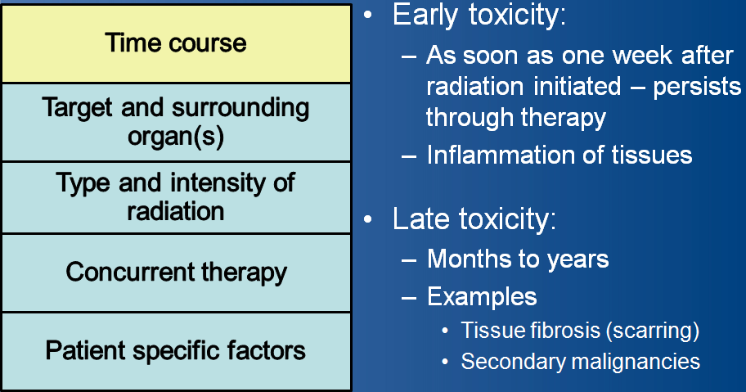
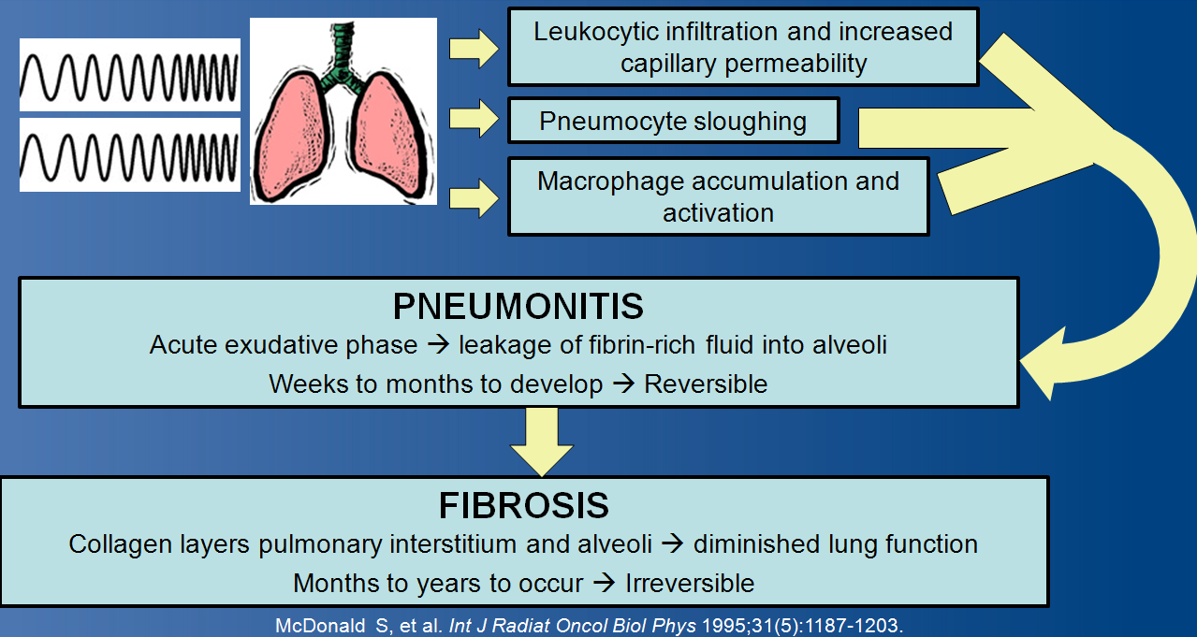
Considerations and predictions
Radiation-induced pulmonary injury

Slide 10
Considerations and predictions
Time course
Target(s) of radiation therapy can predict toxicity
Target and surrounding organ(s)
Target and surrounding organ(s)
Type and intensity of radiation
Type and intensity of radiation
Concurrent therapy
Concurrent therapy
Patient specific factors
Morgan, et al. Radiation Oncology. In: DeVita VT, et al. Cancer: Principles and Practice of Oncology. 8th ed, Philadelphia: Lippincott, Wilkins, and Williams; 2008. p. 289-311.

Slide 11
Considerations and predictions
Time course
Radiation techniques
  “Targeted” radiation to tumor spares tissues and organs from toxicity
↑ exposure = ↑ toxicity
Target and surrounding organ(s)
Target and surrounding organ(s)
Type and intensity of radiation
Type and intensity of radiation
Concurrent therapy
Concurrent therapy
Patient specific factors
Morgan, et al. Radiation Oncology. In: DeVita VT, et al. Cancer: Principles and Practice of Oncology. 8th ed, Philadelphia: Lippincott, Wilkins, and Williams; 2008. p. 289-311.

Slide 12
Considerations and predictions
Time course
Chemoradiation - ↑ cure rates, but ↑ toxicity
Radiosensitizers
  Cisplatin and carboplatin
  Fluoropyrimidines
  Paclitaxel
  Methotrexate
  Cetuximab
Target and surrounding organ(s)
Target and surrounding organ(s)
Type and intensity of radiation
Type and intensity of radiation
Concurrent therapy
Concurrent therapy
Patient specific factors
Morgan, et al. Radiation Oncology. In: DeVita VT, et al. Cancer: Principles and Practice of Oncology. 8th ed, Philadelphia: Lippincott, Wilkins, and Williams; 2008. p. 289-311.

Slide 13
Considerations and predictions
Time course
Chronic disease states
Age
Prior tolerance and toxicities
Curative vs. palliative intent
Target and surrounding organ(s)
Target and surrounding organ(s)
Type and intensity of radiation
Type and intensity of radiation
Concurrent therapy
Concurrent therapy
Patient specific factors
Morgan, et al. Radiation Oncology. In: DeVita VT, et al. Cancer: Principles and Practice of Oncology. 8th ed, Philadelphia: Lippincott, Wilkins, and Williams; 2008. p. 289-311.

Slide 14
Testing your knowledge…
All of the following are predictors of severity or type of toxicity of radiation therapy EXCEPT:
a. Location/target of organ being radiated
b. Duration of radiation therapy
c. Use of cisplatin as a radiosensitizer
d. Drinking orange juice during course of radiation therapy

Slide 15
Testing your knowledge…
Patients receiving radiation for prostate cancer should expect the following toxicities of therapy:
a. Nausea, Dysphagia, Encephalopathy
b. Dermatitis, Urethritis, Proctitis
c. Myelosuppression, Hand and foot syndrome, Abnormal dreams
d. Renal failure, Pneumonitis, Guillain-Barre Syndrome

Slide 16
Selected toxicities
Mucositis/Xerostomia/Dysphagia
Dermatitis
Nausea and vomiting
Proctitis
Cystitis
Pulmonary injury
Encephalopathy

Slide 17
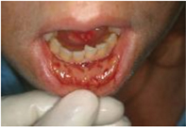
Mucositis
Affected population: Head and neck cancers
Symptoms
  Pain
  Difficulty swallowing, eating, talking
  Taste alterations
Incidence and duration
  Peak: week 5-6
  Resolution: 8-12 weeks post-completion of radiation
Rosenthal DI, Trotti A. Semin Radiat Oncol 2009;19:29-34.
Scarpace SL, et al. Pharmacotherapy 2009;29(5):578-592.
Radvansky LJ, et al. Am J Health-Syst Pharm 2013;70:1025-1032.

Slide 18
Mucositis
Granulocyte-Colony Stimulating Growth Factor (G-CSF) Granulocyte-Monocyte Simulating Growth Factor (GM-CSF) Allopurinol Rinse Gelclair Amifostine Honey Chlorhexidine Aloe Vera Sucralfate Ice chips Magic Mouthwash Palifermin Caphosol
Bensinger W, et al. J Natl Compr Canc Netw 2008;6(suppl 1):S1-S21.
Rosenthal DI, Trotti A. Semin Radiat Oncol 2009;19:29-34.
Worthington HV, et al. Cochrane Database Syst Rev 2011;4:CD000978.
Peterson DE, et al. Ann Oncol 2011;22(suppl 6):vi78-84.

Slide 19
Mucositis Management
MASCC | NCCN
Oral care protocols with patient and staff education Soft toothbrush replaced regularly Inclusion of dental professionals in patient’s care Pain management Avoidance of alcohol-based rinses | Same as MASCC Reduction of oral trauma Bland oral rinses and “Magic Mouthwash” Topical anesthetics Prophylactic antivirals and antifungals
* MASCC = Multinational Association of Supportive Care in Cancer
* NCCN = National Comprehensive Cancer Network
Bensinger W, et al. J Natl Compr Canc Netw 2008;6(suppl 1):S1-S21.
Rosenthal DI, Trotti A. Semin Radiat Oncol 2009;19:29-34.

Slide 20

Xerostomia
  Affected population: Head and neck cancers
    50-60% ↓ in salivary flow after 1 week
    80% ↓ by week 7
  Can become a
  chronic problem
  Complications
  Secondary infections
  Chewing and swallowing difficulties
  Cavities
Berk LB, et al. J Support Oncol 2005;3(3):191-200.
Scarpace SL, et al. Pharmacotherapy 2009;29(5):578-592.
Radvansky LJ, et al. Am J Health-Syst Pharm 2013; 70:1025-1032.

Slide 21
Xerostomia
Non-pharmacologic management
  Good oral hygiene
  Avoidance of alcohol- based rinses
  Chlorhexidine can be recommended
  Sweets
    Hard candy
    Gum
    Mints
Pharmacologic management
  Saliva substitutes
    Short duration of action
    $$$$$$$
  Amifostine
    Supported by ASCO – role controversial
  Pilocarpine
    Cholinergic agonist
    Dosing: 5 mg PO TID
    Brief trial?
Berk LB, et al. J Support Oncol 2005;3(3):191-200.
Scarpace SL, et al. Pharmacotherapy 2009;29(5):578-592.

Slide 22
Dysphagia – Mechanisms
Surgery
Radiation
Chemotherapy
Murphy BA, Gilbert J. Semin Radiat Oncol 2009;9:35-42.

Slide 23
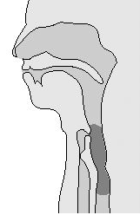
Management
Pharmacist’s role
  Adjust drug administration route
  “Which medications are truly necessary?”
Non-pharmacologic recommendations
  Speech/Language Pathology (SLP) consultation
    Exercises to facilitate swallowing
  Nutrition consultation
    Prophylactic feeding tubes
      Benefits: Reduce weight loss, hospitalizations, treatment interruptions
      Risks: Dysfunction, discomfort, infection risk
Scarpace SL, et al. Pharmacotherapy 2009;29(5):578-592.
Rosenthal DI, et al. J Clin Oncol 2006;24(17):2636-2643.

Slide 24
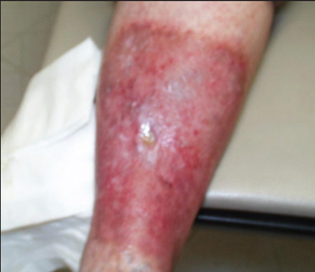
Dermatitis
Affects most patients treated with radiation
Symptoms
  Localized to field of radiation
  Typically mild
    Dryness, erythema, pruritis
  Severe
    Desquamation and ulceration
    Higher incidence with conventional
    daily radiation, concurrent chemotherapy
Bolderston A, et al. Support Care Cancer 2006;14:802-817.
Scarpace SL, et al. Pharmacotherapy 2009;29(5):578-592.
Marcus LS, et al. J Clin Aesthet Dermatol 2010;3(12):50–53.

Slide 25
Management
Prevention | Treatment
- Gentle washing of skin and hair with water +/- mild soap and shampoo - Avoid extreme temperatures - Avoid “bubble baths” and shower gels - Pat skin dry - Sunscreen | - Unscented, water-based topical agents (Aquaphor, Lubriderm, Eucerin) Wound care for moist, ulcerative symptoms Avoid topical corticosteroids
Bolderston A, et al. Support Care Cancer 2006;14:802-817.
Radvansky LJ, et al. Am J Health-Syst Pharm 2013;70:1025-1032.

Slide 26
Testing your knowledge…
Which of the following are preventative or supportive measures that can be recommended to patients with radiation-induced mucositis?
a. Inclusion of dental professionals in patient’s oncology care
b. Avoidance of soft bristle toothbrushes
c. Chlorhexidine and other alcohol-based rinses
d. Avoidance of bisphosphonates, as they can increase the likelihood of osteonecrosis of the jaw in this setting

Slide 27
Testing your knowledge…
Which of the following is an inappropriate recommendation for a patient suffering from radiation-induced xerostomia?
a. Pilocarpine
b. Jolly Ranchers
c. Juicy Fruit
d. French Fries

Slide 28
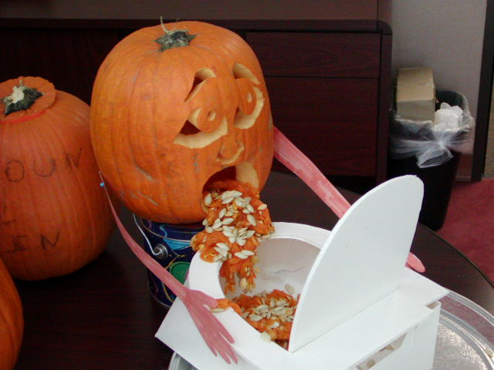
Radiation-Induced
Nausea and Vomiting (RINV)
Mechanism
  Unclear
  Interaction of serotonin (5-HT),
  dopamine, other neurotransmitters
  within chemotherapy trigger zone
Risk factors
  Total body irradiation (TBI)
  Upper abdominal radiation
  Higher doses of radiation
Feyer PC, et al. Support Care Cancer 2011;19(Suppl 1):S5-S14.
NCCN Guidelines for Antiemesis. Version 1.2014.

Slide 29
Radiation-Induced
Nausea and Vomiting (RINV)
Lack of high-level evidence
  Few randomized controlled trials
  Small sample size in current trials
Difficult to control
  Undertreatment
  Inappropriate treatment
Feyer PC, et al. Support Care Cancer 2011;19(Suppl 1):S5-S14.
NCCN Guidelines for Antiemesis. Version 1.2014.

Slide 30
Radiation-Induced
Nausea and Vomiting (RINV)
Per MASCC, ESMO, and NCCN
High Risk TBI or total nodal irradiation | Moderate Risk Upper body or half body irradiation | Low Risk Head Craniospinal Head/Neck Pelvis | Minimal Risk Breast Extremities | Concomitant Chemo
Prophylaxis with 5-HT₃* antagonist +/- dexamethasone | Prophylaxis with 5-HT₃* antagonist +/- short course of dexamethasone | Prophylaxis or rescue with 5-HT₃* antagoist | Rescue with dopamine receptor antagonist or prophylaxis with 5-HT₃* antagonist | Follow guidelines for chemotherapy regimen
> 90% | 60-90% | 30-60% | < 30% | Varies
* = Ondansetron and granisetron are the only 5-HT₃ antagonists evaluated in clinical trials
Feyer PC, et al. Support Care Cancer 2011;19(Suppl 1):S5-S14.
NCCN Guidelines for Antiemesis. Version 1.2014.

Slide 31
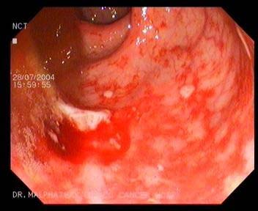
Proctitis
Affected population: GU and lower GI malignancies
Symptoms
  Perirectal pain
    Can be worse with defecation
  Diarrhea
  Severe: hematochezia, strictures,
  anorectal dysfunction
Girnius S. Am J Clin Oncol 2006;29:588-592.
Leiper K. Clinical Oncology 2007;19:724-729.

Slide 32
Proctitis Management
Nonpharmacologic
  Good hygiene
  Moisturized wipes instead of toilet paper
Pharmacologic
  Oral analgesics
  Topical anti-inflammatory agents
    Hydrocortisone/Pramoxine PR TID to QID
    Sulfasalazine and mesalamine
Girnius S. Am J Clin Oncol 2006;29:588-592.
Leiper K. Clinical Oncology 2007;19:724-729.

Slide 33
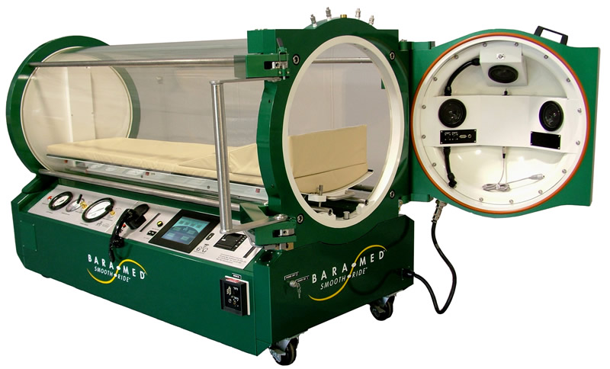
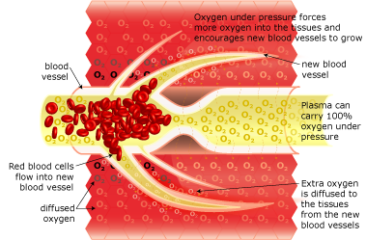
Hyperbaric Oxygen Therapy (HBOT)
Neovascularization via improved oxygen delivery to damaged tissue
2.4-2.5 atm pressure
90 minute treatments
5-7 days/week
Henson C. Ther Adv Gastroenterol 2010;3(6):359-365.
http://www.cosmeticsurgeryforums.com/hyperbaric_oxygen_therapy.htm

Slide 34
Summary of evidence: HBOT
Trials | Results
Warren, et al (1997) | 8 of 14 patients had complete resolution of bleeding
Girnius, et al (2006) | 7 of 9 patients had complete resolution of bleeding (median 54 sessions)
Dall’Era, et al (2006) | 13 of 27 patients with complete resolution of bleeding
Considerations
  Retrospective case series with stark variability between HBOT practices
  Cost
Henson C. Ther Adv Gastroenterol 2010;3(6):359-365.

Slide 35
Case of MR
MR is a left breast cancer patient who presents to breast cancer clinic today for her first day of radiation.
The oncologist asks for your recommendation regarding emesis prophylaxis, stating that he plans to only radiate her left breast.
What is her antiemetic risk?
A. Very high
B. High
C. Low
D. Minimal

Slide 36
Case of MR
What do you recommend as MR’s antiemetic regimen for radiation-induced nausea and vomiting?
A. Dexamethasone 4 mg PO daily 30 minutes prior to radiation
B. Ondansetron 8 mg PO daily 30 minutes prior to radiation
C. Ondansetron 16 mg PO TID
D. None of the above

Slide 37
Cystitis
Affected population: Same as radiation-induced proctitis
Symptoms
  Dysuria
  Urgency
  Hematuria (severe, life-threatening)
Smith SG, et al. Nat Rev Urol 2010;7(4):206-214.

Slide 38
Cystitis Management
Confirm Diagnosis
Conservative
Management
+/- HBOT
Surgical Intervention
Exclude infectious causes
Rule out recurrent malignancy
Oral/IV hydration
Blood transfusion
Bladder catheterization or irrigation
Embolization of iliac arteries
Urinary diversion procedures
Cystectomy and urinary diversion
Smith SG, et al. Nat Rev Urol 2010;7(4):206-214.

Slide 39
Toxicities of Radiation Therapy:
Pulmonary Injury
Affected population: Thoracic malignancies
Clinical course:
  Early (weeks to months): Pneumonitis
  Late (months to years): Fibrosis
Symptoms:
  Cough
  Dyspnea
  Low grade fever
McDonald S, et al. Int J Radiat Oncol Biol Phys 1995;31(5):1187-1203.

Slide 40
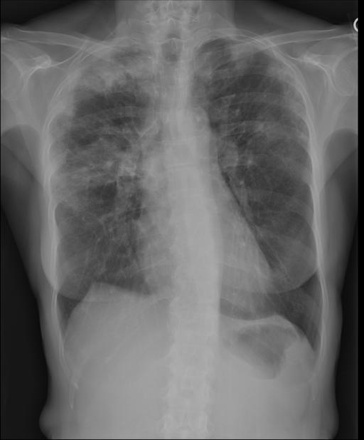
Toxicities of Radiation Therapy:
Pulmonary Injury
Risk Factors
  Female
  Concurrent chemotherapy
  Pre-radiation pulmonary function
Management
  Pneumonitis
    Prednisone 60-100 mg PO daily x 2 weeks → Slow taper
  Fibrosis: Limited options
Graves PR, et al.Semin Radiat Oncol 2010;20:201-207.
Gross NJ. Ann Intern Med 1977;86(1):81-92.

Slide 41
Toxicities of Radiation:
Secondary Malignancies
Mechanism
  Defects in normal cellular repair or bone marrow function after radiation therapy
Late toxicity
  Leukemia: ~2-7 years
  Solid tumors: Up to 30 years
Frequency: variable
Overall risk low
Benefit of therapy outweighs risk of secondary cancer
Harrison RM. Biomed Imaging Interv J 2007;3(2):354.
Sountoulides P, et al. Ther Adv Urol 2010;2(3):119-125.
Neuhauser WD, Durante M. Nat Rev Cancer 2011;11(6):438-448.

Slide 42
Encephalopathy
Affected population: CNS malignancies
Causes
  Disruption of blood-brain barrier
  Demyelination and edema
Symptoms
  Cognitive decline
  Somnolence
  Seizures
Management
  Dexamethasone initiation or up-titration
Dropcho EJ. Neurol Clin 2010;28:217-234.

Slide 43
Case of HU
HU is a 72 year old male with prostate cancer who is undergoing radiation therapy. He presents to clinic with radiation-induced proctitis with a chief complaint of 9/10 pain with defecation despite soft to loose stools. Which of the following would be appropriate pharmacologic options you can recommend to this patient?
a. Hydrocortisone/Pramoxine applied rectally 3 to 4 times daily
b. Dexamethasone 10 mg daily until symptoms resolve
c. a and b
d. None of the above

Slide 44
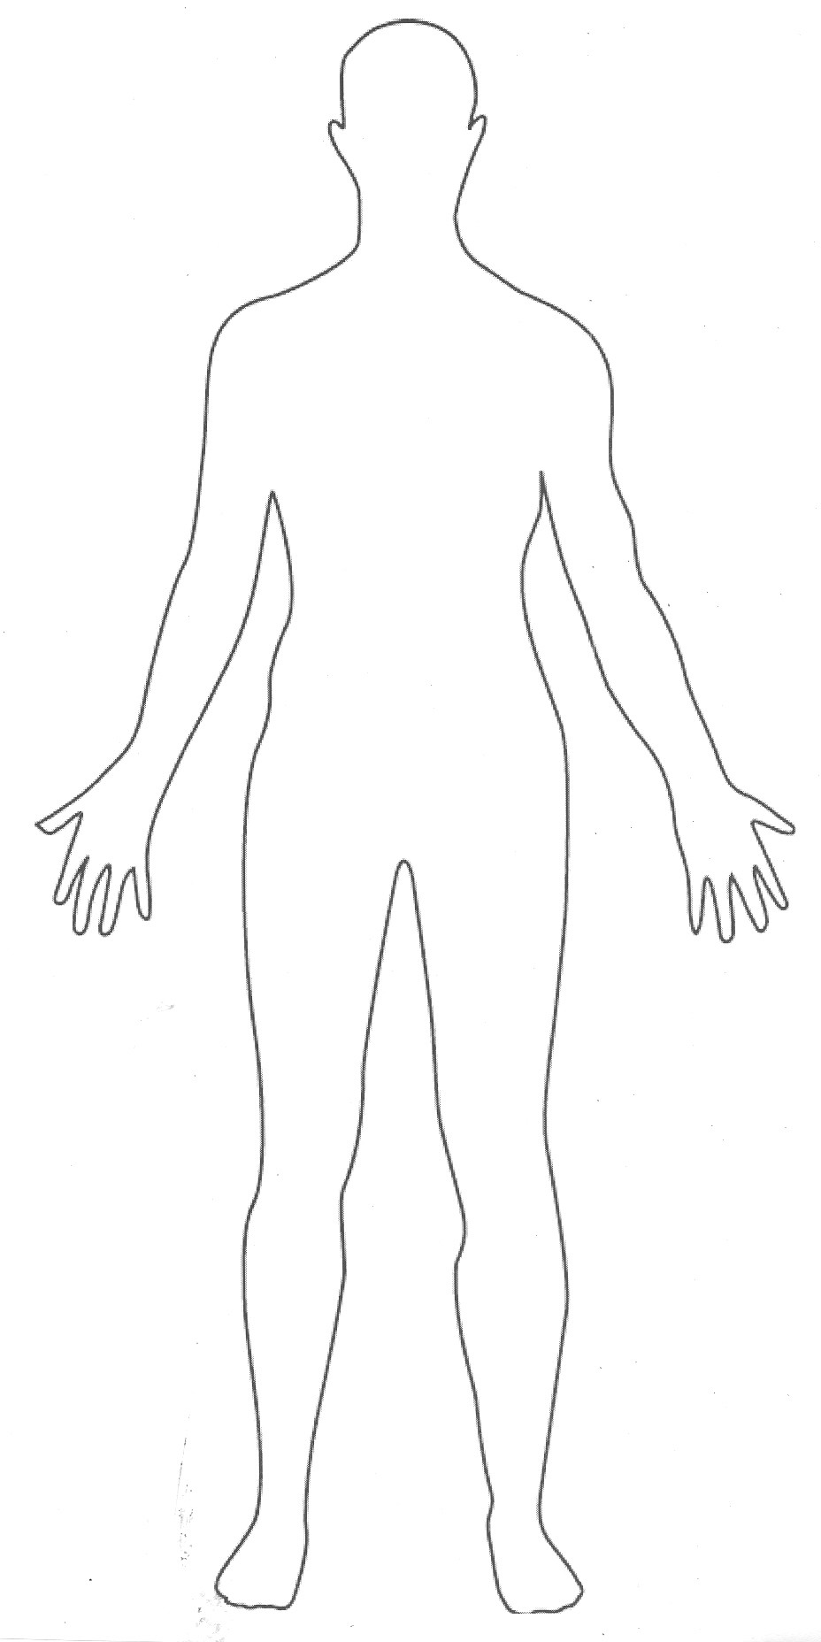
Other toxicities of radiation therapy
Cardiotoxicity
Other CNS
Nephritis
Thyroiditis
Nail bed changes
Infertility

Slide 45
Summary
Toxicities of radiation are common
Patient counseling regarding side effects important
Pharmacists play a role in recommendation of pharmacologic and nonpharmacologic management of toxicities

Slide 46


