Slide 1

Notes:
Picture of my family – love to start talks in the comfort of my living room.
Feel passionate about my girls and about this unique population of patients – adults with congenital heart disease

Slide 2

Pulmonary Hypertension and the Right Ventricle
George Ruiz, M.D.
Director, Pulmonary Vascular Unit
Advanced Heart Failure Program

Slide 3

Notes:
Let’s start with a patient:
I was asked to consult on a 50-year old man that was admitted to our hospital with progressive shortness of breath
He runs his family’s business in a small town in Northern MD
He was an avid sportsman- played tennis twice a week and golf on the weekends.
Describes a 3 month decline in functional capacity – noted that he would get shortness of breath if he walked quickly or climbed steps.
He had been followed by a local cardiologist for years because he had a history of “heart disease.”
I noticed he had a scar on his chest.
Along with the shortness of breath, he started to develop chest tightness.
The last several days, he had been slightly feverish.
His wife forced him to go to the local emergency room

Slide 4
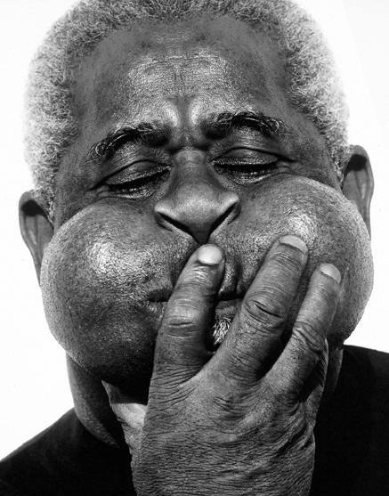

Slide 5
Notes:
At the local hospital, the patient’s EKG revealed “major abnormalities.”
“They thought I was having a heart attack.”
His sats at the OSH were in the mid 80’s on presentation
He was transported by helicopter directly to Washington Hospital Center’s Cath Lab.
Admission diagnosis was “unstable angina.”

Slide 6
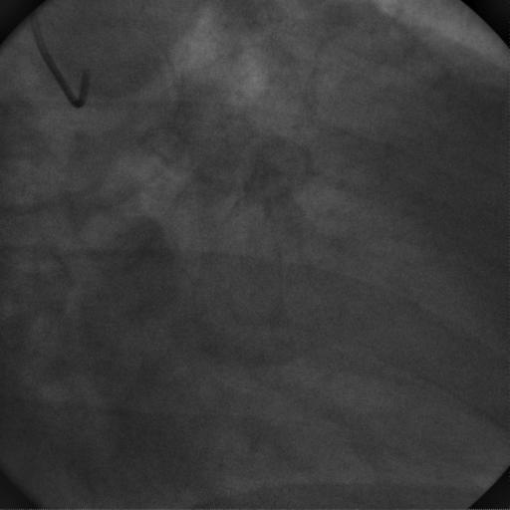
Notes:
Images of his left coronary system revealed no significant CAD

Slide 7
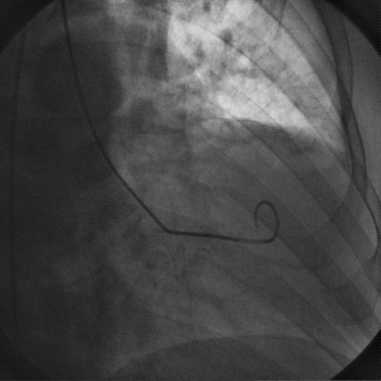
Notes:
His left ventricle was functioning normally

Slide 8
Right Heart Catheterization:
RA 15
RV 120/20
PA 120/68 (85)
PCWP 12
PVR 12 Wood Units
Notes:
Hemodynamics revealed severe pulmonary hypertension
PCWP was elevated – LVEDP was wnl (common pitfall)
CO was preserved.
Sat run was not performed (another common pitfall)
Will explain that this in not an uncommon pattern – physicians start with what is common and what they know and understand. For most 50 year-old men, that’s coronary disease.

Slide 9



Slide 10
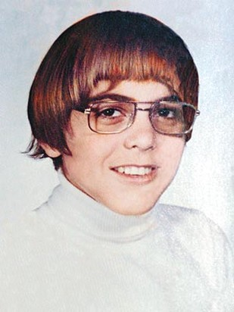
Notes:
At this point we get more history:
His wife hands me copies of old records that his mother had kept.
At the age of 8 (1966) the patient was noted to have a large atrial septal defect with partial anomalous venous return (right superior and inferior pulmonary veins) as well as a small ventricular septal defect.
He had been cath’d at that time – PA pressures reported at 73/42 with a QP/QS of 2:1
He underwent two operations:
ASD closure (1966)
VSD closure (1968)

Slide 11
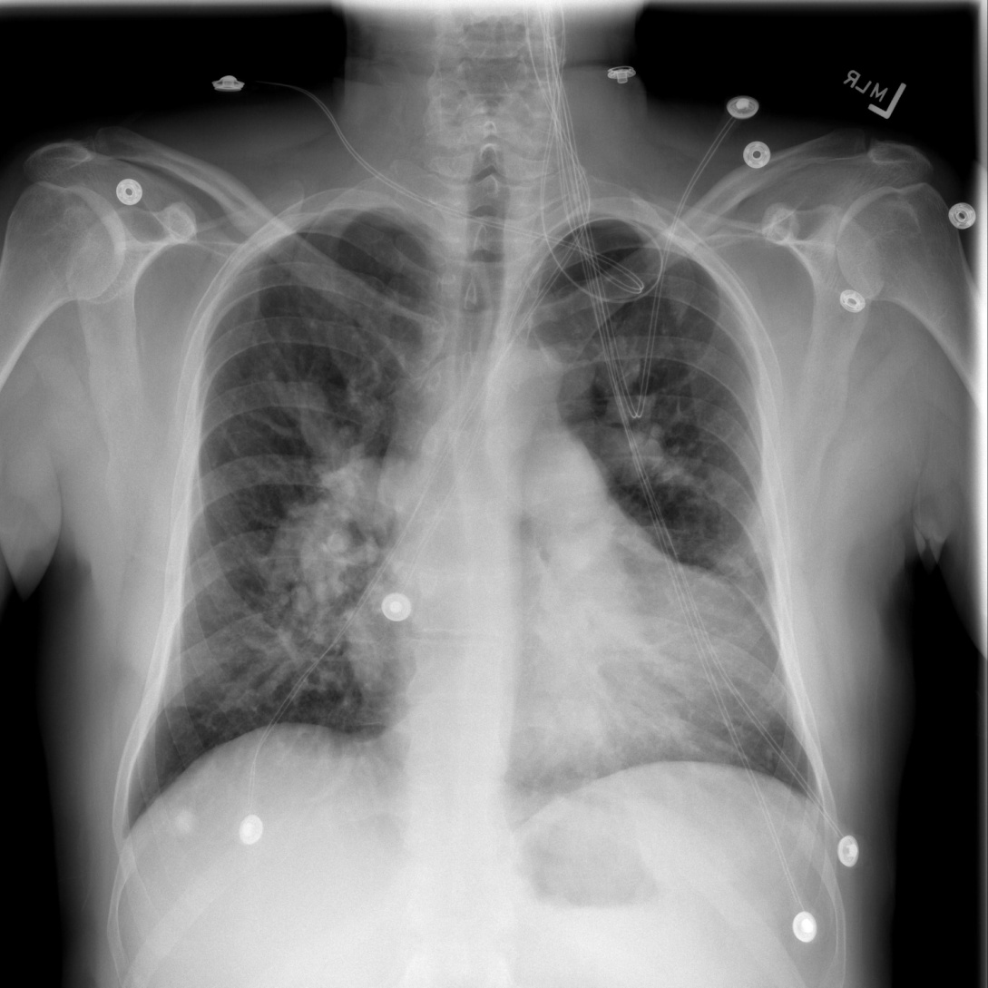
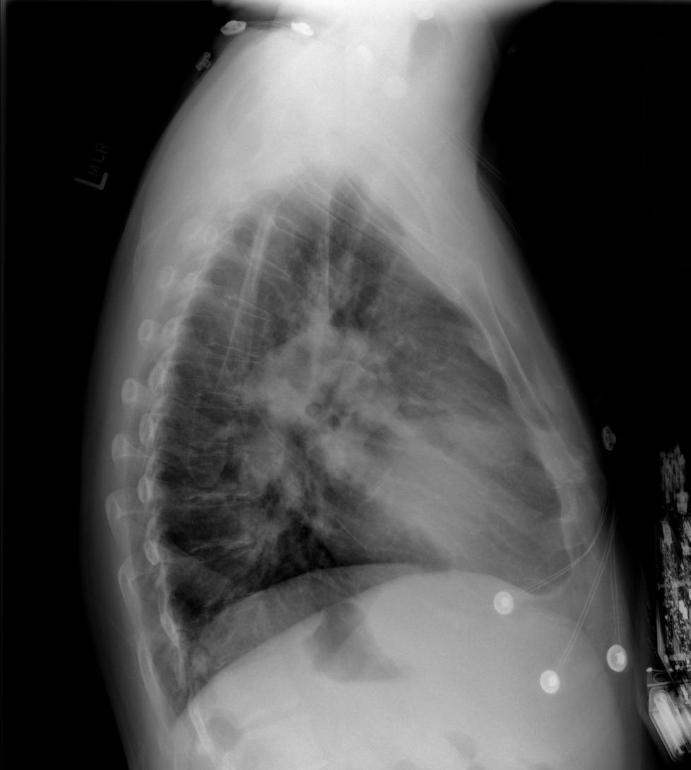
Notes:
So, now we take a breath and start to think about what’s going on.
CXR tells the story
Enlarged RA
Enlarged RV (explains the EKG)
Enlarged PA’s

Slide 12
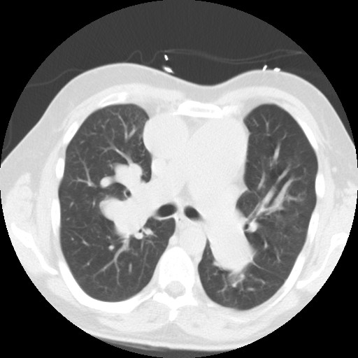
Notes:
PA’s, in fact are extremely large

Slide 13
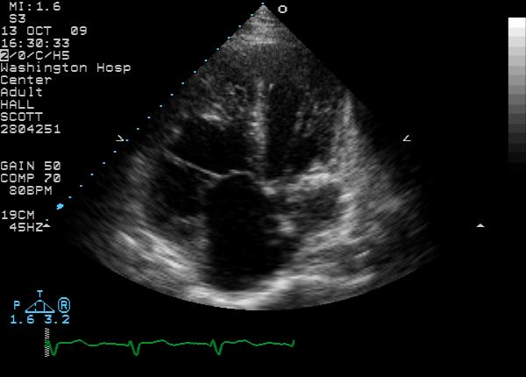

Slide 14
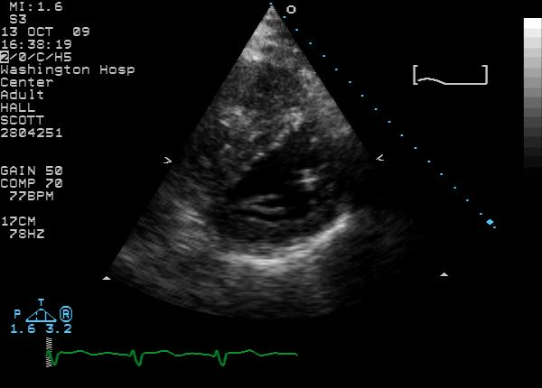

Slide 15
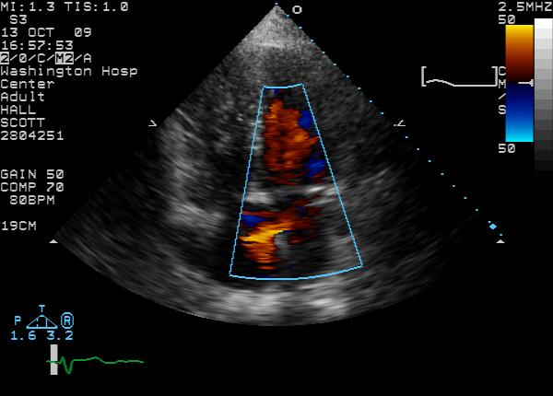

Slide 16


Slide 17
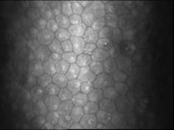

Slide 18


Slide 19
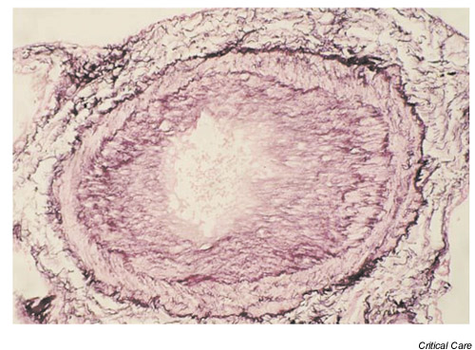

Slide 20


Slide 21


Slide 22
68%
48%
34%
5
3
1
NIH registry 1981-1985 (iPAH)

Slide 23
68%
48%
34%
5
3
1
Right Atrial Pressure, Mean PAP, Cardiac Output
NIH registry 1981-1985 (iPAH)

Slide 24
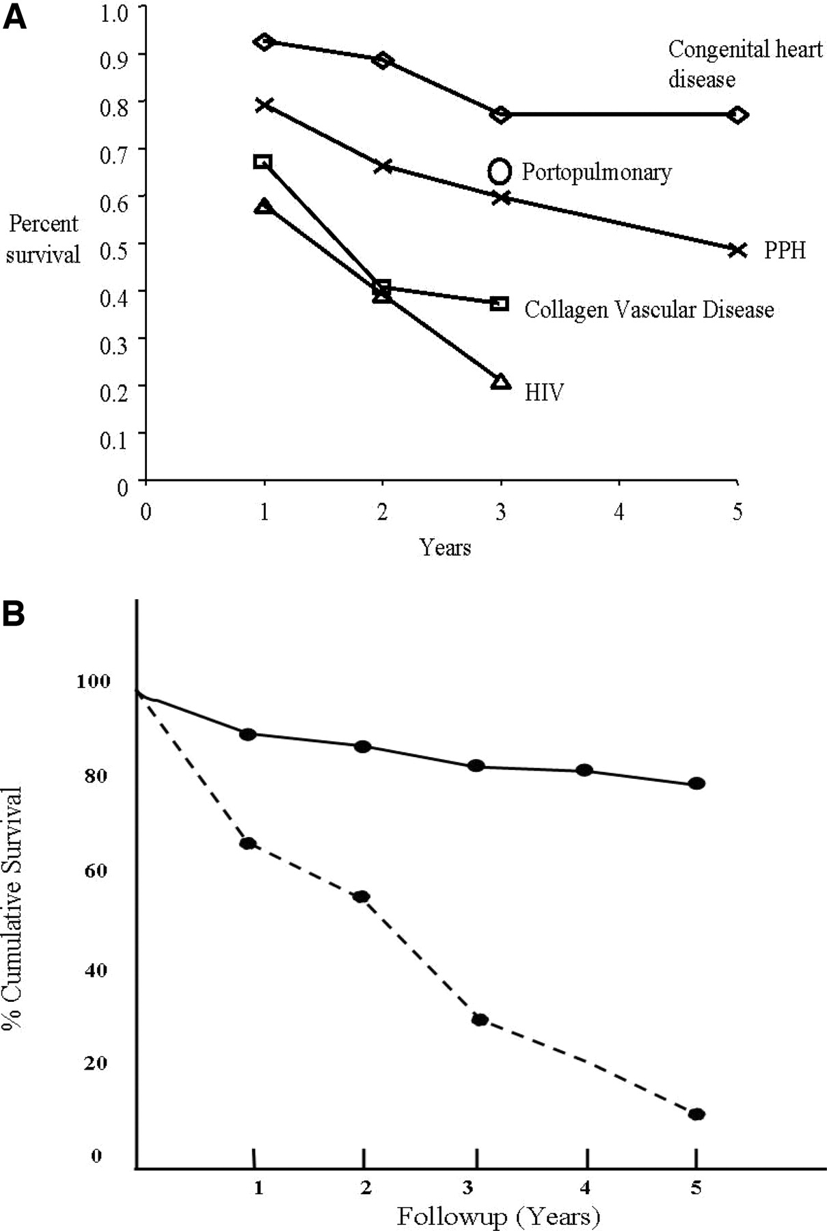


A, Survival with various origins of PAH
McLaughlin, V. V. et al. Circulation 2006;114:1417-1431
Copyright ©2006 American Heart Association

Slide 25


Slide 26
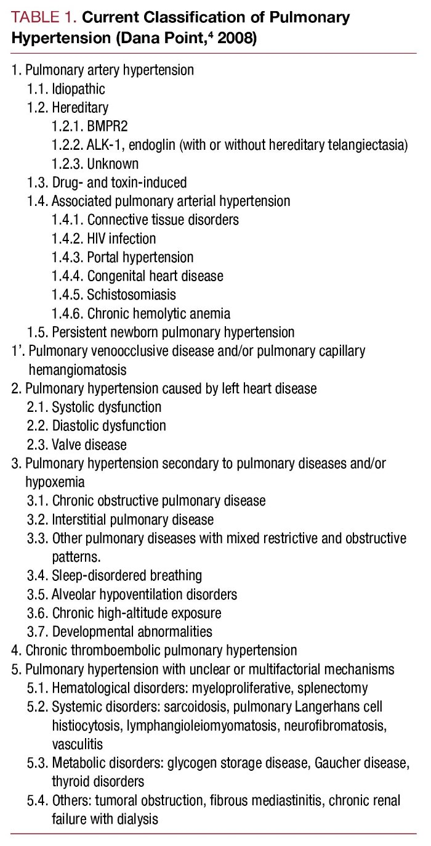

Slide 27


Slide 28
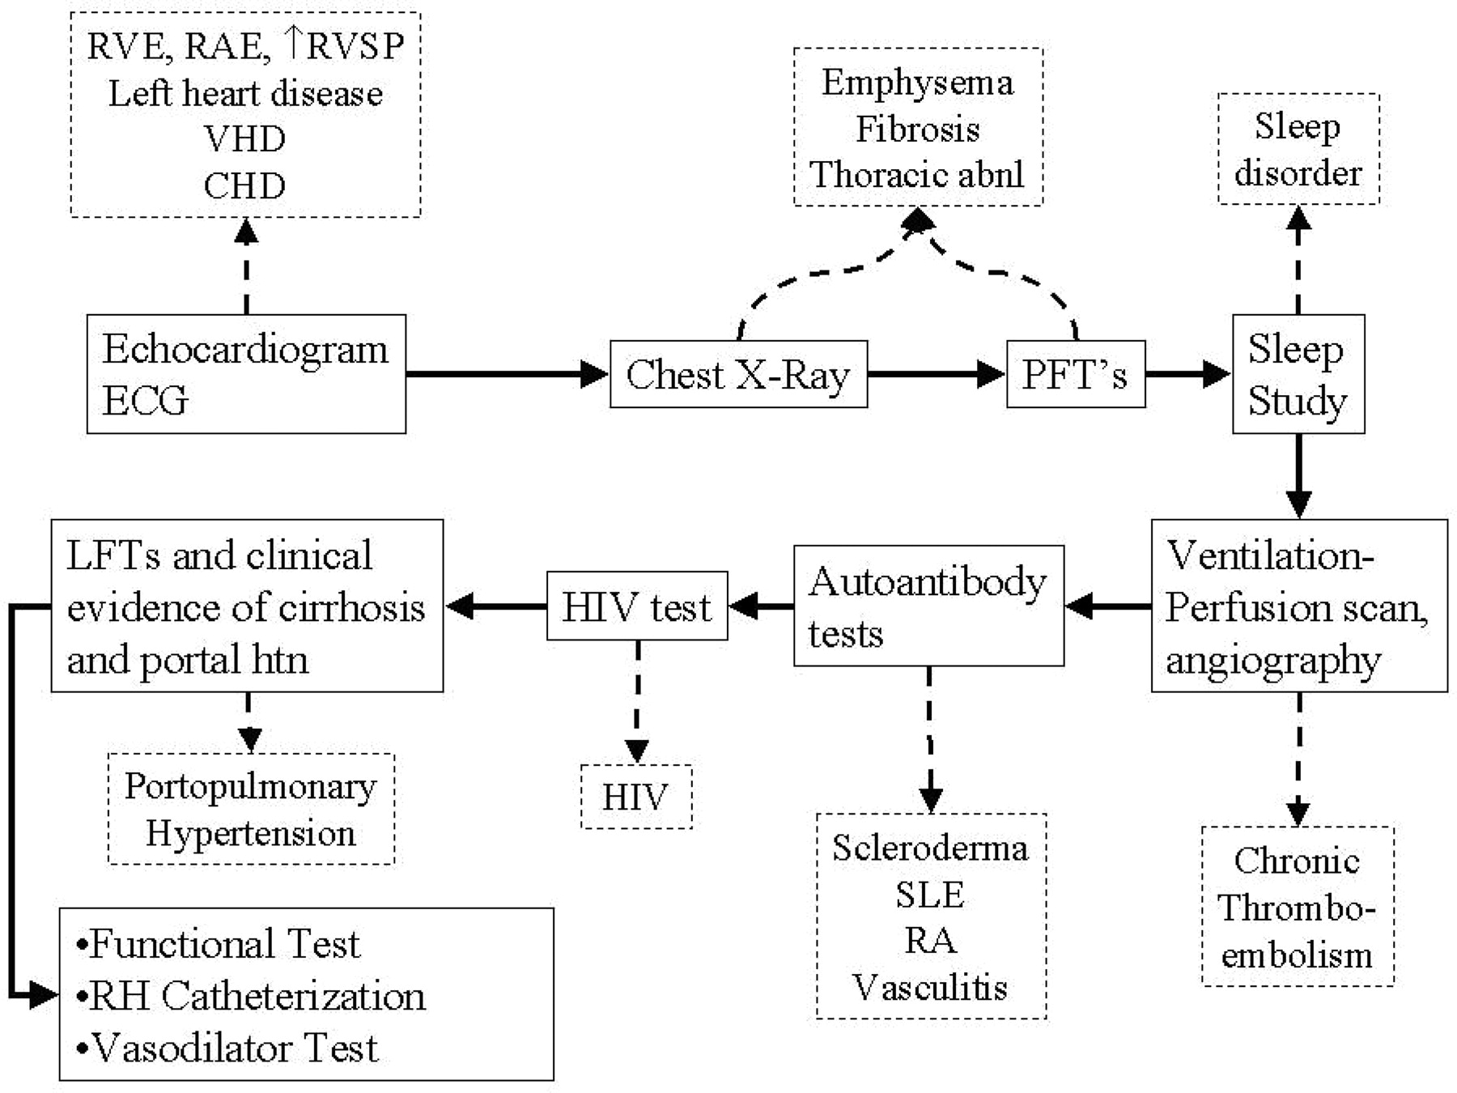
Diagnostic algorithm for the evaluation of PAH, as discussed in text
McLaughlin, V. V. et al. Circulation 2006;114:1417-1431
Copyright ©2006 American Heart Association

Slide 29


Slide 30
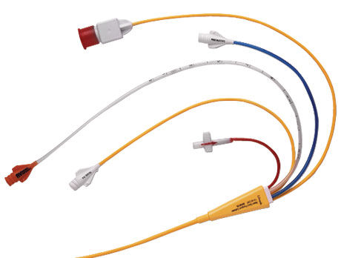

Slide 31

Notes:
Functional class

Slide 32


Slide 34


Slide 35


Slide 36
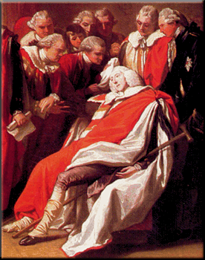

Slide 37
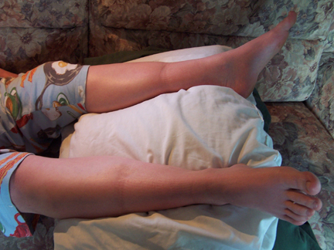

Slide 38
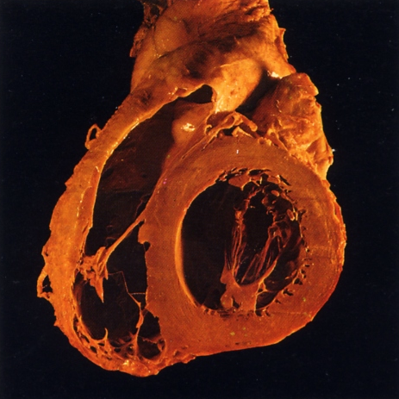

Slide 39
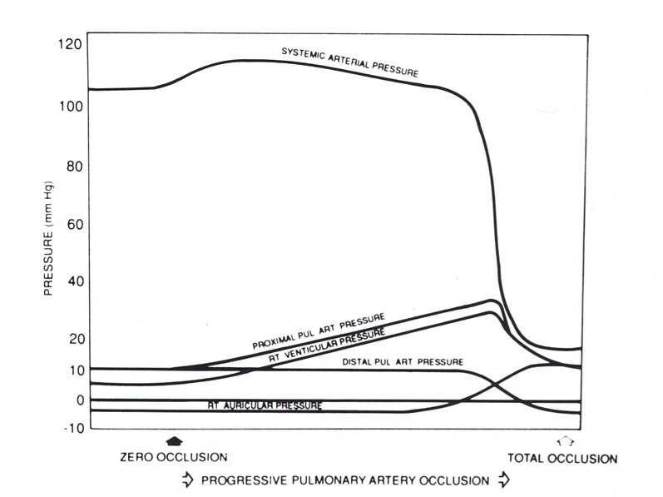

Slide 40
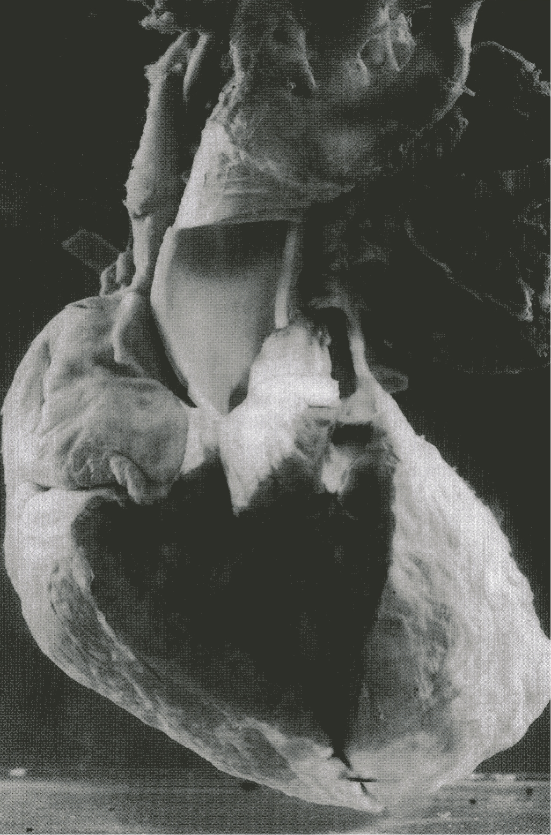

Slide 41


Slide 42


Slide 43


Slide 44
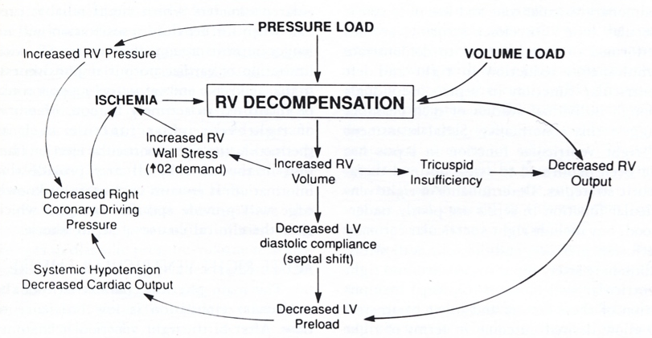

Slide 45
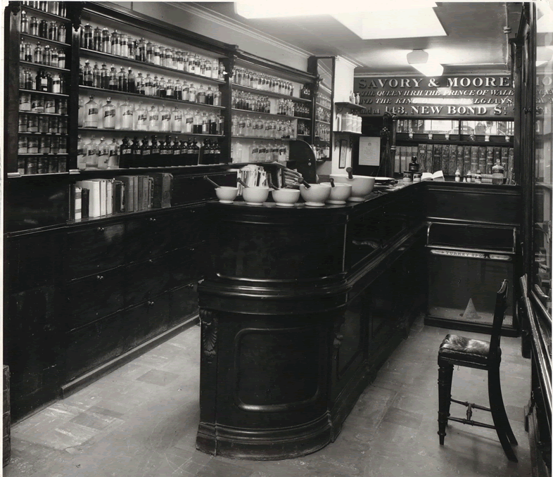

Slide 47
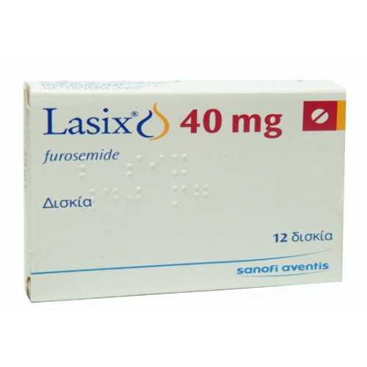


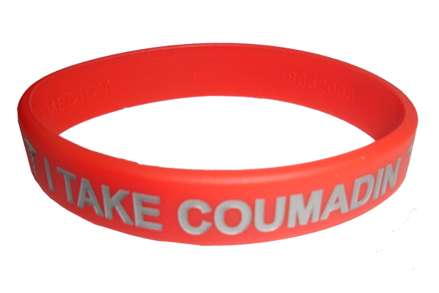

Slide 48
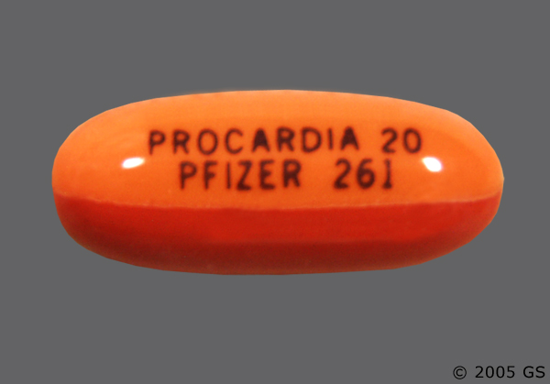

Slide 49
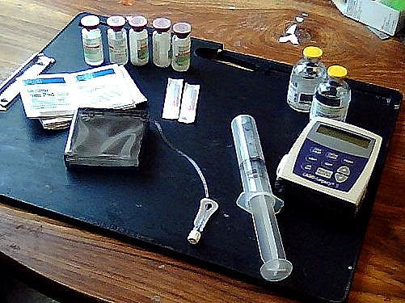
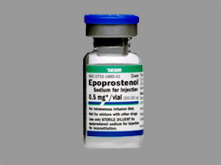
Notes:
1 to 2 ng/kg/min
IV line
Increase several times a week
Repeat RHCath
½ life minutes
Refrigeration (scleroderma)
Diluent

Slide 50
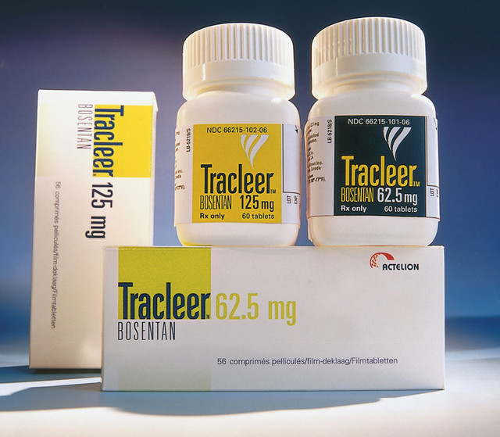
Notes:
Run in period
Pregnancy
Eisenmengers
Early trial
LFTs

Slide 51
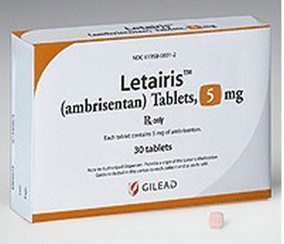

Slide 52
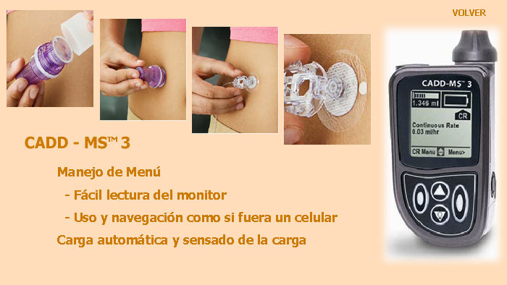
Notes:
Treprsotinil
Half life of 4 hrs
Room temp stable

Slide 53
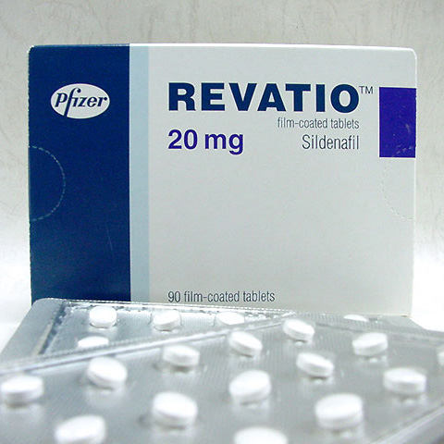

Slide 54
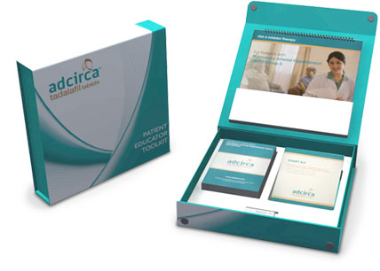
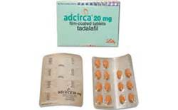

Slide 55
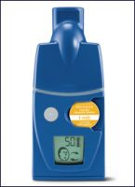
Notes:
ILOPROST
6x per day
2.5 to 5 mcg 6 to 9 times day

Slide 56
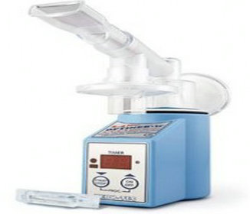
Notes:
TREPROSTIL

Slide 57
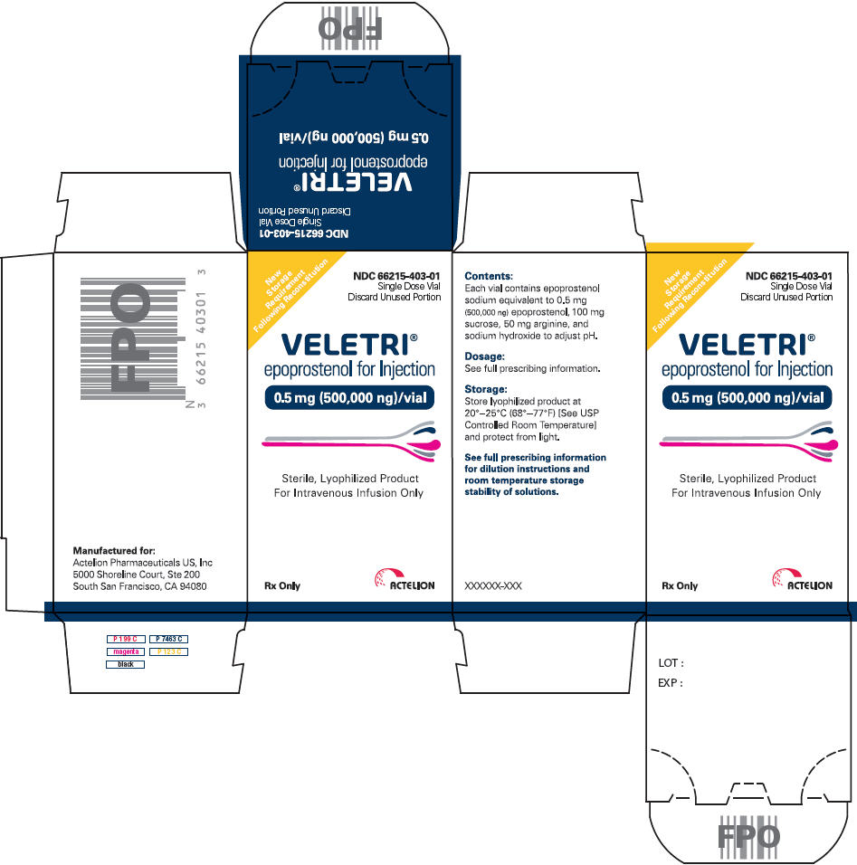

Slide 58


Slide 59
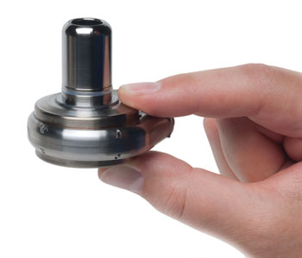

Slide 60


Slide 61

Notes:
Happy to take your quesitons

