Slide 1
Management of Atrial Fibrillation
Phillip H. Lam, M.D.
Chief Medical Resident
Medstar Georgetown University Hospital

Slide 2

Disclosure
None

Slide 3
Disclosure
None

Slide 4
Disclosure
I am not a cardiologist
General medicine perspective

Slide 5
Overview
General overview of atrial fibrillation (AF)
Epidemiology and risk factors for atrial fibrillation
Management of atrial fibrillation: Rate vs. Rhythm
Stroke prevention in atrial fibrillation

Slide 6
Overview
General overview of atrial fibrillation
Epidemiology and risk factors for atrial fibrillation
Management of new onset atrial fibrillation: Rate vs. Rhythm
Stroke prevention in atrial fibrillation

Slide 7
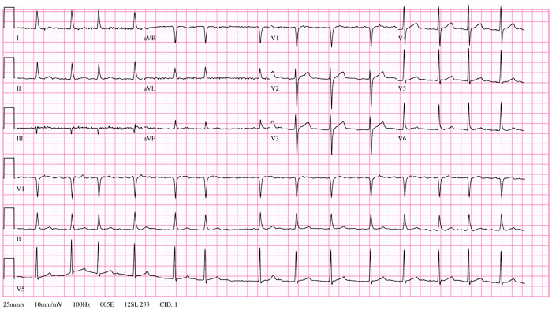

Slide 8
General Overview
Epidemiology and Risk Factors

Slide 9
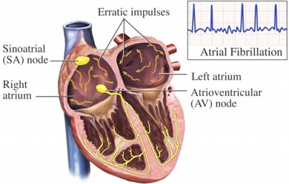
Definition
An arrhythmia caused by rapid, disorganized electrical signals firing at once in the upper chambers of the heart leading fast and irregular contractions
www.lifescript.com

Slide 10
Epidemiology
Most common sustained arrhythmia in clinical practice
Major burden on healthcare system
23 percent increase in admissions from 2003-2010
Overall prevalence in U.S. was 1%
Men > women
Increases with age
Recurrence from first episode varies
70% at one year to 90% at 4 years without therapy
Notes:
ATRIA study looking at a registry of 1.9 million Americans
9% prevalence in patients > age 50

Slide 11
Terminology
Paroxysmal AF
Spontaneously terminates or with intervention in less than 7 days
Persistent AF
Fails to self-terminate within 7 days
Long-standing persistent A-fib
Lasting >12 months
Permanent AF
Persistent where intervention no longer pursued
Notes:
Joint decision between patient and physician to stop using rhythm control methods

Slide 12

Notes:
Focus is going to be on management of the arrhythmia (new onset) rather than on semantics

Slide 13
Risk Factors
Disease associations
HTN
Valvular disease
Heart failure
Hypertrophic cardiomyopathy
VTE
Obesity – BMI >30
Hyperthyroidism
CKD
Surgery
Diabetes
Family history of AF
Lone AF

Slide 14
Symptoms
Irregular palpitations
Shortness ofbreath
Lightheadedness
Fatigue
Weakness
Dyspnea on exertion
Malaise

Slide 15
Management
New onset and long term

Slide 16
Management of new onset AF differs based on clinical setting
Factors
Hemodynamic stability
Active ischemia
Severe manifestations of heart failure
Presence of pre-excitation syndrome

Slide 17
Case presentation
66 year old male with PMH of HTN and DM presents to the ER with a 1 day history of intermittent palpitations, mild dizziness, and mild dyspnea on exertion
Exam
T 37.0C P 140 BP 145/90 R 18 SpO2 98% RA
Tachycardic, irregular rhythm
Lungs clear to ascultation
No edema of lower extremities

Slide 18
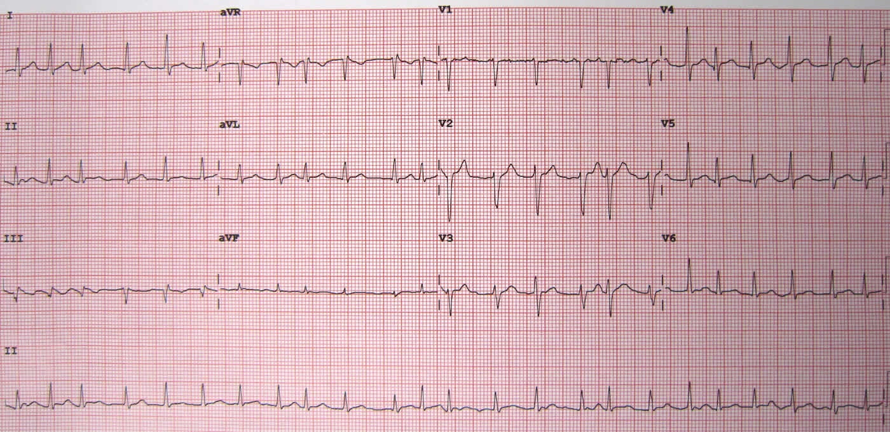

Slide 19
Atrial Fibrillation

Slide 20
What do you do now?
Chemical therapy
Electrical therapy

Slide 21
What do you do now?
Chemical therapy
Electrical therapy

Slide 22
Chemical therapy
Rate control
Rhythm control

Slide 23
Rate controlled
Beta blockers
Calcium channel blockers
Digoxin
Amiodarone

Slide 24
Beta-blockers
Metoprolol
Propranolol
Esmolol
Carvedilol
Atenolol
Nadolol

Slide 25
Calcium channel blockers
Verapamil
Diltiazem

Slide 26
Digoxin
Reserved for patients whose rate is not adequately controlled on beta-blockers or Ca-channel blockers
Given when blood pressure becomes an issue for rate controlled
Association with increased mortality?

Slide 27
TREAT-AF (2014)
Retrospective study, U.S. Dept of Veterans Affairs
28,679 patients on Digoxin for newly diagnosed, nonvalvular AF
Followed from 2004-2008
Notes:
Issue – retrospective study and the impact of digoxin levels

Slide 28
Cumulative mortality rates higher for digoxin-treated patients than for untreated patients (p<0.001)
Independent of drug adherence, renal function, and other cardiovascular co-morbidities

Slide 29
Antiarrhythmic Medications
Class IA, IC, and III agents
Class IA
Quinidine
Disopyramide
Procainamide – Accessory pathway induced arrhythmia
Class IC
Flecainide
Class III
Amiodarone
Dronadarone
Sotalol
Dofetilide

Slide 30
Antiarrhythmic Medications
Class IA, IC, and III agents
Class IA
Quinidine
Disopyramide
Procainamide – Accessory pathway induced arrhythmia
Class IC
Flecainide
Class III
Amiodarone
Dronadarone
Sotalol
Dofetilide

Slide 31
Amiodarone
Most effective antiarrhythmic drug for prevention of AF
CTAF trial (1997)
403 patients with at least one episode of a-fib randomly assigned to amiodarone, sotalol, or propafenone
Amiodarone associated with a significantly greater likelihood of being free from recurrent a-fib
No difference in mortality between the agents

Slide 32
SAFE-T trial (2005)
Randomized trial
Compared amiodarone to sotalol for conversion and maintenance of sinus rhythm from a-fib
Equally efficacious in chemical conversion form a-fib to sinus rhythm
Amiodarone superior for maintaining sinus rhythm

Slide 33
Back to the case
Management of new onset AF differs based on clinical setting
Factors
Hemodynamic stability
Active ischemia
Severe manifestations of heart failure
Presence of pre-excitation syndrome

Slide 34
If unstable, electrical cardioversion
Since patient is stable, option of rate or rhythm control

Slide 35
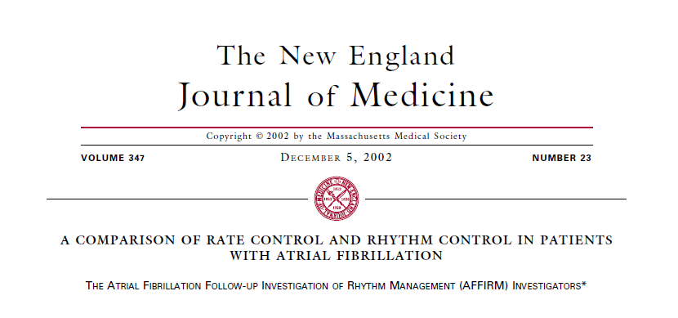

Slide 36
Multicenter, randomized-control study
4,060 patients with nonvalvular atrial fibrillation
Rate control vs. rhythm
Median follow-up: 3.5 years
Primary outcome: all-cause mortality at 5 years
Inclusion
Age ≥65 years with AF that will likely be recurrent
Long-term treat of AF warranted
Risk factors for stroke or death
Notes:
Patients move on to non-pharmacological therapy after at least two trials of either rhythm or rate control drug failure

Slide 37
Medications in the group
Rate
Rhythm
Beta-blockers
Calcium channel blockers
Digoxin
IA
qunidine, procainamide, disopyramide
IC
Flecainide, propafenone, moricizine
III
Amiodarone, sotalol, dofetilide

Slide 38
Results/Conclusions
Primary outcome
5-year mortality
25.9% vs. 26.7% (p=0.08)
Secondary outcome
More hospitalizations in rhythm control group (80.1% vs. 73%, p<0.001)
More GI events, pulmonary events, and bradycardia in rhythm control group

Slide 39
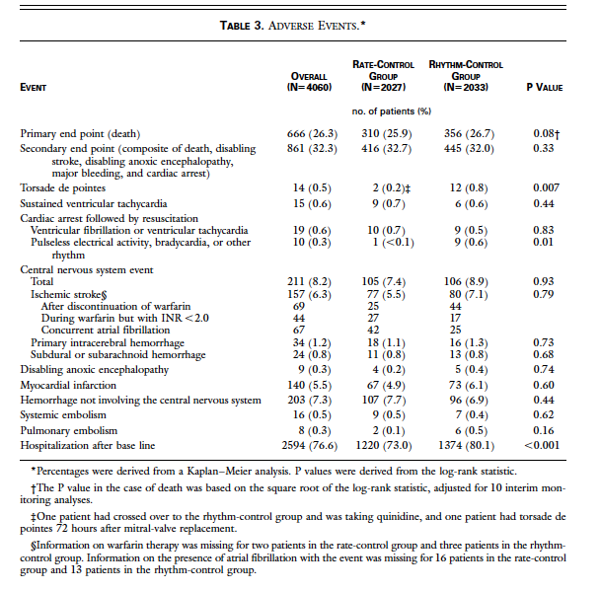

Slide 40
Recommendation
If clinically stable and HR control is necessary, rate control method preferred
Caveats
Younger symptomatic patients who may benefit from conversion to sinus rhythm

Slide 41
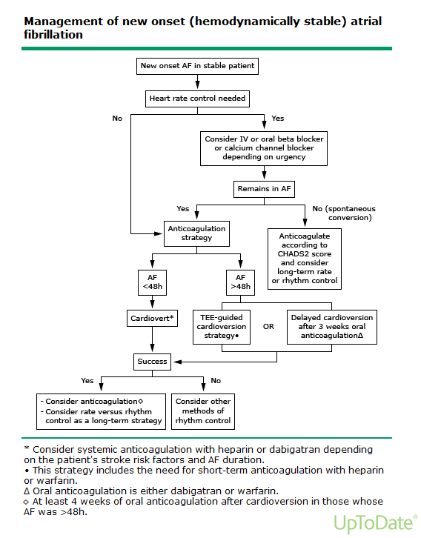
www.uptodate.com

Slide 42
Stroke Prevention

Slide 43
Embolization of atrial thrombi can occur in any form of a-fib
Chronic anticoagulation recommended in most AF patients

Slide 44
How do you decide?
CHADS2 (2001)
CHA2DS2-VASc (2009)

Slide 45
C - congestive heart failure
H - hypertension
A - Age ≥75
D - Diabetes
S2 - TIA/Stroke
0 points = aspirin
2 or more points = recommend anticoagulation

Slide 46
C – congestive heart failure
H – hypertension
A2 – age ≥75
D – diabetes
S2 – stroke/TIA
V – vascular disease (prior MI, PAD< aortic plaque)
A – age 65-74
Sc – sex category (female)

Slide 47
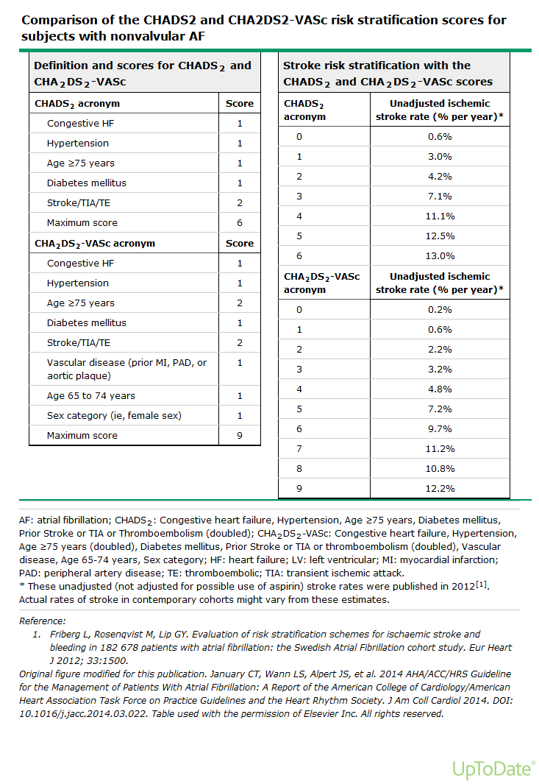
Uptodate.com

Slide 48
What types of anticoagulation are available?
Aspirin
Plavix

Slide 49
Warfarin
Dabigatran
Rivaroxaban
Apixaban

Slide 50
Warfarin
Advantages
Inexpensive
Once daily dosing
Disadvantages
Multiple interactions with food
Inadequate anticoagulation
Compliance
Dabigatran
Rivaroxaban
Apixaban

Slide 51
Warfarin
Dabigatran
Rivaroxaban
Apixaban

Slide 52
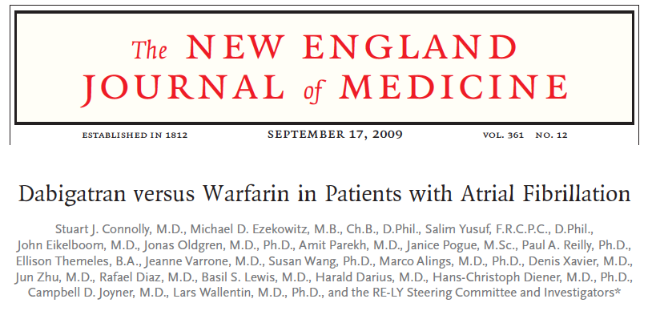

Slide 53
RE-LY
Direct thrombin inhibitor
Randomized, non-inferiority trial
951 centers, 18,113 participants
Assigned to low dose (110mg BID), high dose (150mg BID), or warfarin with INR goal of 2-3
Median follow-up: 2 years

Slide 54
Primary outcome – stroke or systemic embolism per year
1.53% (dabigatran 110mg) vs. 1.11% (dabigatran 150mg)vs. 1.69% (warfarin)
Both doses of dabigatran were non-inferior to warfarin (p<0.001)
Dabigatran 150mg superior to warfarin but dabigatran 110mg was not

Slide 55
Secondary outcomes
Major bleeding
3.36% in warfarin vs. 2.71% in dabigatran 110mg vs. 3.11% in dabigatran 150mg (p=0.003 and p=0.31 respectively)
MI
Elevated in both dabigatran groups
Etiology unknown
Increased risk of GI bleeding in 150mg dose

Slide 56
Warfarin
Dabigatran
Rivaroxaban
Apixaban

Slide 57
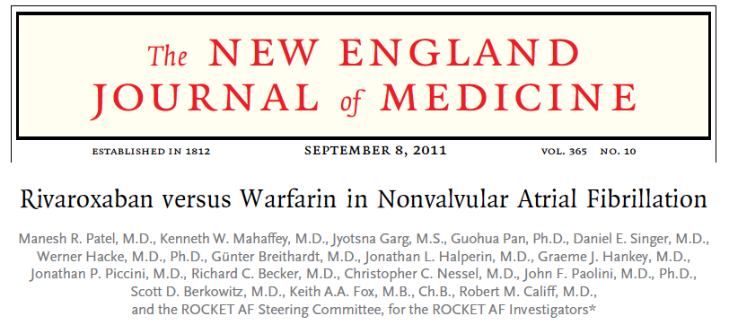

Slide 58
ROCKET-AF
Factor Xa inhibitor
Randomized, non-inferiority trial
14,264 patients with nonvalvular a-fib and at least moderate risk of stroke (mean CHADS2 of 3.5)
Randomized to rivaroxaban 20mg daily or dose-adjusted warfarin
Mean follow-up of 2 years

Slide 59
Primary outcome – stroke or systemic embolism per year
1.7% (rivaroxaban) vs. 2.2% (warfarin), p<0.001

Slide 60
Secondary outcomes
Major and non-major clinically relevant bleeding
20.7% vs. 20.3%, p=NS
Major bleeding
5.6% vs. 5.4%, p=NS

Slide 61
Warfarin
Dabigatran
Rivaroxaban
Apixaban

Slide 62
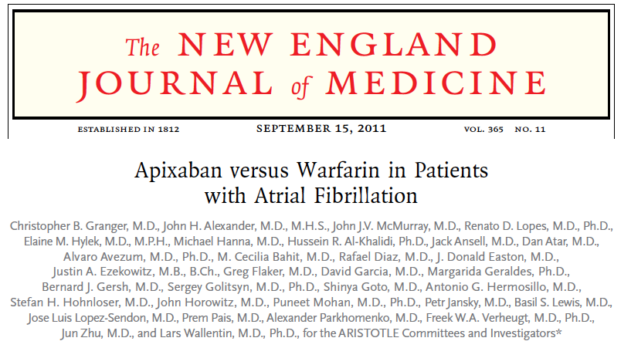

Slide 63
ARISTOTLE
Direct factor Xa inhibitor
Randomized, non-inferiority and superiority trial
18,201 patients
Randomized to apixaban 5mg BID or dose-adjusted warfarin
Median follow-up: 1.8 years

Slide 64
Primary outcome – ischemic/hemorrhagic stroke or systemic embolism
1.27% vs. 1.6% (p<0.001 for non-inferiority, p=0.01 for superiority)

Slide 65
Secondary outcomes
Major bleeding
2.13% vs. 3.09% (p<0.001 for superiority)
All cause mortality
3.52% vs. 3.94% (p=0.047 for superiority)

Slide 66
AHA/ACC/HRS AF
In patients with nonvalvular a-fib withprior stroke, TIA, or CHADS2/CHA2DS2-VASc score ≥2:
Warfarin, goal INR 2-3
Class I, level A
Dabigatran
Class I, level B
Rivaroxaban
Class I, level B
Apixaban
Class I, level B

Slide 67
Which do you choose?
Case by case selection
No standardized reversal protocol for these novel oral anticoagulants
What about those with renal disease?

Slide 68
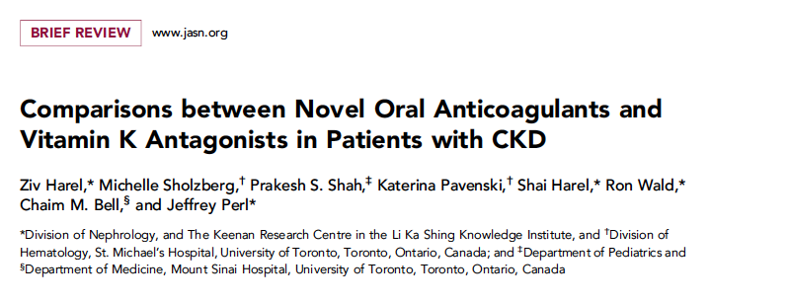

Slide 69
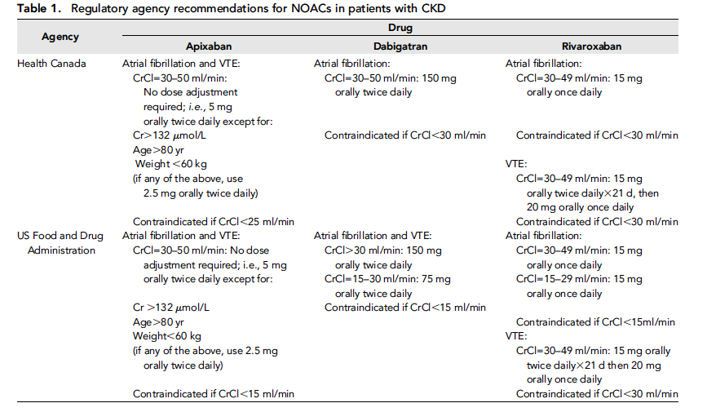

Slide 70
Study Design
Systematic review and meta-analyses of randomized control trials
8 eligible trials
RE-LY, ROCKET-AF, ARISTOTLE
Primary bleeding outcome
Major bleeding or combined bleeding

Slide 71
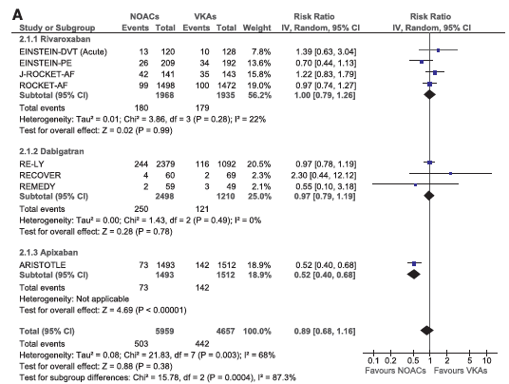

Slide 72
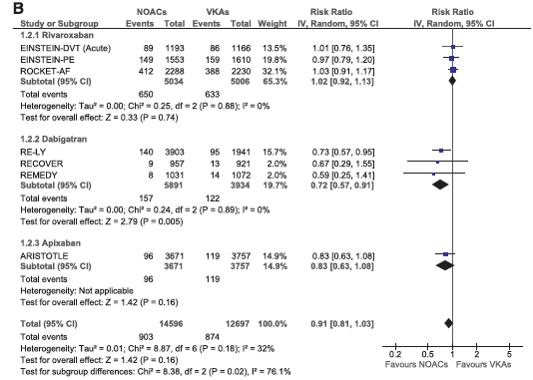

Slide 73
Summary
Management of new onset AF
If clinically stable and HR control is necessary, rate control method preferred
Caveats
Younger symptomatic patients who may benefit from conversion to sinus rhythm
Anticoagulation
Case by case selection
No standardized reversal protocol for these novel oral anticoagulants
Renal dysfunction

Slide 74

THANK YOU!

