Slide 1
Wounds and Wound Management
Jennifer Lancaster, RN, BSN, CCRN

Slide 2
Learning Objectives
1. Identify the major layers of skin and underlying tissue and describe their functions.
2. Discuss methods by which wounds can be classified.
3. Identify and describe the etiology of the following types of wounds: surgical wounds, arterial ulcers, venous ulcers, diabetic ulcers, pressure ulcers, and burns.
4. Describe the four component phases of wound healing.
5. Identify strategies to support the wound healing process.

Slide 3
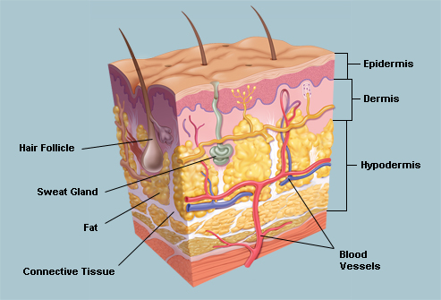
It all starts with the skin...
http://img.webmd.com/dtmcms/live/webmd/consumer_assets/site_images/articles/image_article_collections/anatomy_pages/skin.jpg
Notes:
The skin is the largest organ of the body, encompassing approximately 20 sq ft. It serves as the first line of defense from the environment and protects us from bacteria and the elements.
Skin is comprised of 3 main layers.
The epidermis, which is the outermost layer of skin provides a waterproof barrier and contains melanocytes which give us our skin tone.
The dermis, which is the second layer, contains hair follicles, connective tissue, and sweat glands.
The hypodermis contains subcutaneous fat and more connective tissue.

Slide 4
Phases of Wound Healing
Hemostasis
Inflammatory Phase
Proliferative Phase
Remodeling

Slide 5
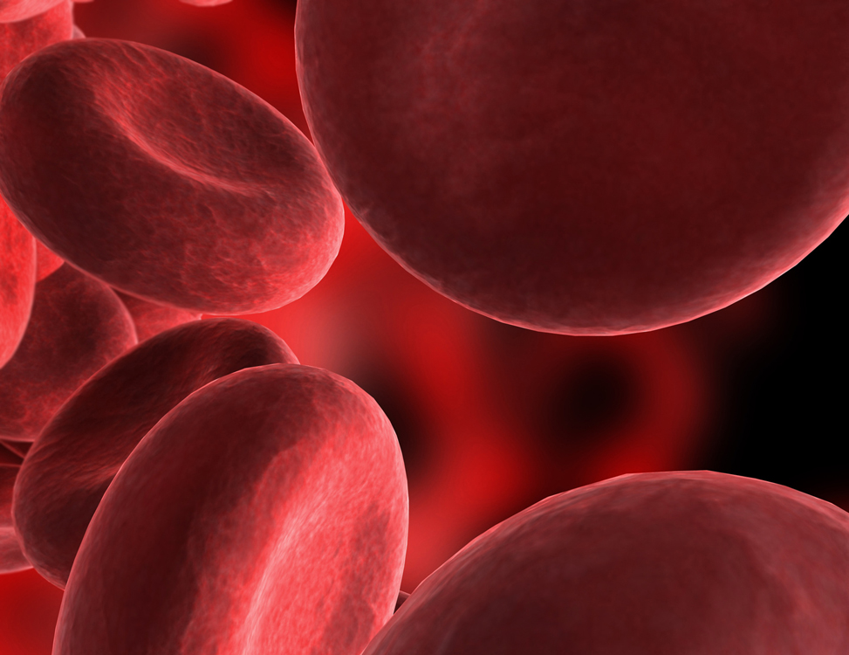
Hemostasis
Begins: Immediately from point of injury
Lasts: Minutes to hours
Characteristics: Vasoconstriction then vasodilation, activation of clotting mechanisms, clot formation
Substances involved: Platelets, ADP, Factor III, Factor VII, prothrombin, thrombin, fibrinogen, fibrin
Notes:
Damaged tissue releases factor III, which with the aid of Ca⁺⁺ will activate factor VII, thus initiating the extrinsic mechanism.
Factor XII from active platelets will activate factor XI, thus initiating the intrinsic mechanism. Both active factor VII and active factor XI will promote cascade reactions, eventually activating factor X. Active factor X, along with factor III, factor V, Ca⁺⁺, and platelet thromboplastic factor (PF₃), will activate prothrombin activator. Prothrombin activator converts prothrombin to thrombin. Thrombin converts fibrinogen to fibrin. Fibrin initially forms a loose mesh, but then factor XIII causes the formation of covalent cross links, which convert fibrin to a dense aggregation of fibers. Platelets and red blood cells become caught in this mesh of fiber, thus the formation of a blood clot.

Slide 6

Inflammatory Phase
Begins: Immediately from point of injury
Lasts: 4-6 days
Characteristics: Rubor, Calor, Tumor, Dolor
Substances involved: platelets, neutrophils, macrophages, epithelial cells, cytokines, and protein rich exudate

Slide 7

Proliferative Phase
Begins: 4-6 days post-injury
Lasts: 2-3 weeks
Characteristics: Epithelialization, granulation tissue formation, collagen synthesis, contraction

Slide 8
Remodeling Stage
Begins: 2-3 weeks post-injury
Lasts: weeks to years
Characteristics: Epithelialization, remodeling of extracellular matrix, scar maturation
Substances involved: Matrix metalloproteinases (MMPs) and tissue inhibitors of metalloproteinases (TIMPs). These must balance for healing to occur.

Slide 9
Classification of Wounds
Partial Thickness
Full Thickness
Partial thickness wounds extend into but not through the dermis
Examples: Stage I and II Pressure Ulcers, Mild abrasions, 1st and some 2nd degree burns
Full thickness wounds extend through the dermis and may involve subcutaneous tissue, connective tissue, and muscle
Examples: Stage III and IV Pressure Ulcers, some 2nd degree burns, 3rd degree burns, surgical incisions

Slide 10
Types of Acute and Chronic Wounds
Acute Wounds
Chronic Wounds
Surgical Incision
Skin Tear
Abrasion
Laceration
Pressure Ulcer
Diabetic Ulcer
Venous Ulcer
Arterial Ulcer
Acute wounds that do not progress “normally”

Slide 11
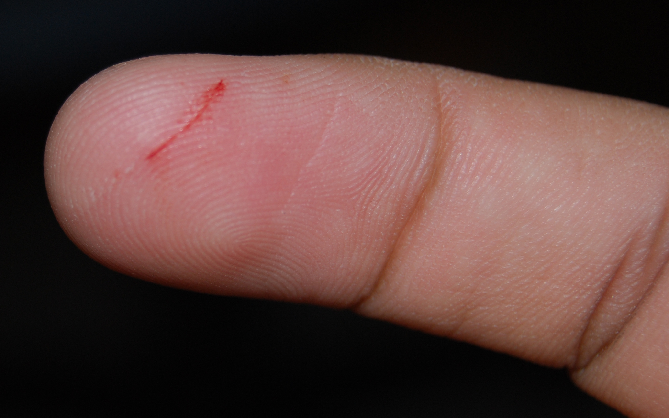
Acute Wounds
Surgical incisions, skin tears, abrasions, and lacerations
Etiology: Usually mechanical or traumatic
Healing/closure usually takes less than 21 days
“Proceed normally through an orderly and timely reparative process that results in sustained restoration of anatomic and functional integrity” (Lazarus, Cooper, Knighton, et al. 1994)

Slide 12
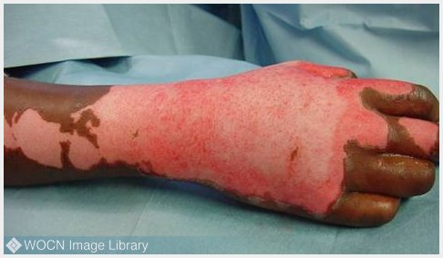
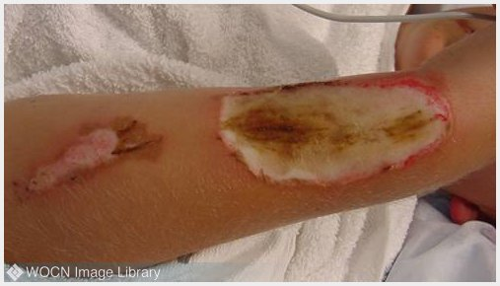
Burns
Types include chemical, electrical, thermal, and radiation
Categorized according to level of severity known as “degrees”
Treatment depends on severity and mechanism of injury. Determining depth is very important.

Slide 13
Burns by Degrees
First Degree: Superficial injury to the epidermis.
Second Degree: Can be classified as partial thickness or full thickness. Damage extends from the epidermis into the upper layer (partial thickness) or through the dermis (full thickness)
Third Degree: All layers of skin destroyed, damage extends into subcutaneous tissue.
Notes:
First degree: red, painful, sunburn without blisters, dry, heal in 3-5 days, injured epithelium peels away
Second degree:
part thick – blisters, pink/red and wet appearing, blanches when pressure applied, heals in 10-21 days without grafting, minimal scarring
Full thick – can be red or white, blanching is sluggish or absent, usually needs excision and skin grafting, painful but sensation can be
Diminished
Third – appear black, white, dry, leathery texture, non-blanchable color, may have little or no pain due to nerve damage, take months to heal small areas, significant scarring, large areas may require grafting

Slide 14
Chronic Wounds
Venous ulcers, arterial ulcers, diabetic ulcers, pressure ulcers
Acute wounds that fail to progress. These wounds usually stall in the proliferative phase.
May scar and reopen
Can cause functional deficits
Require a multidisciplinary approach to treatment

Slide 15
Why Wounds Become Chronic
Infection
Nutritional deficits
Retained foreign objects
Necrotic tissue
Anti-Inflammatory medication
Smoking
Hypoxia
Metabolic disorders
Immunosuppressive conditions
Pressure
Excessive Moisture

Slide 16
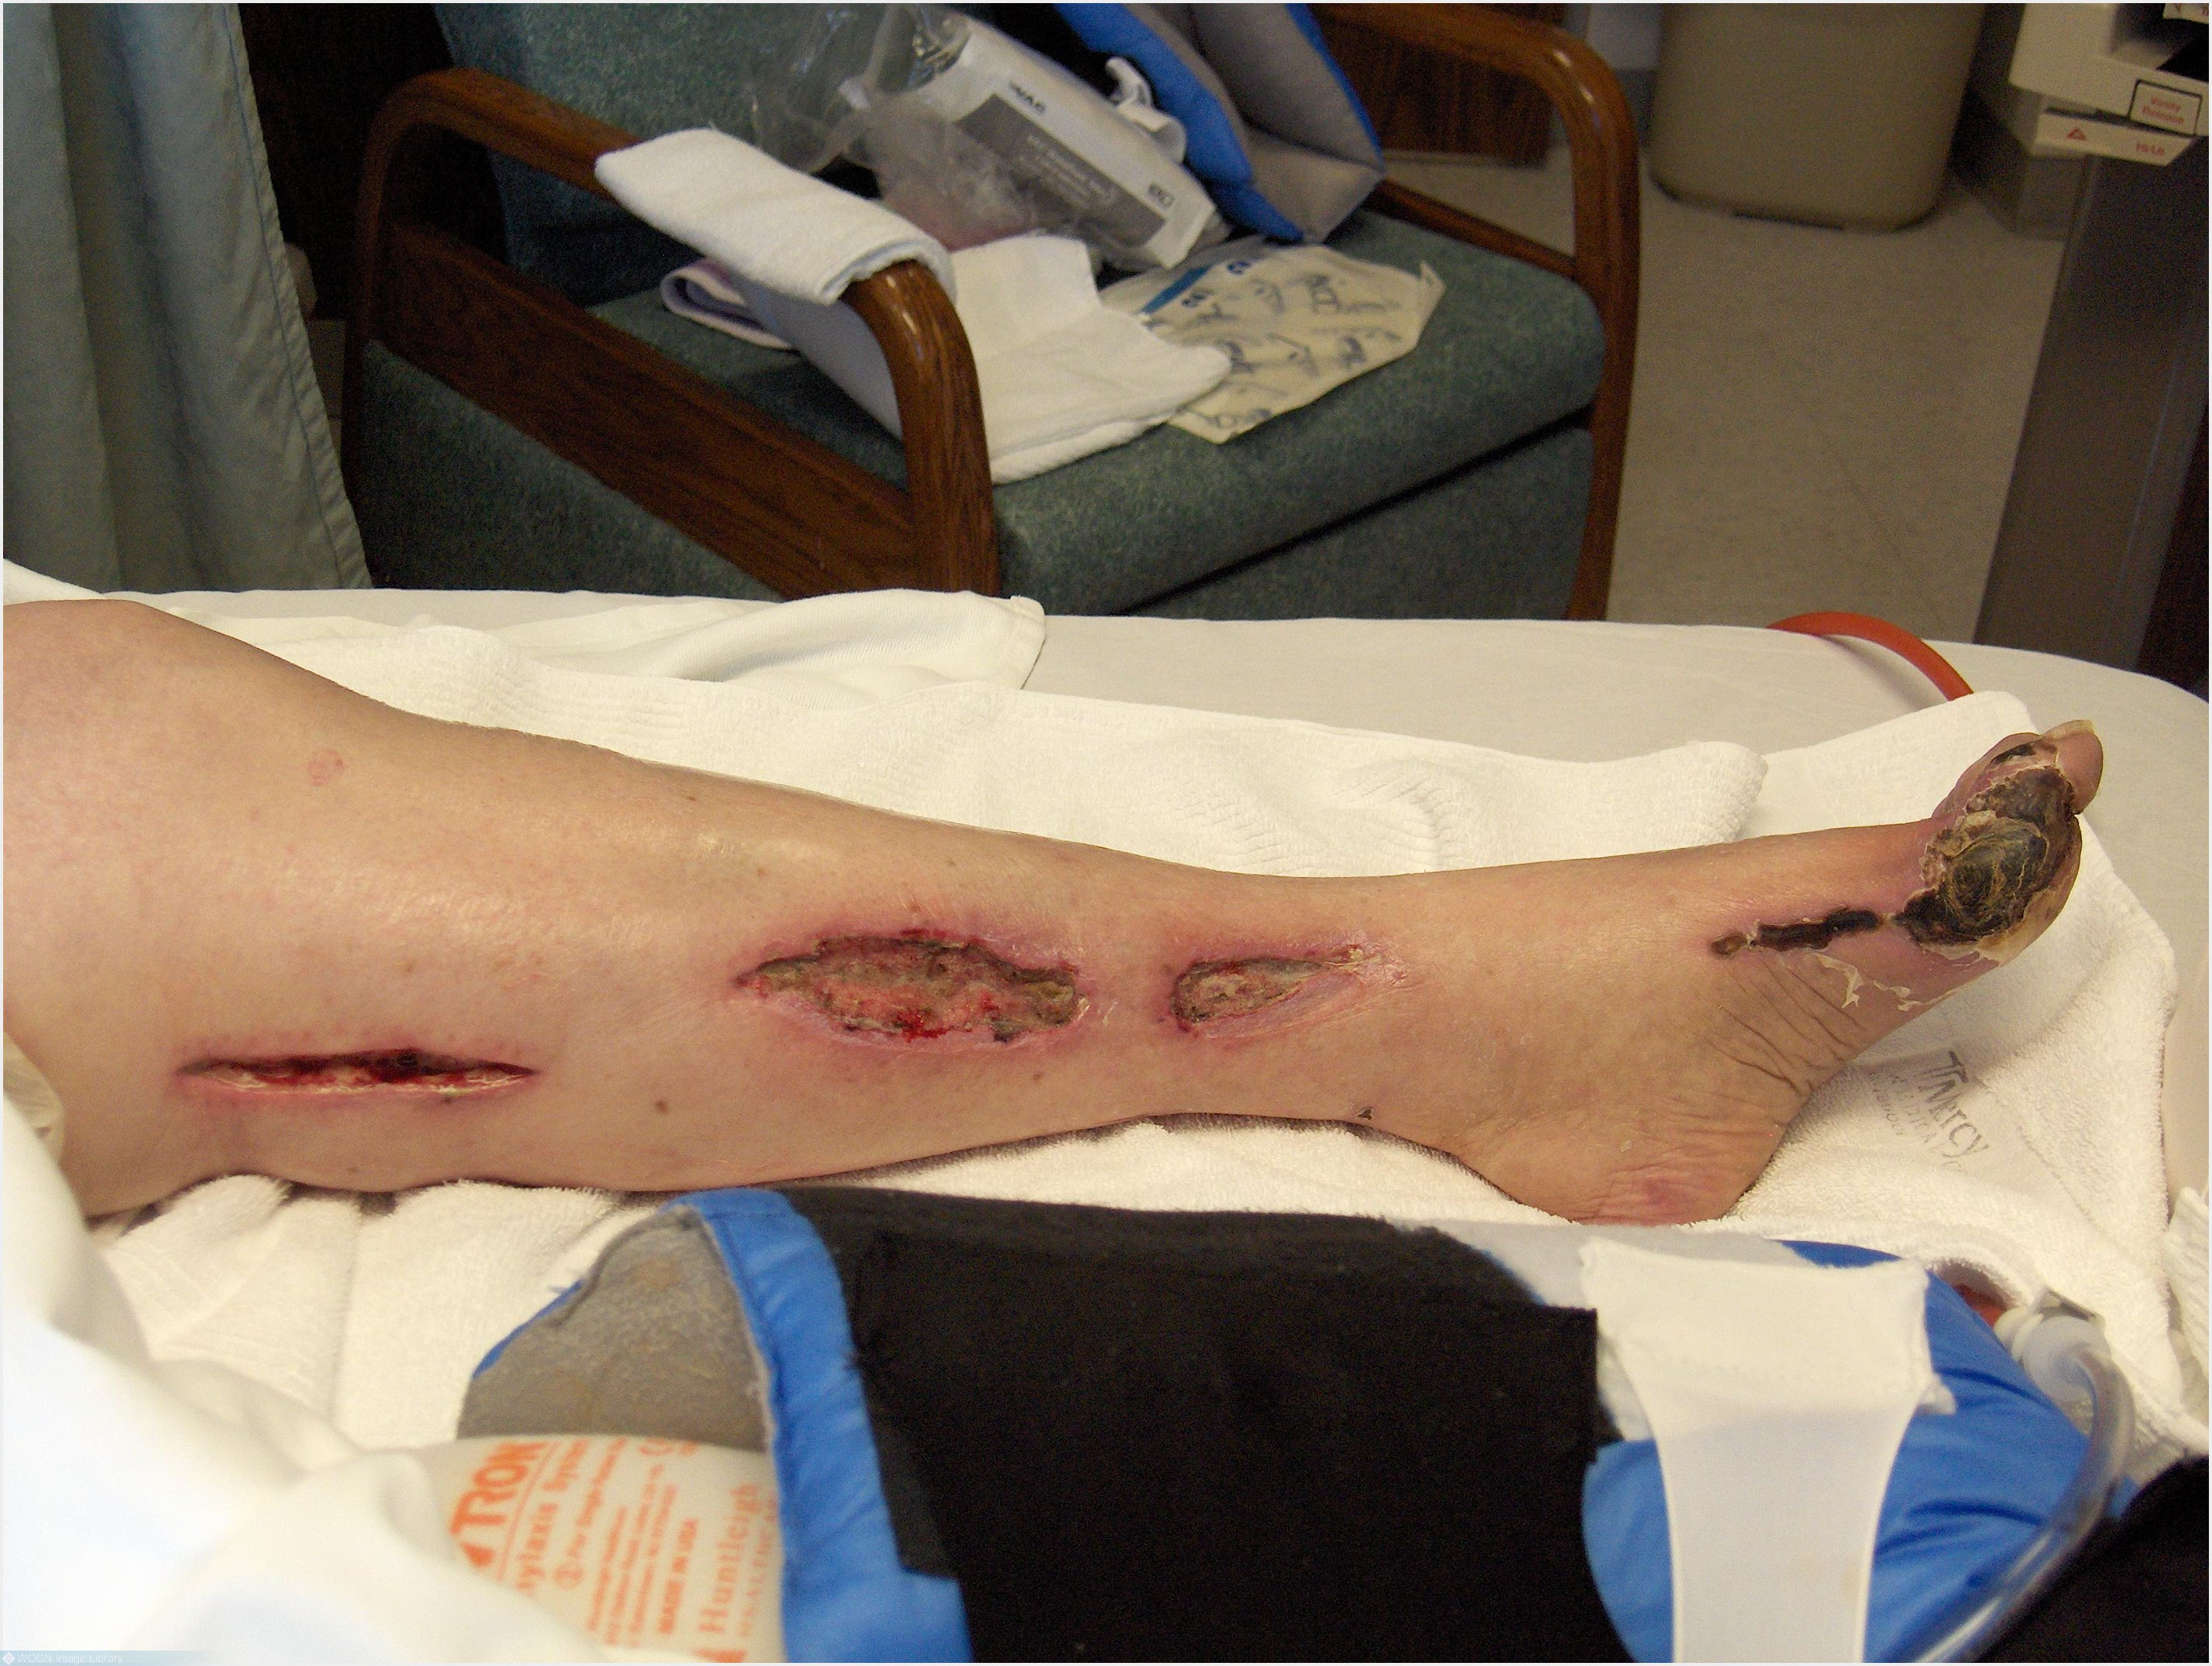
Arterial Ulcers
Caused by ischemia in conjunction with pressure or trauma
Surrounding skin is dry, shiny, taut
Wound bed is yellow, brown, gray, or black
Rounded shape
“Punched out” appearance
Affected extremity is cool or cold to touch
Presence of eschar, can progress to wet gangrene
Painful

Slide 17
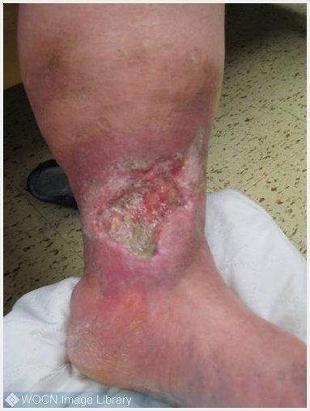
Venous Ulcers
Caused by venous hypertension resulting in venous stasis
Usually have Irregular borders
Moist wound bed
May have significant exudate
Wound base is beefy red
Presence of yellow/brown slough on surface
Treatment: Specialized dressings to absorb exudate, compression with wraps or stockings, surgical or chemical debridement

Slide 18
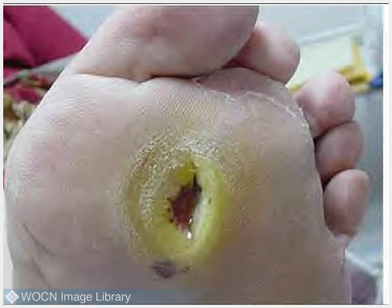
Diabetic Ulcers
Caused by diabetic neuropathy in conjunction with trauma or pressure
Located on the plantar surface or bony prominences of the foot
Wound base is normally pinkish-red
“Punched out” appearance
Surrounded by callus
Treatment: Localized debridement, r/o osteomyelitis, specialized footwear, contact casting, optimizing diabetic control, may be non-weight bearing

Slide 19
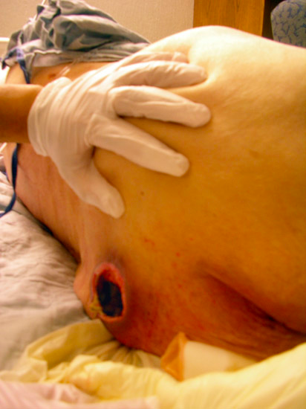
Pressure Ulcers
A pressure ulcer is localized injury to the skin and/or underlying tissue usually over a bony prominence, as a result of pressure, or pressure in combination with shear. (NPUAP/EPUAP, 2007)
Notes:
Shear is a combo of friction and gravity: a patient sliding down in bed because the HOB is elevated too high
Friction is created when the patient is slid back up and the skin rubs against the sheets “sheet burn”

Slide 20
Pressure Ulcer Staging (NPUAP, 2007)
Stage I: Non-blanchable erythema
Stage II: Partial thickness loss of dermis or fluid filled blister
Stage III: Full thickness loss of tissue extending into subcutaneous tissue. Prone to undermining, tunneling, and tissue necrosis.
Stage IV: Full thickness loss of tissue with exposed tendon, bone, and/or muscle. Prone to undermining, tunneling, and tissue necrosis.
Notes:
Category/Stage I: Non-blanchable erythema
Intact skin with non-blanchable redness of a localized area usually over a bony prominence. Dark skin may not blanch but may appear discolored;. The area may be painful, firm, soft, warmer or cooler as compared to adjacent tissue
Category/Stage II: Partial thickness
Shouldn’t be used to describe skin tears, tape burns, incontinence associated dermatitis, maceration or excoriation.
*Bruising indicates deep tissue injury.
Category/Stage III: Full thickness skin loss
Full thickness tissue loss. Subcutaneous fat may be visible but bone, tendon or muscle are not exposed. Slough may be present but does not obscure the depth of tissue loss. May include undermining and tunneling. The depth of a Category/Stage III pressure ulcer varies by anatomical location. The bridge of the nose, ear, occiput and malleolus do not have (adipose) subcutaneous tissue and Category/Stage III ulcers can be shallow. In contrast, areas of significant adiposity can develop extremely deep Category/Stage III pressure ulcers. Bone/tendon is not visible or directly palpable.
Category/Stage IV: Full thickness tissue loss
Full thickness tissue loss with exposed bone, tendon or muscle. Slough or eschar may be present. Often includes undermining and tunneling. The depth of a Category/Stage IV pressure ulcer varies by anatomical location. The bridge of the nose, ear, occiput and malleolus do not have (adipose) subcutaneous tissue and these ulcers can be shallow. Category/Stage IV ulcers can extend into muscle and/or supporting structures (e.g., fascia, tendon or joint capsule) making osteomyelitis or osteitis likely to occur. Exposed bone/muscle is visible or directly palpable.

Slide 21
Not all pressure ulcers have stages…
Suspected Deep Tissue Injury (SDTI): Purple or maroon localized area of discolored intact skin or blood-filled blister due to damage of underlying soft tissue from pressure and/or shear.
Unstageable: Full thickness tissue loss with the wound bed obscured by necrotic tissue (eschar or slough).
Notes:
Deep Tissue Injury: The area may be preceded by tissue that is painful, firm, mushy, boggy, warmer or cooler as compared to adjacent tissue. Deep tissue injury may be difficult to detect in individuals with dark skin tones. Evolution may include a thin blister over a dark wound bed. The wound may further evolve and become covered by thin eschar. Evolution may be rapid exposing additional layers of tissue even with optimal treatment.
Unstageable: Full thickness tissue loss in which actual depth of the ulcer is completely obscured by slough (yellow, tan, gray, green or brown) and/or eschar (tan, brown or black) in the wound bed. Until enough slough and/or eschar are removed to expose the base of the wound, the true depth cannot be determined; but it will be either a Category/Stage III or IV. Stable (dry, adherent, intact without erythema or fluctuance) eschar on the heels serves as “the body’s natural (biological) cover” and should not be removed

Slide 22
Pressure Ulcer Risk Factors
Immobility
Altered Mental Status
Incontinence
Malnutrition
Poor Circulation
Illness
Age
Notes:
Shear is a combo of friction and gravity: a patient sliding down in bed because the HOB is elevated too high
Friction is created when the patient is slid back up and the skin rubs against the sheets “sheet burn”

Slide 23
Copyright Barbara Braden and Nancy Bergstrom, 1988. Reprinted with Permission. All rights reserved.

Slide 24
Treatment Options Abound…
Gauze
Foams
Alginates/Hydrofiber
Hydrogel
Transparent films
Contact layers
Antimicrobials
Collagenase
Silver gel
Silver alginates
Povidone-Iodine
Dakin’s solution
Acetic acid solution
Negative pressure therapy
Sharp debridement
Bioengineered skin equivalents

Slide 25
Why is this important?
Chronic wounds can lead to serious infections, gangrene, disability, amputation, and even loss of life due to complications.
Approximately 6.5 million Americans suffer from chronic wounds. (Sen, Gordillo, Roy, et al 2009)
Every year, more than 82,000 people with diabetes have amputations. The risk of leg amputation is estimated to be 15 to 40 times greater in persons with diabetes.
An estimated excess of US $25 billion is spent annually on treatment of chronic wounds and the burden is rapidly growing due to increasing health care costs, an aging population and a sharp rise in the incidence of diabetes and obesity worldwide. (Sen, et al 2009)

Slide 27
For More Information…
Wound Ostomy and Continence Nurses Society http://www.wocn.org/
National Database of Nursing Quality Indicators (NDNQI) Free Pressure Ulcer Training http://www.nursingquality.org
The Wound Institute http://www.thewoundinstitute.com/

