Slide 1
Hepatitis C, Then and Now
Samuel J. Kallus, MD
Chief Resident in Quality Improvement and Patient Safety
Medstar Georgetown University Hospital / VA Medical Center
Department of Internal Medicine

Slide 2
Disclosures
Nothing to disclose. I do not, nor have I ever, received monetary compensation from any pharmaceutical company

Slide 3
Objectives
Review the burden of hepatitis C virus (HCV) infection
Understand Virology of HCV
Learn old and new treatment regimens for HCV genotype 1 infection

Slide 4
Epidemiology
Worldwide, HCV infects 170 million people^{1,2}
1.6% of the US population (3.2-5 million people) have been exposed to HCV^{1,2}
Chronic HCV infection leads to cirrhosis and/or hepatocellular carcinoma
Currently, the sequelae of HCV infection are the leading indications for liver transplantation in the United States and in Europe³
Notes:
Prevalence of HIV (2009) 1.1 million people

Slide 5
At Risk Populations
Intravenous drug users (responsible for an estimated 68% of new cases of HCV infection)⁴
People born between 1945 and 1965 (USPSTF recommendation as of 2013)
Recipients of blood transfusions prior to 1992⁵
Greater than 50 lifetime sexual partners
Income below the poverty line
History of incarceration

Slide 6

Transmission
Percutaneous
  Injection drug use
  Blood transfusion
  Needle stick inoculation
Non-percutaneous
  Perinatal exposure
  Sexual contact

Slide 7
Hepatitis C Classification
Single stranded RNA virus belonging to the Flaviviridae family; genus hepacivirus
HCV is an enveloped virus 50 nm in diameter
Envelope made up of two proteins, E1 and E2.
The RNA encodes for one large viral polypeptide that is then further processed
Major site of viral replication is the hepatocyte

Slide 8
Virology
The next slides review the viral life cycle of the hepatitis C virus
It is important to understand this aspect of virology as a lot of the proteins involved in transcription, translation and processing are targeted by current therapies

Slide 9
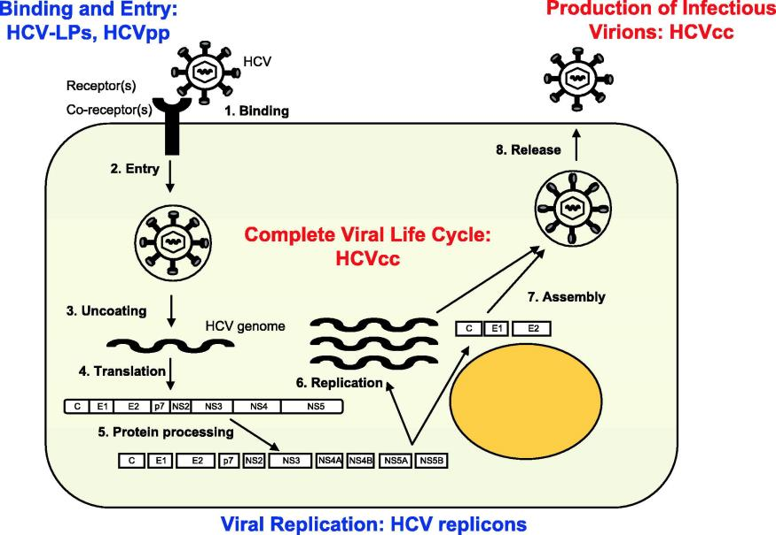

Fig. 1
Journal of Hepatology 2006 44, 436-439DOI: (10.1016/j.jhep.2005.11.031)
Copyright © 2005 European Association for the Study of the Liver Terms and Conditions
Notes:
Putative HCV life cycle and HCV model systems. HCV binding to a cell surface receptor complex leads to viral entry into host cell. In the cytoplasm, HCV genomic RNA functions as a template for HCV polyprotein translation. This polyprotein is then processed into structural (core (C), envelope proteins E1 and E2) and non-structural proteins (NS2 to NS5B). RNA-dependent RNA polymerase (NS5B) allows HCV genome replication. Replication occurs within cytoplasmic, membrane-associated replication complexes. Replicon-based systems [8] have allowed the elucidation and dissection of the viral replication complex. The new HCV tissue culture model system [10–12] resulting in the production of cell culture-derived HCV (HCVcc) finally allows the study of all aspects of the HCV life cycle including viral attachment, entry, trafficking, replication, assembly and release. [This figure appears in colour on the web.]

Slide 10
Binding
Envelope proteins (E1 and E2) attach to cell surface molecules to facilitate cell entry
Once HCV attaches to the cell, endocytosis of the virus particle occurs

Slide 11
Fig. 1
Journal of Hepatology 2006 44, 436-439DOI: (10.1016/j.jhep.2005.11.031)
Copyright © 2005 European Association for the Study of the Liver Terms and Conditions
Notes:
Putative HCV life cycle and HCV model systems. HCV binding to a cell surface receptor complex leads to viral entry into host cell. In the cytoplasm, HCV genomic RNA functions as a template for HCV polyprotein translation. This polyprotein is then processed into structural (core (C), envelope proteins E1 and E2) and non-structural proteins (NS2 to NS5B). RNA-dependent RNA polymerase (NS5B) allows HCV genome replication. Replication occurs within cytoplasmic, membrane-associated replication complexes in a perinuclear membranous web (not shown). Progeny genomes assemble with structural proteins into HCV particles which are subsequently released from the cell. HCV-like particles (HCV-LPs) [3,5] and retroviral HCV pseudotypes (HCVpp) [6,7] have been used to analyze virus binding and entry. Replicon-based systems [8] have allowed the elucidation and dissection of the viral replication complex. The new HCV tissue culture model system [10–12] resulting in the production of cell culture-derived HCV (HCVcc) finally allows the study of all aspects of the HCV life cycle including viral attachment, entry, trafficking, replication, assembly and release. [This figure appears in colour on the web.]

Slide 12
Fusion and Un-coating
The pH drop with endocytosis leads to fusion of the viral and cellular membranes, releasing viral RNA into the cytoplasm
The 5’ untranslated region (UTR) of the RNA directs the RNA to its docking site on the endoplasmic reticulum

Slide 13
Fig. 1
Journal of Hepatology 2006 44, 436-439DOI: (10.1016/j.jhep.2005.11.031)
Copyright © 2005 European Association for the Study of the Liver Terms and Conditions
Notes:
Putative HCV life cycle and HCV model systems. HCV binding to a cell surface receptor complex leads to viral entry into host cell. In the cytoplasm, HCV genomic RNA functions as a template for HCV polyprotein translation. This polyprotein is then processed into structural (core (C), envelope proteins E1 and E2) and non-structural proteins (NS2 to NS5B). RNA-dependent RNA polymerase (NS5B) allows HCV genome replication. Replication occurs within cytoplasmic, membrane-associated replication complexes in a perinuclear membranous web (not shown). Progeny genomes assemble with structural proteins into HCV particles which are subsequently released from the cell. HCV-like particles (HCV-LPs) [3,5] and retroviral HCV pseudotypes (HCVpp) [6,7] have been used to analyze virus binding and entry. Replicon-based systems [8] have allowed the elucidation and dissection of the viral replication complex. The new HCV tissue culture model system [10–12] resulting in the production of cell culture-derived HCV (HCVcc) finally allows the study of all aspects of the HCV life cycle including viral attachment, entry, trafficking, replication, assembly and release. [This figure appears in colour on the web.]

Slide 14
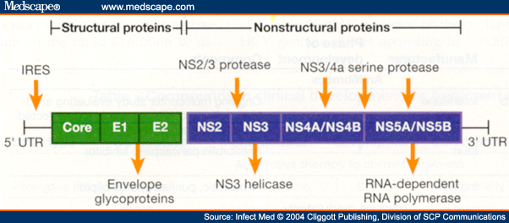
Translation
At the Endoplasmic Reticulum, HCV RNA is translated into a large polyprotein
The large polyprotein is processed proteolytically into 11 viral proteins consisting of structural and non-structural components
Structural proteins include: nucleocapsid (C), envelope 1 (E1), envelope 2 (E2)
Non-structural proteins include: NS2, NS3, NS4A, NS4B, NS5A and NS5B

Slide 15
Fig. 1
Journal of Hepatology 2006 44, 436-439DOI: (10.1016/j.jhep.2005.11.031)
Copyright © 2005 European Association for the Study of the Liver Terms and Conditions
Notes:
Putative HCV life cycle and HCV model systems. HCV binding to a cell surface receptor complex leads to viral entry into host cell. In the cytoplasm, HCV genomic RNA functions as a template for HCV polyprotein translation. This polyprotein is then processed into structural (core (C), envelope proteins E1 and E2) and non-structural proteins (NS2 to NS5B). RNA-dependent RNA polymerase (NS5B) allows HCV genome replication. Replication occurs within cytoplasmic, membrane-associated replication complexes in a perinuclear membranous web (not shown). Progeny genomes assemble with structural proteins into HCV particles which are subsequently released from the cell. HCV-like particles (HCV-LPs) [3,5] and retroviral HCV pseudotypes (HCVpp) [6,7] have been used to analyze virus binding and entry. Replicon-based systems [8] have allowed the elucidation and dissection of the viral replication complex. The new HCV tissue culture model system [10–12] resulting in the production of cell culture-derived HCV (HCVcc) finally allows the study of all aspects of the HCV life cycle including viral attachment, entry, trafficking, replication, assembly and release. [This figure appears in colour on the web.]

Slide 16
Protein Processing
The NS2 cysteine protease auto-catalytically cleaves itself from the polyprotein.
The NS3 protease cleaves the remainder of the nonstructural proteins
NS3 is a serine protease and RNA helicase
NS4A is an NS3 protease cofactor
NS4B, NS5A (RNA binding site), and NS5B (RNA-dependent RNA polymerase).

Slide 17
Fig. 1
Journal of Hepatology 2006 44, 436-439DOI: (10.1016/j.jhep.2005.11.031)
Copyright © 2005 European Association for the Study of the Liver Terms and Conditions
Notes:
Putative HCV life cycle and HCV model systems. HCV binding to a cell surface receptor complex leads to viral entry into host cell. In the cytoplasm, HCV genomic RNA functions as a template for HCV polyprotein translation. This polyprotein is then processed into structural (core (C), envelope proteins E1 and E2) and non-structural proteins (NS2 to NS5B). RNA-dependent RNA polymerase (NS5B) allows HCV genome replication. Replication occurs within cytoplasmic, membrane-associated replication complexes in a perinuclear membranous web (not shown). Progeny genomes assemble with structural proteins into HCV particles which are subsequently released from the cell. HCV-like particles (HCV-LPs) [3,5] and retroviral HCV pseudotypes (HCVpp) [6,7] have been used to analyze virus binding and entry. Replicon-based systems [8] have allowed the elucidation and dissection of the viral replication complex. The new HCV tissue culture model system [10–12] resulting in the production of cell culture-derived HCV (HCVcc) finally allows the study of all aspects of the HCV life cycle including viral attachment, entry, trafficking, replication, assembly and release. [This figure appears in colour on the web.]

Slide 18
Replication
Replication occurs via formation of a replication complex, which consists of NS2, NS3, NS4A, NS4B, NS5A, and NS5B
HCV replication is catalyzed by the NS5B RNA-dependent RNA polymerase
The genomic RNA serves as a template for the production of numerous strands of RNA of positive polarity that are packaged into new virus particles

Slide 19
Fig. 1
Journal of Hepatology 2006 44, 436-439DOI: (10.1016/j.jhep.2005.11.031)
Copyright © 2005 European Association for the Study of the Liver Terms and Conditions
Notes:
Putative HCV life cycle and HCV model systems. HCV binding to a cell surface receptor complex leads to viral entry into host cell. In the cytoplasm, HCV genomic RNA functions as a template for HCV polyprotein translation. This polyprotein is then processed into structural (core (C), envelope proteins E1 and E2) and non-structural proteins (NS2 to NS5B). RNA-dependent RNA polymerase (NS5B) allows HCV genome replication. Replication occurs within cytoplasmic, membrane-associated replication complexes in a perinuclear membranous web (not shown). Progeny genomes assemble with structural proteins into HCV particles which are subsequently released from the cell. HCV-like particles (HCV-LPs) [3,5] and retroviral HCV pseudotypes (HCVpp) [6,7] have been used to analyze virus binding and entry. Replicon-based systems [8] have allowed the elucidation and dissection of the viral replication complex. The new HCV tissue culture model system [10–12] resulting in the production of cell culture-derived HCV (HCVcc) finally allows the study of all aspects of the HCV life cycle including viral attachment, entry, trafficking, replication, assembly and release. [This figure appears in colour on the web.]

Slide 20
Viral Particle Formation
Within the endoplasmic reticulum, the core protein interacts with the viral RNA forming the viral particle

Slide 21
Fig. 1
Journal of Hepatology 2006 44, 436-439DOI: (10.1016/j.jhep.2005.11.031)
Copyright © 2005 European Association for the Study of the Liver Terms and Conditions
Notes:
Putative HCV life cycle and HCV model systems. HCV binding to a cell surface receptor complex leads to viral entry into host cell. In the cytoplasm, HCV genomic RNA functions as a template for HCV polyprotein translation. This polyprotein is then processed into structural (core (C), envelope proteins E1 and E2) and non-structural proteins (NS2 to NS5B). RNA-dependent RNA polymerase (NS5B) allows HCV genome replication. Replication occurs within cytoplasmic, membrane-associated replication complexes in a perinuclear membranous web (not shown). Progeny genomes assemble with structural proteins into HCV particles which are subsequently released from the cell. HCV-like particles (HCV-LPs) [3,5] and retroviral HCV pseudotypes (HCVpp) [6,7] have been used to analyze virus binding and entry. Replicon-based systems [8] have allowed the elucidation and dissection of the viral replication complex. The new HCV tissue culture model system [10–12] resulting in the production of cell culture-derived HCV (HCVcc) finally allows the study of all aspects of the HCV life cycle including viral attachment, entry, trafficking, replication, assembly and release. [This figure appears in colour on the web.]

Slide 22
Release
Once the viral genome and envelope are formed, the viral particle is released from the cell
Following release, viral particles may infect adjacent hepatocytes or enter the circulation, where they are available for infection of another cell or host
HCV viral packaging and release are inefficient as much of the virus remains in the infected cell

Slide 23
Polypeptide Components: E1 and E2
Mediate cell entry by binding to surface receptors
Responsible for fusion between the host cell membrane and the viral envelope
Evade antibody mediated immune response via the proximal amino acid portion of E2 which makes up the hypervariable region (high frequency of mutations)

Slide 24
Polypeptide Components: NS3
Cleaves the polypeptide to form NS4A, NS4B, NS5A and NS5B
Binds with NS4A to enhance its function
Cleaves/destroys Cardif and TRIF, which impairs host response to HCV infection by blocking interferon secretion
Functions as a helicase (unwinds viral RNA and host DNA)

Slide 25
Polypeptide Components: NS4A
Stabilizes helicase (with NS3)
Anchors the replication complex to the endoplasmic reticulum membrane

Slide 26
Polypeptide Components: NS5A
Essential for viral replication by providing an RNA binding site within the replication complex
Inhibits apoptosis (programmed cell death) of the infected cell

Slide 27
Polypeptide Components: NS5B
Is the viral RNA-dependent RNA polymerase, which synthesizes HCV RNA genome

Slide 28
Treatment of HCV
Interferon
Interferon + Ribavirin
Interferon + Ribavirin + Protease Inhibitor (Victerelis and Incivek)
Interferon + Ribavirin + Simeprivir (Olysio) or Sofosbuvir (Sovaldi)
Ledipisvir + Sofosbuvir (Harvoni)

Slide 29
Treatment Goals
SVR 24 – sustained virologic response
  An undetectable HCV-RNA level 24 weeks after completion of treatment
SVR 12 – sustained virologic response
  An undetectable HCV-RNA level 12 weeks after completion of treatment

Slide 30
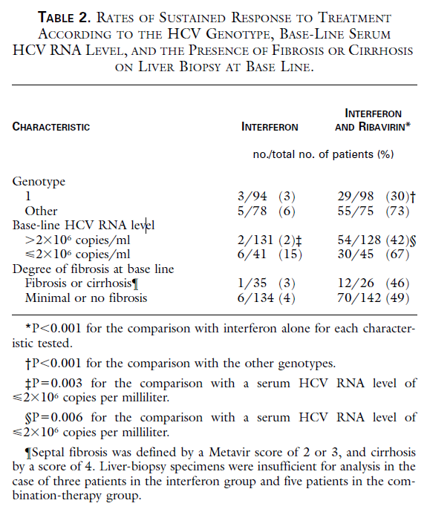
Treatment of HCV
Interferon + Ribavirin
The study was a double-blind, placebo-controlled trial
Patients either received 48 weeks of interferon + placebo OR 48 weeks of interferon + ribavirin
only 3% of patients with hepatitis C who were treated with interferon alone achieved SVR
30% of patients with hepatitis C treated with interferon and ribavirin achieved SVR
This was the standard of care until May 2011
Davis et al. Interferon Alfa-2b Alone or in Combination with Ribavirin for the Treatment of Relapse of Chronic Hepatitis C
N Engl J Med 1998; 339:1493-1499 November 19, 1998

Slide 31
Interferon and Ribavirin (FDA approved in 1998)
Interferon
  Anti-viral activity
  Angiogenesis inhibition
  Enhancement of MHC (major histocompatibility complex) antigen expression
Ribavirin
  Inhibits replication of RNA and DNA viruses
  Nucleoside analogue of guanosine, which acts as an inhibitor of the viral polymerase. Since viral polymerases utilize intracellular nucleotides to replicate their genome, ribavirin triphosphate would be recognized by the viral polymerase and either inhibit subsequent elongation or prevent the binding of other endogenous nucleotides necessary for the completion of genome replication⁶
  “Error Catastrophe” - ribavirin can base pair with both cytosine and uracil and subsequently drive an increasing number of mutations in the HCV genome, ultimately resulting in the production of less fit viruses⁷

Slide 32
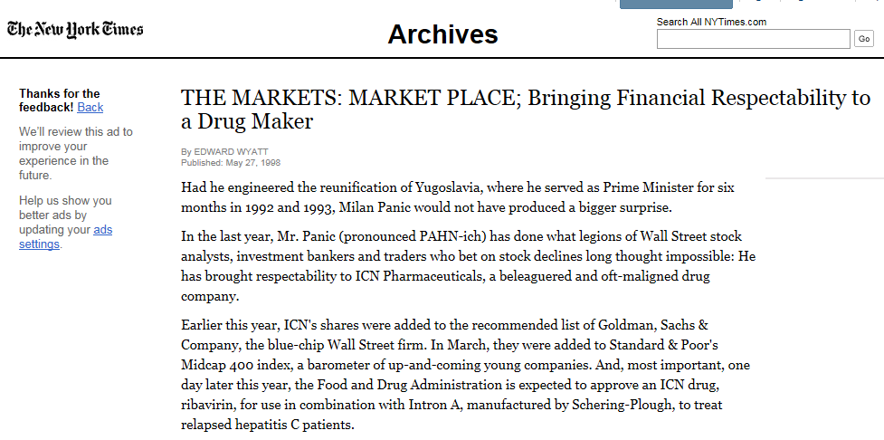
Notes:
Also made Claritin

Slide 33
Treatment of HCV
Interferon x 48 wks (1990-1997) SVR = 7-11%
INF + RBV x 48 wks (1998-2011) SVR = 28-40%

Slide 34
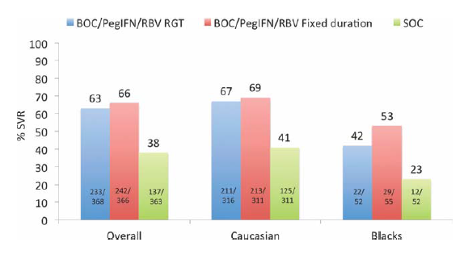
Treatment of HCV
Interferon + Ribavirin + Protease Inhibitor
With the addition of Boceprevir (PI), SVR rates were 63-66% in treatment naïve patients with HCV genotype 1
Boceprevir treatment in prior relapsers and partial responders was 59-66%
Poordad F, McCone JJr, Bacon BR, Bruno S, Manns MP, Sulkowski MS, et al.; for SPRINT-,2 Investigators. Boceprevir for untreated chronic HCV genotype 1 infection. N Engl J Med 2011;364: 1195-1206.
Bacon BR, Gordon SC, Lawitz E, Marcellin P, Vierling JM, Zeuzem S, et al.; for HCV RESPOND-,2 Investigators. Boceprevir for previously treated chronic HCV genotype 1 infection. N Engl J Med 2011;364:1207-1217.
Notes:
Fig. 1. Sustained virological response (SVR) rates, overall and
according to race, in treatment-naı ¨ve patients with genotype 1 chronic
HCV infection: Boceprevir (BOC) plus peginterferon (PegIFN) and ribavirin
(RBV) versus standard of care (SOC). All patients were first
treated with PegIFN þ RBV for 4 weeks as lead-in therapy followed by
one of three regiments: (1) BOC/PegIFN/RBV RGT - triple therapy for
24 weeks provided HCV RNA levels were negative weeks 8 thorugh
24 – response guided therapy; those with a detectable HCV RNA level
between weeks 8 and 24 received SOC for an additional 20 weeks;
(2) BOC/PegIFN/RBV fixed duration - triple therapy for a fixed duration
of 44 weeks; and (3) SOC - consisted of PegIFN and weight based
RBV administered for 48 weeks.
Fig. 2. Sustained virological response (SVR) rates, overall and
among relapsers and partial responders, in treatment experienced
patients with genotype 1 chronic HCV infection: Boceprevir (BOC) plus
peginterferon and ribavirin (PR) versus standard of care (SOC). All
patients were first treated with PegIFN and RBV for 4 weeks as lead-in
therapy followed by one of 3 regimens: (1) BOC/PR48 triple therapy
for 44 weeks. (2) BOC RGT triple therapy for 32 weeks if an eRVR was
achieved (undetecatble HCV RNA at week 8 and 12). If an eRVR was
not achieved, but HCV RNA became undetectable at week 12, BOC
was stopped at week 32 and patients received an additional 12
weeks of SOC treatment (total 48 weeks of therapy). (3) SOC treatment
consisted of PegIFN and RBV administered for 48 weeks.13

Slide 35
Boceprevir and Telaprevir
(FDA approved 2011)
Boceprevir
  structurally novel peptidomimetic ketoamide protease inhibitor that binds reversibly to the HCV nonstructural 3 (NS3) site.
  Potent inhibitor of HCV replication
Telaprevir
  Inhibitor of the HCV NS3/4A serine protease, necessary for the proteolytic cleavage of the HCV encoded polyprotein into mature forms of the NS4A, NS4B, NS5A and NS5B proteins and essential for viral replication.

Slide 36
Benefits of Telaprevir and Boceprevir
Shorter treatment duration (24-28 weeks compared to 48 weeks for certain early responding populations)
Improved SVR rates (65% compared to 40%)
Oral therapy given 3x daily

Slide 37


Slide 38
Treatment of HCV
Interferon x 48 wks (1990-1997) SVR = 7-11%
INF + RBV x 48 wks (1998-2011) SVR = 28-40%
INF +RBV + PI (2011-2014) SVR = 59-66%

Slide 39
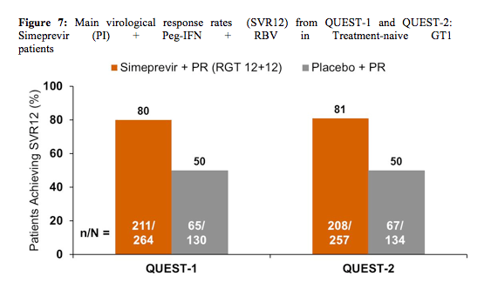
Treatment of HCV
Interferon + Ribavirin + Simeprevir (NS3/4A protease inhibitor)
QUEST-1 and 2: multicentered, randomized, double-blinded, placebo controlled trial comparing Sim +INF/RBV to INF/RBV in treatment naïve HCV genotype 1 patient
Treatment of prior non-responders (not shown) was for 48 wks and had SVR rates of 51-75%⁸
Jacobson IM, Dore GJ, Foster GR, et al. Simeprevir with pegylated interferon alfa 2a plus ribavirin in treatment-naive patients with chronic hepatitis C virus genotype 1 infection (QUEST-1): a phase 3, randomised, double-blind, placebo-controlled trial. Lancet. 2014; 384: 403–13.

Slide 40
Benefits of Simeprevir (FDA approved in 2013)
Shorter treatment duration (24 weeks in treatment naïve HCV patients, 48 weeks in prior non-responders)
Improved SVR rates in treatment naïve HCV patient (80% compared to 50% in treatment naïve)
Oral therapy given 1x daily

Slide 41
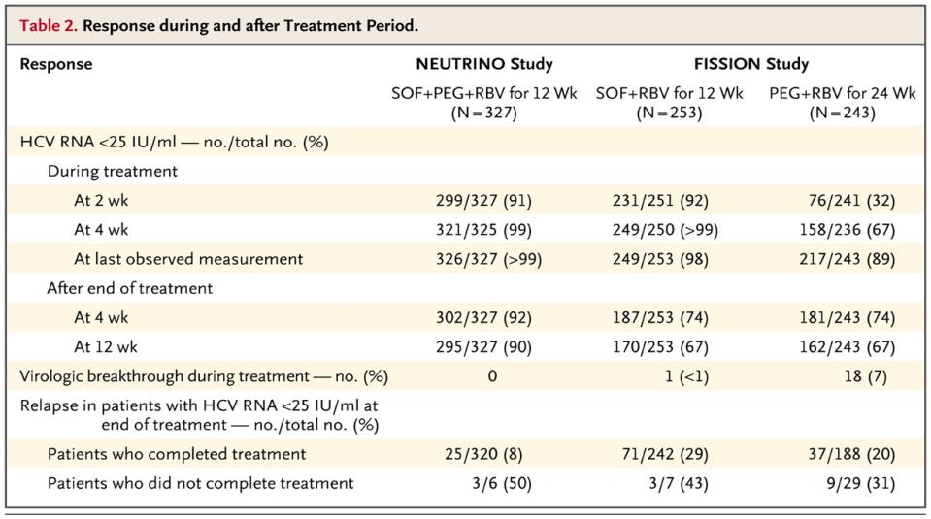
Treatment of HCV
Interferon + Ribavirin + Sofosbuvir (nucleotide analogue HCV NS5B polymerase inhibitor)
Jacobson IM, Dore GJ, Foster GR, et al. Simeprevir with pegylated interferon alfa 2a plus ribavirin in treatment-naive patients with chronic hepatitis C virus genotype 1 infection (QUEST-1): a phase 3, randomised, double-blind, placebo-controlled trial. Lancet. 2014; 384: 403–13.
Lawitz et al. Sofosbuvir for previously untreated chronic hepatitis C infection. N Engl J Med 2013; 368:1878-1887
Notes:
Both studies were treatment naive
The NEUTRINO trial was a single-group, open-label study of sofosbuvir plus peginterferon–ribavirin in 327 patients infected with HCV genotype 1, 4, 5, or 6. From June 2012 through August 2012, patients were enrolled at 56 sites in the United States (81% SVR in patients with cirrhosis)
The FISSION trial was a randomized, open-label, active-control study of sofosbuvir plus ribavirin in patients with HCV genotype 2 or 3 infection; patients with the two genotypes were enrolled in an approximately 1:3 ratio, respectively. From December 2011 through May 2012
Not shown – Patients who had previous INF/RBV failure had SVR rates of 74%

Slide 42
Sofosbuvir (FDA approved in 2013)
Nucleotide analog inhibitor of hepatitis C virus NS5B polymerase—the key enzyme mediating HCV RNA replication.
Improved SVR rates in treatment naïve HCV patients (90% compared to 50%)
Treatment duration 12 weeks
Oral therapy given 1x daily

Slide 43
Treatment of HCV
Interferon x 48 wks (1990-1997) SVR = 7-11%
INF + RBV x 48 wks (1998-2011) SVR = 28-40%
INF +RBV + PI (2011-2014) SVR = 59-66%
Sofosbuvir +RBV +INF (2013) SVR = 90%

Slide 44
SOF/LDV w/wo RBV (ION-1) treatment naïve HCV genotype 1 patients
Kowdley et al. Ledipasvir and Sofosbuvir for 8 or 12 Weeks for Chronic HCV without Cirrhosis. NEJM 2014;370:1879-1888¹⁰
Notes:
ION-1 Trial was an open labeled, treatment naïve, randomized trial with SOF/LDV +/-RBV for 12 or 24 weeks in genotype 1 HCV patients
Once daily Ledipasvir-Sofosbuvir with or without ribavirin for 12 or 24 weeks was highly effective in previously untreated patients with HCV genotype 1 infection.
12 weeks – SOF/LDV = 99% SOF/LDV +RBV = 97%
24 weeks – SOF/LDV = 98% SOF/LDV +RBV = 99%

Slide 45
SOF/LDV w/wo RBV (ION-1) treatment naïve HCV genotype 1 patients w/wo Cirrhosis
Afdhal et al. Ledipasvir and Sofosbuvir for Previously Treated HCV Genotype 1 Infection. NEJM 2014;370:1483-1493¹¹

Slide 46
SOF/LDV w/wo RBV (ION-2) prior treatment failure HCV genotype 1 patients
Afdhal et al. Ledipasvir and Sofosbuvir for Previously Treated HCV Genotype 1 Infection. NEJM 2014;370:1483-1493¹¹
Notes:
ION-2 had prior treatment failure patients
12 weeks – SOF/LDV = 94% SOF/LDV + RBV = 96%
24 weeks – SOF/LDV = 99% SOF/LDV + RBV = 99%

Slide 47
SOF/LDV w/wo RBV (ION-2)
Prior treatment failure HCV genotype 1 patients w/wo Cirrhosis
Afdhal et al. Ledipasvir and Sofosbuvir for Previously Treated HCV Genotype 1 Infection. NEJM 2014;370:1483-1493¹¹

Slide 48
Benefits of Sofosbuvir/Ledipasvir (Harvoni)
Ledipasvir
  Inhibits NS5A protein (required for viral replication)
Sofosbuvir
  Inhibits NS5B (RNA-dependent polymerase)
Once daily tablet
Shorter treatment durations
  12 weeks for treatment naïve patients w/ or w/o cirrhosis
  12 weeks for treatment experienced patients without cirrhosis
  24 weeks for treatment experienced patients with cirrhosis

Slide 49
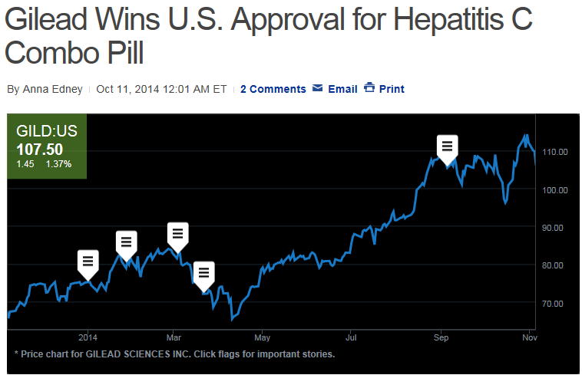

Slide 50
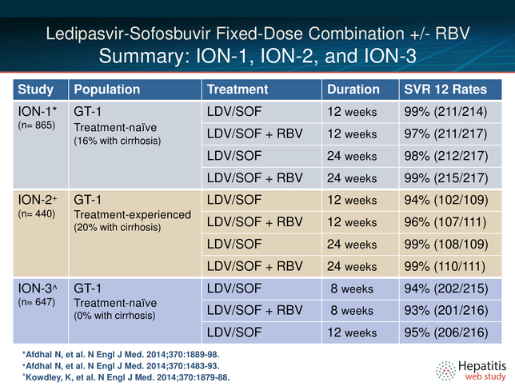
Summary of ION trials (Harvoni)

Slide 51
Treatment of HCV
Interferon x 48 wks (1990-1997) SVR = 7-11%
INF + RBV x 48 wks (1998-2011) SVR = 28-40%
INF +RBV + PI (2011-2014) SVR = 59-66%
Sofosbuvir +RBV +INF (2013) SVR = 90%
Sofosbuvir + Ledipasvir (2014) SVR = 98-100%

Slide 52
References
¹ Armstrong GL, Wasley A, Simard EP, et al. The prevalence of hepatitis C virus infection in the United States, 1999 through 2002. Ann Intern Med. 144:705-714 2006
² Alter MJ, Kruszon-Moran D, Nainan OV, et al. The prevalence of hepatitis C virus infection in the United States, 1988 through 1994. N Engl J Med.
³ Feldman M, Friedman LS, Brandt LJ. Chapter 79: Hepatitis C. Sleisenger and Fordtran’s Gastrointestinal and Liver Disease. 79(2):1313-1334 2010
⁴ Wasley A, Grytdal S, Gallagher K. Surveillance for acute viral hepatitis—United States, 2006. MMWR Surveill Summ. 57:1-24 2008
⁵ Prati D. Transmission of hepatitis C virus by blood transfusions and other medical procedures: A global review. J Hepatol. 45:607-616 2006
⁶ Bougie I, Bisaillon M. Initial binding of the broad spectrum antiviral nucleoside ribavirin to the hepatitis C virus RNA polymerase. J Biol Chem 2003; 278: 52471-52478.
⁷ Crotty S, Maag D, Arnold JJ, et al. The broad-spectrum antiviral ribonucleoside ribavirin is an RNA virus mutagen. Nat Med 2000; 6: 1375-1379.
⁸ Randomized, double-blind, placebo-controlled, phase 3 trial of simeprevir + PEG + RBV versus PEG + RBV in HCV GT1
⁹ Lawitz et al. Sofosbuvir for previously untreated chronic hepatitis C infection. N Engl J Med 2013; 368:1878-1887
¹⁰ Kowdley et al. Ledipasvir and Sofosbuvir for 8 or 12 Weeks for Chronic HCV without Cirrhosis. NEJM 2014;370:1879-1888
¹¹ Afdhal et al. Ledipasvir and Sofosbuvir for Previously Treated HCV Genotype 1 Infection. NEJM 2014;370:1483-1493

Slide 53
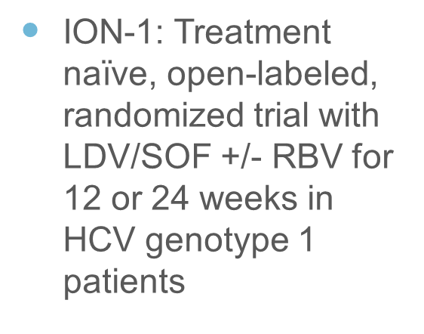
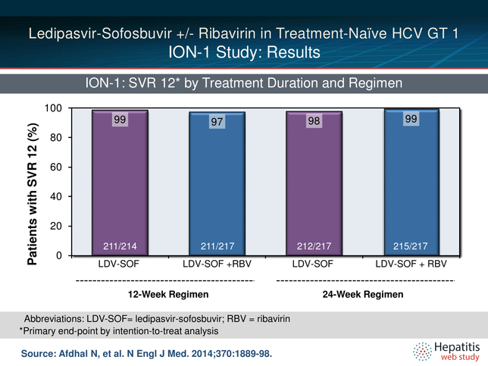
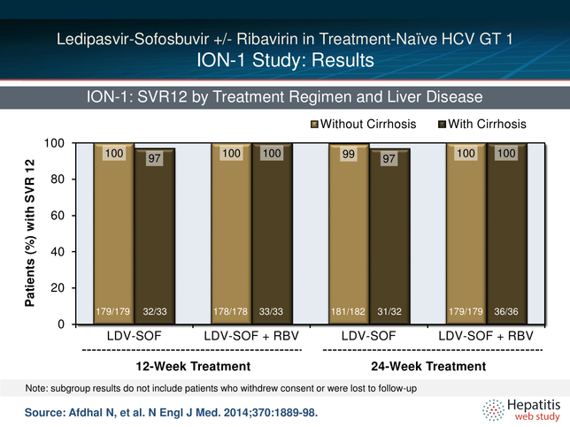
Treatment of HCV
Sofosbuvir + Ledipasvir (NS5A inhibitor)
ION-1: No difference noted between the cirrhotic patients and non-cirrhotics (treatment naïve)
Notes:
Once daily Ledipasvir-Sofosbuvir with or without ribavirin for 12 or 24 weeks was highly effective in previously untreated patients with HCV genotype 1 infection.

