Slide 1

Consensus or controversy?
Guidelines for the Management of Cardiovascular Risk
Brent N. Reed, PharmD, BCPS-AQ Cardiology, FAHA
Assistant Professor, Department of Pharmacy Practice and Science
University of Maryland School of Pharmacy

Slide 2
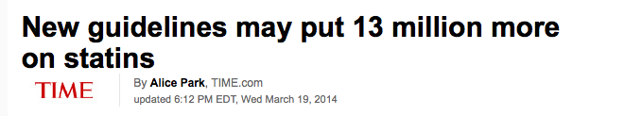
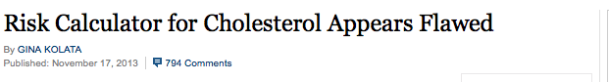
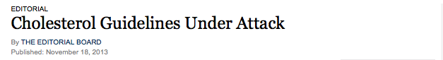
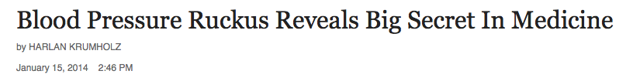
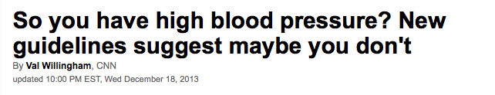
Headlines from NPR, The New York Times, and Time

Slide 3
Why the controversy?
Significant departure from previous editions
Discrepancies between experts
Evidence-based, but unanswered questions
“… not a substitute for clinical judgment, and decisions about care must carefully consider… each individual patient.”
- JNC8 Guidelines

Slide 4

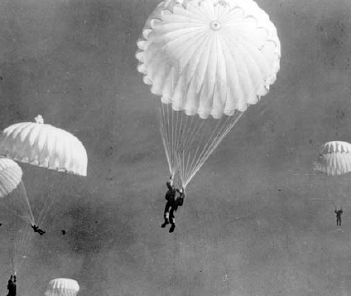
Parachute use to prevent death and major trauma related to gravitational challenge: systematic review of randomised controlled trials
Gordon C S Smith, Jill P Pell
“Parachutes reduce the risk of injury after gravitational challenge, but their effectiveness has not been proved with randomized controlled trials”
BMJ 2003;327;1459-1461.

Slide 5
Learning objectives
Describe pharmacologic management of blood cholesterol and blood pressure
Summarize evidence responsible for major changes in updated practice guidelines
Recognize where important questions remain

Slide 6
Guidelines for blood cholesterol
Stone NJ, et al. Circulation. 2013.

Slide 7
Trial Data
Statin vs. Control
SSSS
HPS
ALLIANCE
CARDS
JUPITER
ASCOT-LLA
Post-CABG
WOSCOPS
PROSPER
CARE
LIPID
ASPEN
AURORA
AFCAPS/
TexCAPS
LIPS
GISSI-HF
4D
ALERT
MEGA
ALLHAT-LLT
GISSI-P
More vs. Less Statin
PROVE-IT
TNT
IDEAL
SEARCH
A to Z

Slide 8
Secondary prevention
5-year absolute benefits per mg/dL LDL-C reduction
Outcomes avoided per 1000 (95% CI)
30 (24-37) | 27 (20-34) | 8 (4-12) | 48 (39-57)
Adapted from Lancet 2005; 366(9493):1267-78.

Slide 9
Primary prevention
5-year absolute benefits per mg/dL LDL-C reduction
Outcomes avoided per 1000 (95% CI)
18 (14-23) | 12 (9-16) | 5 (1-8) | 25 (19-31)
Adapted from Lancet 2005; 366(9493):1267-78.

Slide 10
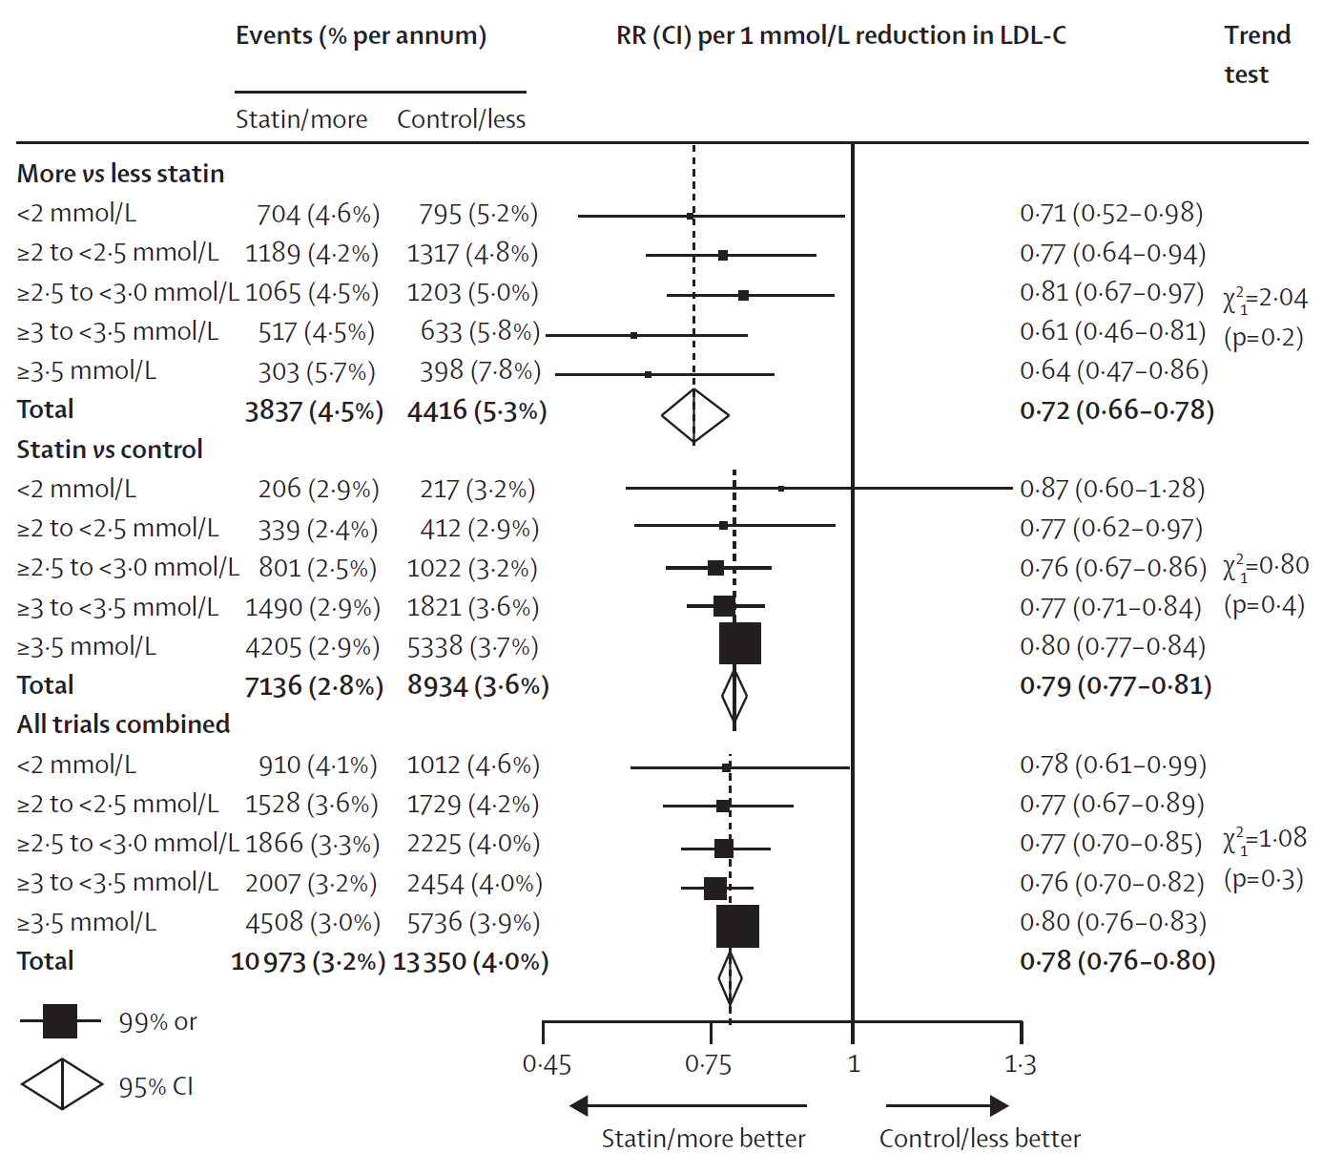
Baseline
LDL-C (mg/dL)
< 80
80 - < 100
100 - < 120
120 - < 140
> 140
< 80
80 - < 100
100 - < 120
120 - < 140
> 140
Reduction of vascular events by baseline LDL-C. Adapted from Lancet. 2010 Nov 13;376(9753):1670-81. LDL-C values converted to non-SI units, and rounded to nearest 20 mg/dL.

Slide 11
Areas of inadequate evidence
Titration of statin therapy to LDL-C or non-HDL-C targets, or “lower is better” strategy
Adjunct use of non-statin therapies
Symptomatic heart failure (NYHA Class II-IV) or hemodialysis-dependent kidney disease
Age < 40 or > 75 years

Slide 12
High-intensity statin
(Moderate-intensity if > 75 yo or not candidate for high-intensity statin)
Adults > 21 years of age and candidate for statin
Yes
Clinical
ASCVD?
Yes
No
Yes
High intensity statin
(Moderate-intensity if not candidate for high-intensity)
LDL-C > 190
mg/dL?
No
Yes
Moderate-intensity statin
(High-intensity if 10-yr
ASCVD risk > 7.5%)
Diabetes?
No
Calculate 10-yr ASCVD risk using Pooled Cohort Equations
Moderate-to-high
intensity statin
> 7.5% 10-yr ASCVD risk?
Yes
No
ASCVD prevention benefit less clear, but may be considered

Slide 13
Statin intensity
High Intensity (Lowers LDL-C by > 50%) | Moderate-Intensity (Lowers LDL-C by 30-50%) | Low-Intensity (Lowers LDL-C by < 30%)
Atorvastatin 40-80 mg Rosuvastatin 20-40 mg | Atorvastatin 10-20 mg Rosuvastatin 5-10 mg Simvastatin 20-40 mg Pravastatin 40-80 mg Lovastatin 40 mg Fluvastatin 40 mg BID Pitavastatin 2-4 mg | Simvastatin 10 mg Pravastatin 10-20 mg Lovastatin 20 mg Fluvastatin 20-40 mg Pitavastatin 1 mg
Statins and doses listed in italics are approved for use but have not been studied in randomized controlled trials. Adapted from Stone NJ, et al. 2013 ACC/AHA Blood Cholesterol Guideline.

Slide 14
Risk factors for adverse events
Multiple or serious comorbidities
History or statin intolerance, muscle disorders
Unexplained ALT elevations > 3 times ULN
Patient characteristics and/or concomitant medications affecting statin metabolism
Age > 75 years

Slide 15
Statins in primary prevention
Absolute benefit proportional to baseline risk
Risk reduction proportional to LDL-C lowering
Risk for adverse events must be weighed against risk of catastrophic CVD event
Clear net benefit at 10-year ASCVD risk > 7.5%; less clear at 5 to < 7.5%

Slide 16
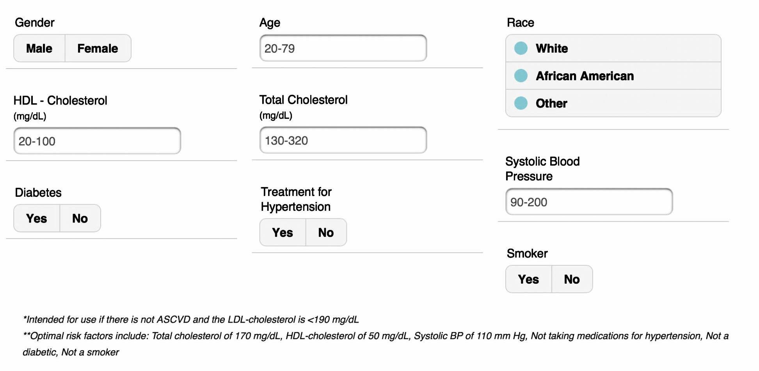
Risk calculator
Image from ASCVD Risk Calculator App (iTunes).

Slide 17
No clinical ASCVD
Diabetes
or LDL-C > 190
mg/dL?
Yes
No
No
40-75 yo
and LDL-C < 190
mg/dL?
Yes
Calculate 10-yr ASCVD risk using Pooled Cohort Equations
< 5% 10-yr ASCVD risk
5 to < 7.5% 10-yr ASCVD risk
> 7.5% 10-yr ASCVD risk
In select individuals, additional factors may be considered to inform treatment decision making
Patient discussion regarding ASCVD risk reduction benefits, adverse effects, drug-drug interactions, and patient preferences

Slide 18
Prior to statin initiation
Emphasize heart-healthy lifestyle
Obtain baseline laboratories
  Fasting lipid panel
  Alanine transaminase (ALT)
  Creatinine kinase (CK) if indicated
Exclude secondary causes of dyslipidemia
Evaluate for risk of drug-related adverse effects

Slide 19
Assess adherence with fasting lipid panel
Yes
Expected Response?
No
No
Statin Intolerance?
Yes
Reinforce medication adherence
Manage Intolerance
No
Expected Response?
Yes
Reinforce Improved Adherence
Increase intensity OR consider addition of non-statin therapy
Reinforce continued adherence
Follow-up in 3-12 months

Slide 20
Non-statin therapies
Agent | Improved Outcomes† | Monitoring
Niacin | Mortality (all-cause, CV) Recurrent CV events | Hepatic transaminases Hgb A1C or FBG Uric acid concentrations Intolerance (flushing)
Fibrates | Mortality (CV) Recurrent CV events | Renal function Triglycerides (for potential benefit if added to statin) Avoid gemfibrozil/statin combination
Bile Acid Sequestrants | Recurrent CV events | Triglycerides (adverse effect)
Fish Oil | CV mortality | Intolerance (GI disturbances, skin changes, bleeding)
Ezetimibe | None | Hepatic transaminases
†In the absence of statin therapy. CV = cardiovascular, FBG = fasting blood glucose, GI = gastrointestinal, Hgb = hemoglobin

Slide 21
Guidelines for blood pressure
James PA, et al. JAMA. 2014; 311(5):507-520.

Slide 22
Major differences from JNC7
Topic | Difference in JNC8
Methodology | Systematic search and review process Standardized protocol for recommendations
Definitions | Hypertension, prehypertension not defined
Treatment goals | Similar except when trial evidence supported different goals in a specific subgroup
Lifestyle recommendations | Addressed separately
Drug therapy | ACEi or ARB, CCB, or thiazide Specific drug in racial or disease subgroups
Review process | Expert review from various organizations No official sponsorship

Slide 23
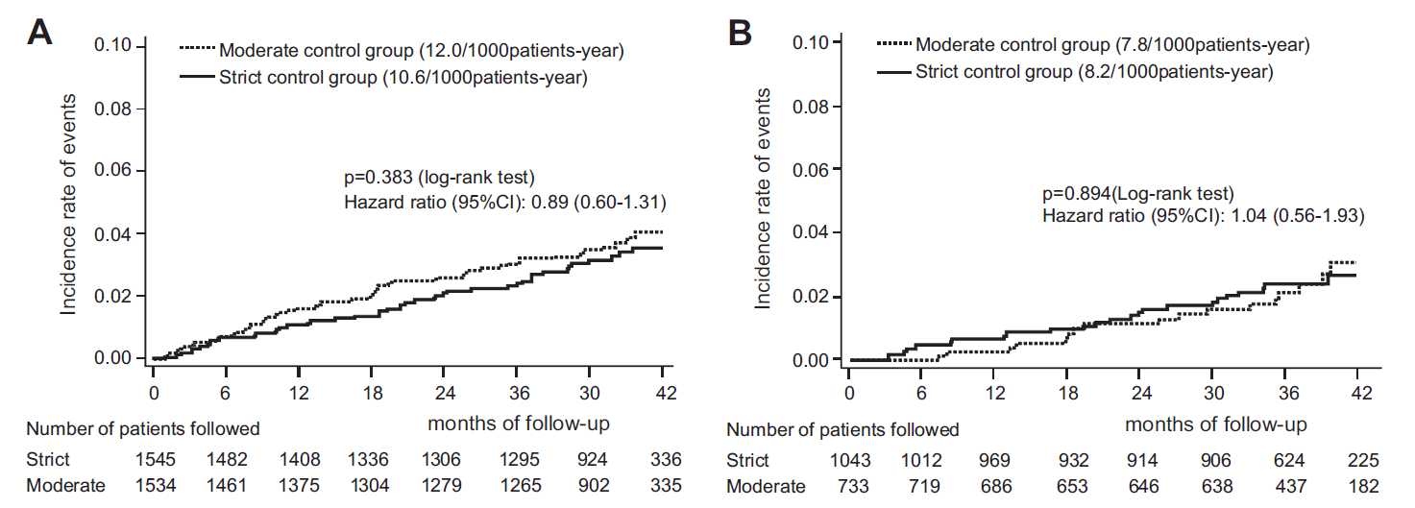
Age-stratified goals
Intention-to-treat
Per-protocol
Strict vs. Moderate Blood Pressure Control in Older Patients
Showing no differences in the primary composite endpoint when a goal of < 140 mmHg (strict) vs. 140-150 mmHg (moderate) was compared.
Hypertension. 2010;56:196-202.

Slide 24
Chronic kidney disease
No improvement in cardiovascular outcomes at lower BP goals (i.e., < 130 / 80 mmHg)
Some improvement in kidney-related outcomes in post-hoc analyses but results inconsistent
Lancet. 2005;365(9463):939-946. JAMA. 2002;288(19):2421-2431. N Engl J Med. 1994;330(13):877-884.

Slide 25
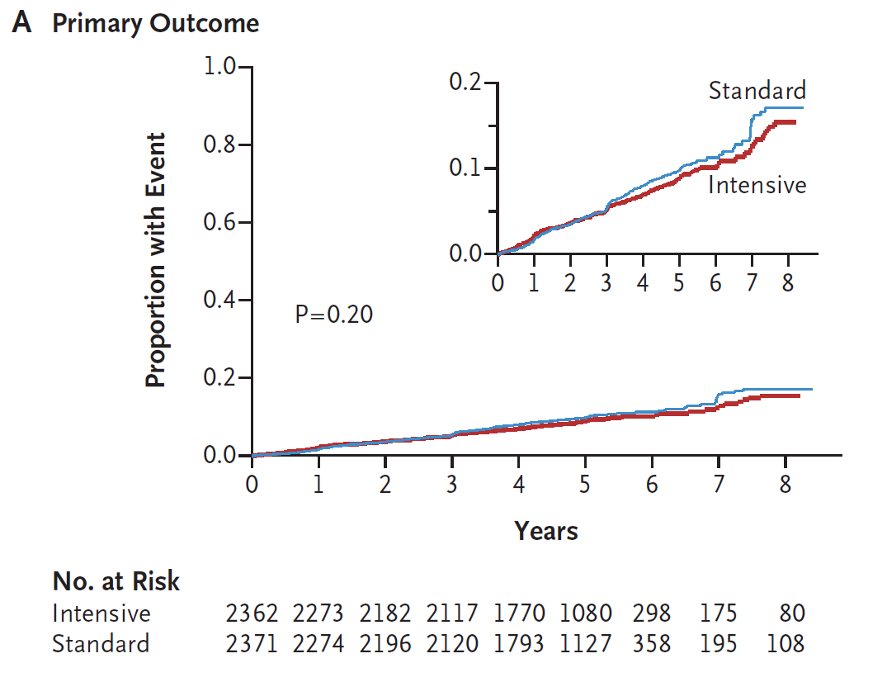
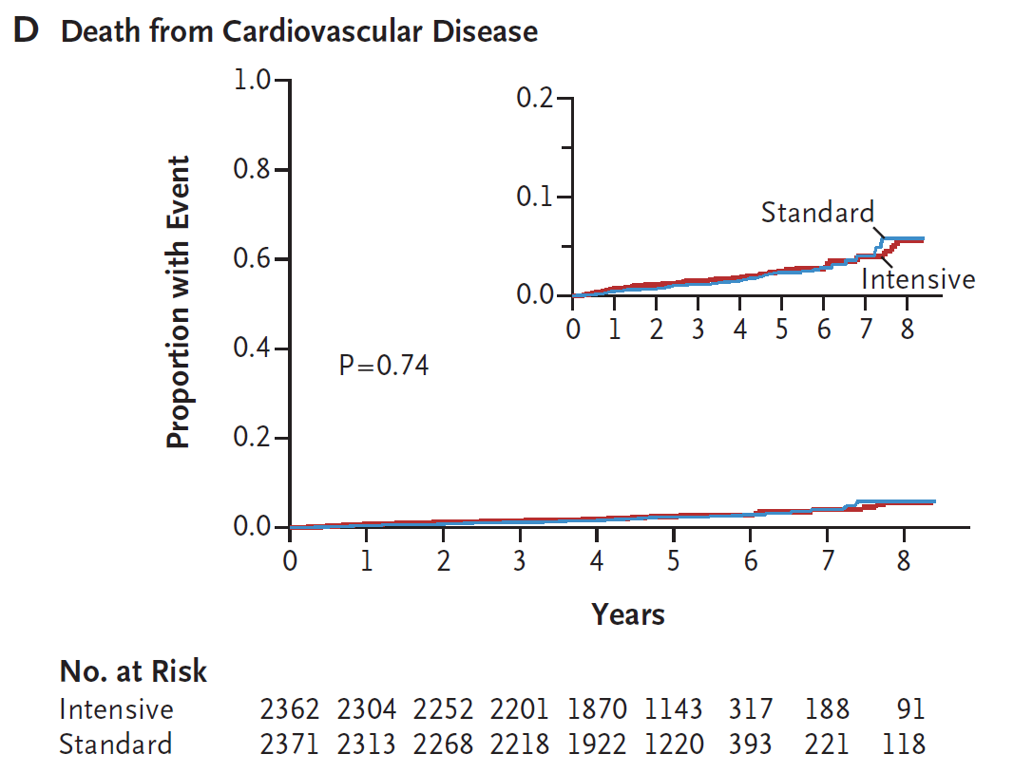
Diabetes mellitus
Systolic Blood Pressure Goals in Diabetes Mellitus
Showing no differences in the primary composite endpoint and cardiovascular death when a goal SBP of < 140 mmHg vs. < 120 mmHg was compared.
N Engl J Med. 2010;362(17):1575-1585.

Slide 26
Selection of initial therapy
Non-blacks: similar improvements with ACEi or ARB, calcium channel blockers, or thiazides
Blacks: calcium channel blockers or thiazides prior to ACEi or ARB
Not impacted by presence of diabetes
ACEi or ARB recommended as initial therapy in chronic kidney disease
JAMA. 1991;265(24):3255-3264. JAMA. 1979;242(23):2562-2571. JAMA. 1970;213(7):1143-1152. JAMA. 2002;288(23):2981-2997. JAMA. 2002;288(19):2421-2431.

Slide 27
Adults > 18 years with hypertension
No
Yes
Yes
DM or CKD?
CKD?
No
Yes
No
Age < 60 y?
< 150 / 90 mm Hg
< 140 / 90 mm Hg
< 140 / 90 mm Hg
Acceptable if < 140/90 mm Hg achieved safely
No
Yes
Black?
Thiazide, ACEi, ARB or CCB
Thiazide or CCB
ACEi or ARB
Optimize by up-titrating and/or adding thiazide, ACEi or ARB, or CCB. For refractory patients, may add from an additional class (e.g., beta blocker, aldosterone antagonist)

Slide 28
Antihypertensive strategies
Strategy | Description
A | Start with one drug, titrate to maximum dose, then add a second drug
B | Add second drug before achieving a maximum dose of first drug
C | Begin two drugs at same time either as separate pills or combination pill
Select ACEi or ARB, CCB, or thiazide first
Avoid ACEi / ARB combination therapy
Consider Strategy C if BP > 160/100 or if SBP is > 20 over goal and DBP is > 10 over goal (mm Hg)

Slide 29
Class | Medication | Initial Daily Dose (mg) | Target Daily Dose (mg) | Doses/day
ACEi | Captopril | 50 | 150-200 | twice
 | Enalapril | 5 | 20 | once to twice
 | Lisinopril | 10 | 40 | once
ARB | Candesartan | 4 | 12-32 | once
 | Losartan | 50 | 100 | once to twice
 | Valsartan | 40-80 | 160-320 | once
 | Irbesartan | 75 | 300 | once
CCB | Amlodipine | 2.5 | 10 | once
 | Diltiazem ER | 120-180 | 360 | once
Thiazide diuretic | Chlorthalidone | 12.5 | 12.5-25 | once
 | Hydrochlorothiazide | 12.5-25 | 25-100 | once to twice
ACEi = ACE inhibitor, ARB = angiotensin receptor blocker, CCB = calcium channel blocker. International drugs omitted from table. Adapted from James PA, et al. JAMA 2014;311(5):507-520.

Slide 30
Evidence for recommendations
Group | Recommendation | Grade
Age > 60 y | Goal < 150 / 90 mmHg | A (Strong)
Age < 60 y | Goal < 140 / 90 mmHg | E (Expert opinion) (SBP) A (Strong) (DBP)
CKD | Goal < 140 / 90 mmHg | E (Expert opinion)
DM | Goal < 140 / 90 mmHg | E (Expert opinion)
Non-blacks | Thiazide, ACEi/ARB, or CCB | B (Moderate)
Blacks | Initial: CCB or thiazide | B (Moderate) (non-DM) C (Weak) (DM)
CKD | Initial ACEi or ARB | B (Moderate)
All | Strategies for achieving goal | E (Expert opinion)

Slide 31
Remaining questions
Blood Cholesterol
Blood Pressure
Primary prevention in older populations
Alternate strategies for reducing ASCVD risk
Non-statin therapies added to low-dose statin
Diabetes risks
New therapies vs. statins
Goals for older patients with high-risk features
Goals in younger patients
Non-hypertensive populations (e.g., HF)
Which optimization strategy is best?

Slide 32
Consensus or controversy?
Guidelines for the Management of Cardiovascular Risk
Brent N. Reed, PharmD, BCPS-AQ Cardiology, FAHA
Assistant Professor, Department of Pharmacy Practice and Science
University of Maryland School of Pharmacy

