Slide 1


Treatment of Preformed Antibodies “Desensitization Protocols”
Maria E. Rodrigo, MD
Associate Director, Heart Transplantation
Medstar Washington Hospital Center

Slide 2
Background
Introduction of CI in 1980s allowed heart transplantation to become a viable therapeutic option for end-stage heart failure
Since then, rejection rates have declined due to
improvements in IS and monitoring of IS
tissue typing
improved techniques for assessing allograft compatibility

Slide 3
Background
Plateauing of the number of transplants per- formed annually, as demand has outstripped the supply of donor organs
With increasing numbers of patients with advanced heart disease, the waiting lists for heart transplantation continue to grow

Slide 4
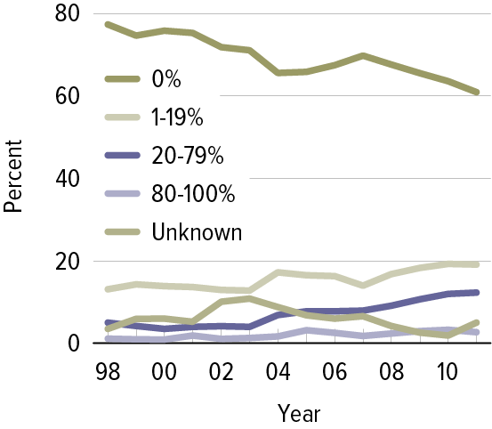
Rising Incidence of Sensitized Patients Awaiting Heart Transplantation
OPTN/SRTR 2011 Annual Data Report: U.S. Department of Health and Human Services. December 2012.

Slide 5
Background
Challenge for transplantation as they have preformed antibodies
limits the pool of compatible donors
post-transplant, places patients at increased risk of rejection, graft loss, and development of allograft vasculopathy
Prolonged and often prohibitive times on transplant wait lists, with the consequent risk of increased mortality while awaiting transplantation

Slide 6
Objectives
Definition of pre-transplant sensitization
Management of the sensitized patient
Evolving modalities available for the treatment of sensitized patients awaiting heart transplantation

Slide 7
Approach to the Heart Transplant Recipient- Sensitized?
Screen for the presence of antibodies
Specify the antibodies
Quantify the antibodies? Are they Cytotoxic?

Slide 8
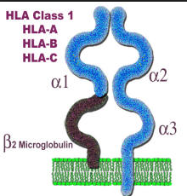
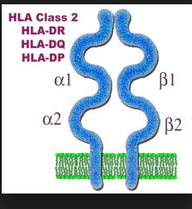
Crossmatch
Developed in an attempt to identify recipients who are likely to develop acute vascular rejection of a graft from a given donor.
Hyperacute rejection (HAR): result of preformed antibodies to one or more HLA of the donor (DSAbs)

Slide 9
Crossmatch
Preformed antibodies cause rejection by binding to HLA antigens expressed on the endothelium of vessels in the transplanted heart
Activation of the complement cascade with resultant thrombosis and infarction of the graft
Crossmatching helps predict and hence prevent this catastrophic outcome

Slide 10
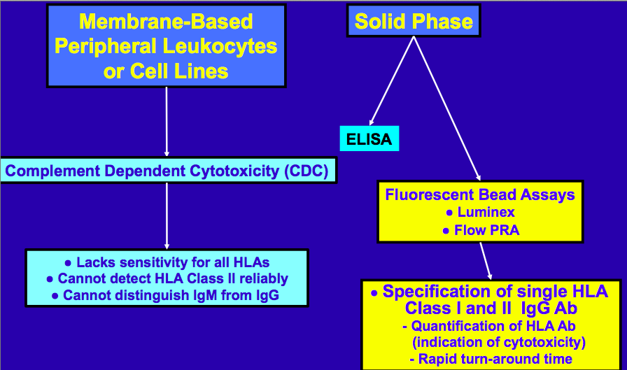
Antibody Detection Methods

Slide 11
CDC (Complement-dependent cytotoxicity) Crossmatch
Recipient Serum
Donor Lymphocytes
HLA Ag
HLA Ag
? Donor Specific anti HLA Abs
HLA Ag
HLA Ag
HLA Ag
CYTOTOXIC REACTION

Slide 12
Crossmatch
Are there clinically significant DS HLA antibodies in the recipient?
Donor Lymphocytes
Recipient Serum
T
T
T
B
B
T
T
T
B
B
Complement
T
T
T
B
B

Slide 13
Crossmatch
DS Abs
Activation of Complement Cascade
Bind
Donor Cell
Lysis of lymphocytes

Slide 14
Crossmatch
? Proportion of cells lyzed (by microscopy)
Grade crossmatch
Can be enhanced by adding AHG (anti-human globulin) – Increased sensitivity; detection of a lower level of Abs with cytotoxic potential.
Weakly positive
Moderately positive
Strongly positive

Slide 15
The Calculated Panel-Reactive Antibody
It represents the proportion of the population to which the person being tested will react via pre-existing antibodies
The cPRA is a quantitative measure, expressed as a percentage, of the portion of the general population for which a candidate recipient has circulating antibodies.
Low Risk: <10%
Moderate Risk: 10-25%
High Risk: >25%
A higher cPRA reflects increased difficulty in finding a suitable donor.

Slide 16
Antibody Detection Methods

Slide 17
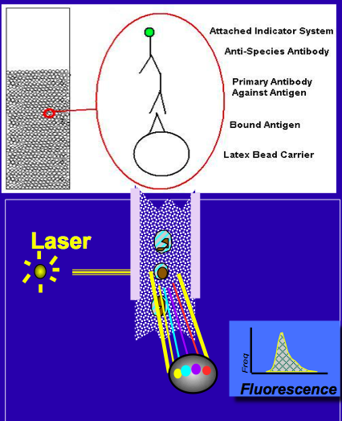
FlowPRA
Flow cytometry test which utilizes microparticle beads coated with HLA Class I or Class II proteins isolated from purified cell lines from which HLA proteins or donor platelets are over-expressed.
PRAs are evaluated by determining the percentage of beads that react positively with patient sera.
Cytometry B Clin Cytom. 2007;72(4):256–64.

Slide 18
Flow Crossmatch
The significance of a positive result is mainly of interest when the CDC crossmatch is negative
In this setting the positive flow crossmatch is likely to be caused by
a non-complement fixing antibody
a non-HLA antibody
a low-level antibody

Slide 19
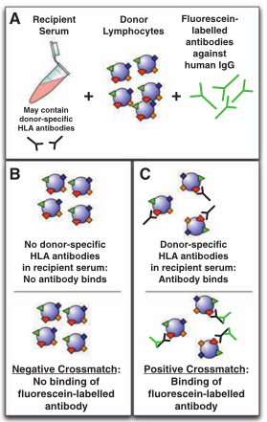
Flow Crossmatch
Quantitation
Channel Shifts Intensity of fluorescence above control
Number of dilutions required to generate a negative result
Nephrology 16 (2011) 125–133

Slide 20
Detecting Antibody Specificity- Luminex Test
Some transplant clinicians do not use flow crossmatching as part of their pre-transplant assessment and rely on CDC crossmatching along with defining DSAbs by Luminex
Multiple antibodies can be detected simultaneously
Multiple purified HLA molecules are attached to microparticles and detected by flow cytometry

Slide 21
Detecting Antibody Specificity- Luminex Test
Removal of false positives because of antibody binding to non-HLA antigens
Antigens present can be controlled, so confusion regarding the class of HLA they are binding to is eliminated
Positive results graded (weak, moderate or strong) based on the degree of fluorescence of the positive bead

Slide 22
Assessing PRAs: Quantification by Fluorescent Bead Assays
 | Mean Fluorescent Intensity (MFI)
Weak | < 5,000
Moderate | 5,000-10,000
Strong (Cytotoxic) | >10,000
Notes:
Scored as a mean fluorescence index or molecules of equivalent soluble fluorescence.

Slide 23
The advent of flow crossmatch and Luminex has allowed detection of lower titre but potentially clinically relevant anti-HLA antibodies by approximately 10-fold
Some variability in results; many laboratories will utilize multiple tests for confirmation

Slide 24
The development of the highly sensitive solid-phase antibody assays described has allowed for identification of potentially cytotoxic recipient antibodies and selection of appropriate donors by use of a “virtual crossmatch”.
J Heart Lung Transplant : Off Publ Int Soc Heart Transplant. 2009;28(11):1129–34.

Slide 25
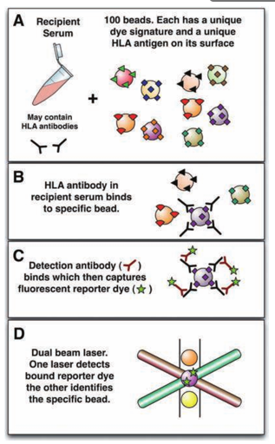
The Virtual Crossmatch
Prospective crossmatch: has been the standard tool for assessing graft recipient compatibility for sensitized patients awaiting cardiac transplantation
Allows assessment of donor hearts that may be at risk of exposure to recipient circulating cytotoxic antibodies
Nephrology 16 (2011) 125–133

Slide 26
The Virtual Crossmatch
Can be logistically challenging
Requires local expertise
Recipient blood must be available close to the site of the donor so that the crossmatch can be expedited in a timely manner (necessitates sending blood from sensitized potential recipients to several distant locations where potential donors may be sourced)

Slide 27
Complement-Fixing Antibodies
Most of the solid-phase assays do not distinguish between complement-activating and non-complement-activating anti-bodies
A test was recently developed that enables the identification of alloantibodies capable of complement fixation: the c1q assay
May permit further expansion of the donor pool by allowing the exclusion of only complement- fixing antibodies in the virtual crossmatch
Hum Immunol. 2011;72(10):849–58.

Slide 28
Complement-Fixing Antibodies
Complement-fixing antibody in a standard virtual crossmatch was associated with a higher incidence of AMR compared to a virtual crossmatch with no complement- fixing antibodies
The complement-binding ability of the antibody was independent of antibody strength, and C1q fixation was independent of MFI values
Much more sensitive than the standard CDC at detecting complement-fixing antibodies

Slide 29
What matters clinically?
How easy will it be to find a donor for my patient awaiting heart transplantation?
cPRA defines the frequency of the unacceptable HLA in the donor population
cPRA 10%: 90% of donor would be a match
cPRA 80%: only 20% of donors would be a match

Slide 30
Monitoring of Sensitized Patients Awaiting Transplantation
Circulating antibodies must be periodically monitored in patients awaiting heart transplantation
Variable response to desensitization therapies
Antibodies can rebound following completion of a course of treatment
Further sensitizing events may take place

Slide 31
Consensus Statements for Pre-Transplant Sensitization
Recommended frequency for antibody screening and identification:
If no evidence of sensitization, a frequency of every 6 months is advised.
In patients with detectable circulating antibodies, a frequency of every 3 months.
In LVAD recipients, the optimal frequency is once per month.
With “interceding events” (such as blood transfusions) recommend a
PRA screen at 1 to 2 weeks after the event.
After desensitization therapy, PRA should be checked 1 to 2 weeks after therapy.
In all others (pediatric, retransplant, parous women), a frequency of every 3 months is advised.
J Heart Lung Transplant : Off Publ Int Soc Heart Transplant. 2009;28(3):213–25.

Slide 32
Risk Factors for Sensitization
Complex interaction between the patient’s immune system and exposure to non-self antigens
Blood transfusions
Pregnancy/Multiparity
Prior transplantation/Exposure to tissue grafts
Left Ventricular Assist Device (LVAD)
Use leukocyte-depleted blood products

Slide 33
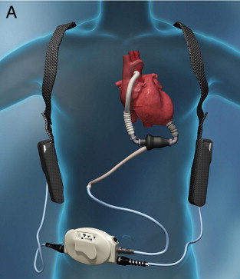
Sensitization in Patients with a LVAD
Allosensitization after LVAD implantation, when measured by the more sensitive single-antigen bead assay, was found to be common (53 %).
This did not translate into increased risk of rejection or mortality in the first year post-transplant.
Transplantation. 2013;96(3):324–30.

Slide 34
Risk Factors for Sensitization
A recent analysis of the UNOS/OPTN registry suggests that race may be an important factor
In this study, blacks were more likely to be sensitized, had higher peak PRA, and were more apt to experience graft failure than Hispanic, white, or Asian recipients
J Am Coll Cardiol. 2013;62(24):2308–15.

Slide 35
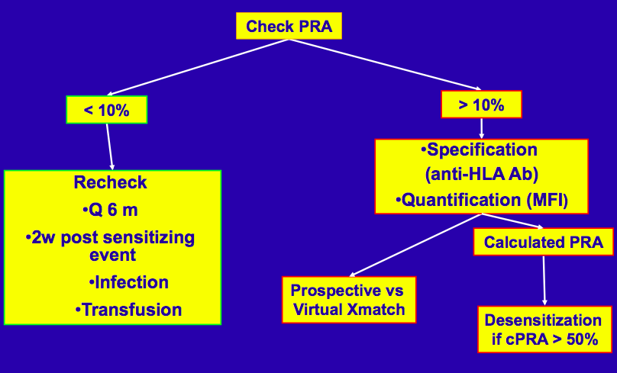
Pre- Transplant Management of Sensitized Patients
Kobashigawa JA, J Heart and Lung Transplant 2009; 28:213-25

Slide 36
Desensitization Strategies

Slide 37
Desensitization Strategies
Primary objective: eliminate or reduce Abs to donor HLA to a level that permits successful transplantation.
Indications
Pre-Transplant
cPRA >50%
Post-Transplant
Positive crossmatch (induction)
Refractory AMR

Slide 38
Desensitization Strategies
Remove preformed antibodies: Plasmapheresis
Block Ab function: IV Ig
B cell destruction: Rituximab
Plasma Cell destruction: Bortezomib

Slide 39
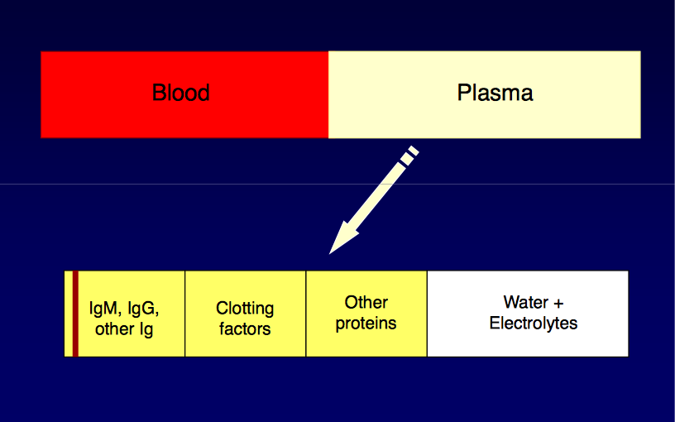
Plasmapheresis
Removal of plasma and replacement with certain components of plasma

Slide 40
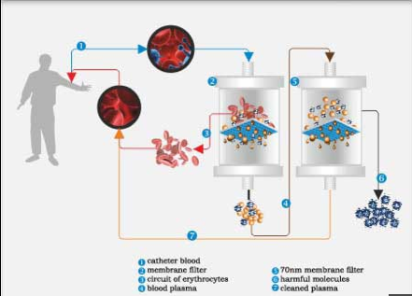
Plasmapheresis

Slide 41
Intravenous Gammaglobulin (IV Ig)
Powerful immunomodulatory effects on inflammatory and autoimmune diseases
Reduces anti-HLA antibodies
Reduces ischemia-reperfusion injuries
Fewer acute rejection episodes
Higher successful long-term allograft outcomes for cardiac and renal allograft recipients
Effective in treatment of allograft rejection episodes
American Journal of Transplantation. 2006;6(3):459-466.

Slide 42
IV Ig
Commonly administered as part of a treatment protocol that includes plasmapheresis
Administration after each plasmapheresis treatment (100 mg/kg per treatment day) or as a set dose of 2 g/kg total, alone or if given with plasmapheresis after the final plasmapheresis treatment
There are no comparative data to indicate which of these approaches is superior

Slide 43
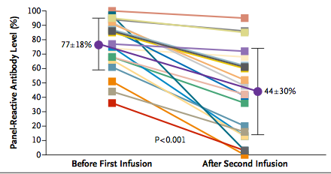
Rituximab
Anti-CD20 monoclonal antibody that targets B cells
In sensitized patients awaiting renal transplantation, the use of rituximab in combination with IVIg significantly reduced PRA and wait time to transplant, and was associated with excellent graft and patient survival at 12 months
Individual data for patient before the first infusion of intravenous immune globulin and after the second infusion.
N Engl J Med. 2008;359(3):242– 51.

Slide 44
Rituximab
Experience in heart transplantation is limited
In 21 sensitized heart transplant candidates, use of plasmapheresis, IVIg, and rituximab resulted in a decrease in mean PRA from 70.5 % to 30.2 %
All patients subsequently had a negative donor-specific prospective crossmatch and were transplanted successfully, with five-year survival and freedom from allograft vasculopathy comparable to a control group with PRA <10 %
Clin Trans. 2011;25(1): E61–7.

Slide 45
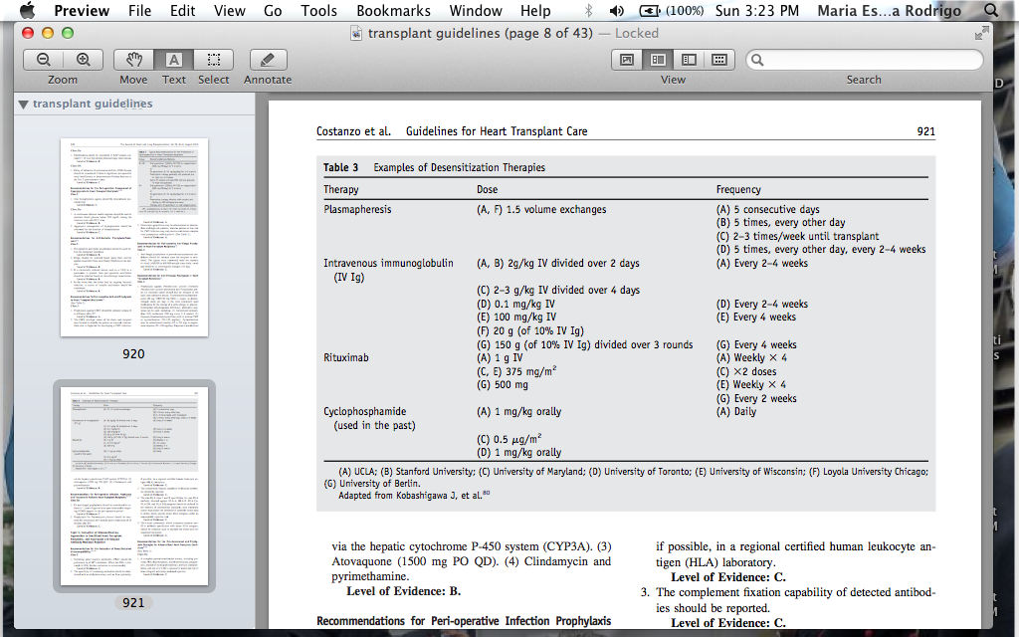
Guidelines
J Heart Lung Transplant 2010;29:914–956

Slide 46
Desensitization at MWHC
J Heart Lung Transplant 2010;29:914–956

Slide 47
Although the methods described above variably reduce antibody burden, none directly affect the cell responsible for antibody production, the mature plasma cell

Slide 48
Bortezomib
Selective 26S proteasome inhibitor used for the treatment of multiple myeloma, a neoplasm of plasma cells
In vitro, it has been shown to cause plasma cell apoptosis and inhibit alloantibody production
Am J Transplant: Off J Am Soc Transplant Am Soc Transplant Surg. 2009;9(1):201–9.

Slide 49
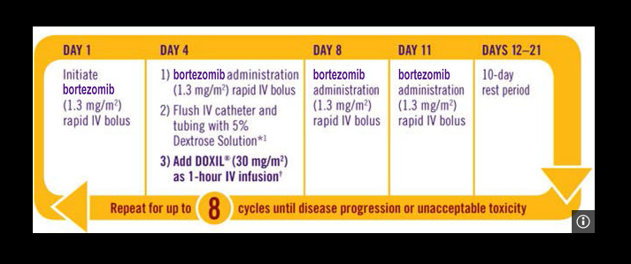
Bortezomib
SIDE EFFECTS:
Fatigue
Peripheral neuropathy
Lung disease
PRES
Fever
GI symptoms
Pancytopenia
Herpes zoster

Slide 50
Splenectomy
Reduces the number of plasma cells and precursor B cells, and impairs general B cell- mediated immune surveillance
Experience as a treatment to prevent allograft rejection in heart transplantation has been limited
In renal transplantation, has allowed both ABO- and HLA-incompatible transplantation against a positive crossmatch in combination with plasmapheresis and IVIg
Associated with a lifetime risk of infection from encapsulated bacteria

Slide 51
Therapeutic Options for the Sensitized Patient at Transplant

Slide 52
Induction Therapy
While there are no large randomized clinical trials to support the routine use of induction therapy in heart transplant patients, most centers will adopt induction for their highest-risk sensitized patients
Options:
Interleukin-2 receptor antibody (IL-2RAb)
Cytolytic induction: anti-thymocyte globulin (ATG)

Slide 53
Induction Therapy
Meta-analysis of randomized clinical trials suggested a signal for less rejection with IL-2RAb induction compared to placebo and superiority of cytolytic induction with anti-thymocyte globulin (ATG) over IL-2RAb
Cochrane Database System Rev. 2013;12, CD008842.

Slide 54
Induction Therapy
Two polyclonal IgG cytolytic preparations of ATG available:
Thymoglobulin: rabbit-derived (rATG)
ATGAM: equine- derived
Both target a broad range of T cell surface epitopes
Profound depletion within 24 hrs of the first dose
Renal transplant literature: suggestion superior efficacy of rATG
Transplantation. 2004;78(1):136–41.

Slide 55
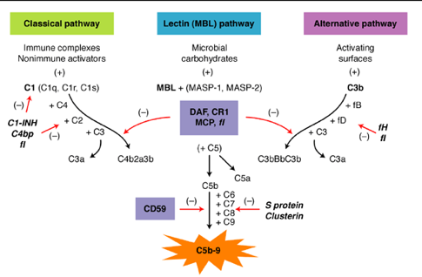
Eculizumab

Slide 56
Eculizumab
Cell lysis

Slide 57
Eculizumab
Given the critical role of the complement system in antibody-mediated cytotoxicity, strategies aimed at inhibiting the system may potentially be effective in preventing antibody-mediated rejec- tion (AMR) in sensitized patients

Slide 58
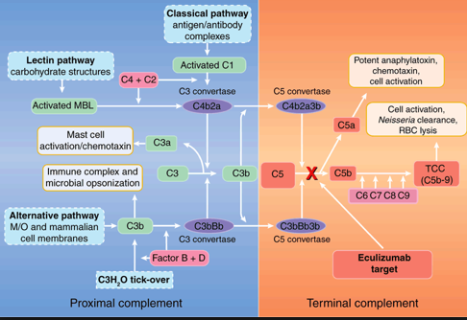
Eculizumab
Monoclonal antibody that avidly binds to C5 and prevents its cleavage to C5a and C5b, inhibiting the formation of the membrane attack complex

Slide 59
Eculizumab
By targeting the terminal components of the complement system, complement components activated early in the cascade are preserved to participate in immune defense
Experience with eculizumab has been most extensive in renal transplantation

Slide 60
Eculizumab
Treatment of 26 highly sensitized patients with eculizumab was shown to reduce biopsy-proven AMR in the first three months after transplant, from 41.2 % in a matched historical cohort to 7.7 % in the eculizumab group (p=0.0031)
At one year, transplant glomerulopathy was also significantly reduced, from 35.7 % to 6.5 % (p = 0.044), suggesting that early complement inhibition after transplantation in highly sensitized patients may provide both short-term and long-term benefits
A single-center pilot study of the use of eculizumab in highly sensitized patients after heart transplantation is currently enrolling patients (ClinicalTrials.gov identifier NCT02013037)

Slide 61
Post-Transplant Managment
Pre-transplant desensitization may reduce the alloantibody burden sufficiently to allow transplantation to proceed with a negative cytotoxic crossmatch
Concern for a post-transplant amnestic antibody response significant rebound in antibody levels and subsequent risk of delayed acute rejection

Slide 62
Post-Transplant Managment
Quantitative monitoring of antibodies should also be performed periodically in the postoperative period
The frequency of monitoring will depend upon the pre-transplant antibody burden and profile of any low-level donor-specific antibodies (DSAs) that may have been permitted at virtual crossmatch

Slide 63
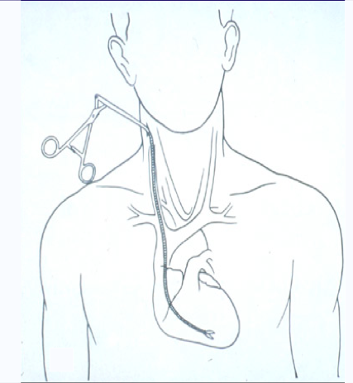
Post-Transplant Managment
Further data from surveillance endomyocardial biopsies, echocardiography, and clinical presentation will determine the need for additional therapies

Slide 64
Post-Transplant Managment
Maintenance therapy for sensitized patients will generally consist of tacrolimus, MMF, and corticosteroids, the last of which may need to be continued indefinitely for patients with evidence of significant DSAs

Slide 65
Conclusions
Transplant wait lists continue to grow in parallel with increased demand for organs and limited donor supply pool.
Sensitized patients represent a particular challenge.
Increasing number of patients on mechanical circulatory support.
Pre- transplant sensitization is associated with longer wait time to transplant and increased risk of rejection after transplant.

Slide 66
Conclusions
Solid-phase and flow-cytometric single-antigen bead assays offer greater sensitivity and specificity for HLA antibody detection.
These high -resolution tests allow patients to be listed for transplant by virtual crossmatch, thereby increasing the donor pool.
The solid-phase C1q binding assay further distinguishes HLA antibodies that can bind the first component of complement, and may further help to expand the donor pool by identifying the most pathogenic antibodies.

Slide 67
Conclusions
Treatment options for sensitized patients remain an area of active investigation
Promising therapies include techniques for:
antibody removal (plasmapheresis and immunoadsorption),
targeted B cell and immunomodulatory therapies (rituximab and IVIg),
plasma cell depletion (bortezomib)
Most effective approach: combination of therapies

Slide 68
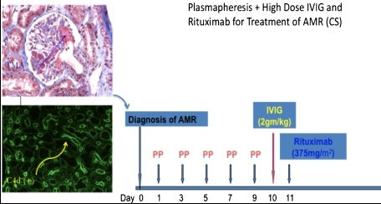

Slide 69
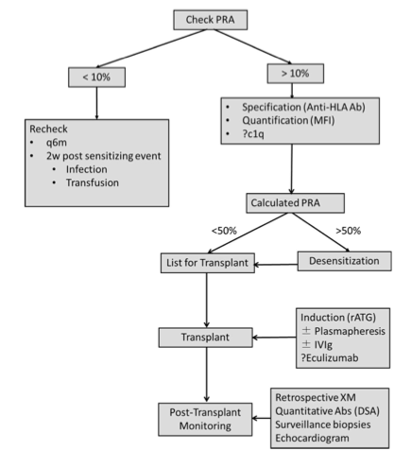
Conclusions
Augmented therapies at transplant
Plasmapheresis
Cytolytic induction (rATG)
Immunomodulation (IVIg)
Terminal complement blockade (eculizumab)

Slide 70
Conclusions
Patients require judicious monitoring after transplant for antibody rebound and clinical rejection.
Determining the most effective therapeutic approach for sensitized patients will require expanded clinical trials in order to fully address the pleomorphic nature of the phenomenon of allosensitization.

Slide 71
Thank you

